Slide 1
Research, Grants, and the Career Trajectory
Lynne Dahmen
Senior Proposal Coordinator
Research and Development Services
EVPRP, Purdue University
ldahmen@purdue.edu
April 4, 2017
Notes:
Self intro
working with OVPR for 4 years
Worked with teams on proposals to many agencies including NSF, NIH, Dept. of Ed., energy and defense, foundations and non-profits
Excited to be here!

Slide 2
Overview of Presentation
Your research career, what’s ahead?
Roles for Researchers
Prepare now for success later
Resources
5 Key Strategies for Approaching Grants
Notes:
EVPRP research development services work with large, interdisciplinary proposals over $1 million. While providing consultations for smaller teams and individuals as well as numerous educational events throughout the year.
This presentation is different. How many people have worked with faculty or on their own on grant proposals (show of hands, ask what agencies, type of grant etc)
How many of you expect to find work in a research-intensive university
How many are currently on the market?
How many feel confident in their ability to find and apply for funding? Not confident to very confident.
It is very hard to develop skills in grant writing in 2 hours, so we focus on overall approach and identifying resources.
Then, towards the end, we will discuss a few key tips to get you started.

Slide 3
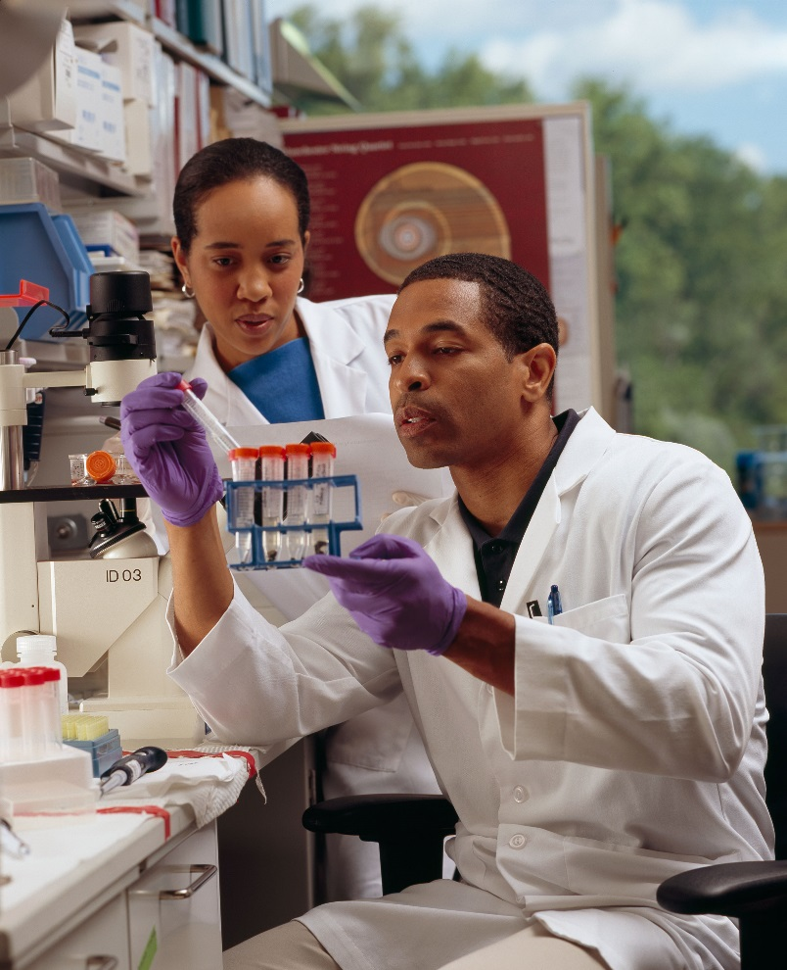
Your Life Now
Dependent on mentor
Directed research
Future uncertainty
Small stipend
Compelling preparation?
Notes:
The points on this slide are not meant to be ‘overly gloomy’ but to provide an overview of some tensions between life as a graduate student/post-doc and the career pathways you are preparing for.
Dependent on mentor—ie, he or she provides key projects and may or may not worry about developing your skills for the long term.
Is he or she keeping an eye not only on your skills but on ‘the market’ for what areas of research are developing or ‘hot’?
Lots of uncertainty, not all of it from your research but funding climate, university hiring, family/life decisions
Typically, depending on fields, you are working on a smaller salary and hoping for a larger one.
Are you prepared?

Slide 4
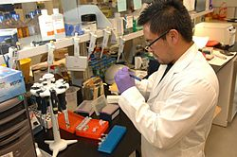
Goals for Future
Secure position
Living wage and more
Your own lab
Your own grad students
Your own research dollars

Slide 5
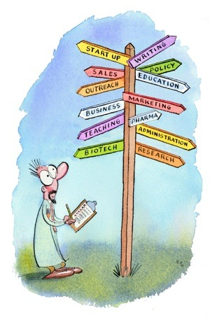
How do I get there?
What can you do on your own?
How can you work with your mentor to prepare?
What do I need to know about my field, funding agencies, my potential university?
Notes:
It’s easy to think that we will ‘wait’ to see what the ‘future holds’, but in fact, there are quite a few things you can pro-actively ‘do’ starting today.
So we’ll focus on things you can do on your own, things your mentor can work with you to do, and then some avenues for researching more information.

Slide 6
What can I do on my own?
Know what agencies support your work
Start reading FOA’s in your area
Keep your eyes on federal research areas and priorities
  https://www.nimh.nih.gov/research-priorities/index.shtml
  https://www.nsf.gov/pubs/2014/nsf14043/nsf14043.pdf
  https://www.nsf.gov/pubs/2016/nsf16034/nsf16034.pdf
  https://officeofbudget.od.nih.gov/pdfs/FY17/31-Overview.pdf
  DOE priorities
Notes:
Discuss basic agencies—NIH, NSF, DOE, USDA
NIH—life sciences, making life/public health improvements for americans.
NSF Basic research and educuational programs in STEM, including engineering, social sciences, economics, agriculture…
USDA—agriculture and environment
DOE-energy, biofuels, nuclear programs
Will talk more later about FOAs
Know the priorities and dollars by attending meetings and webinars, getting on listservs and networking…

Slide 7

What can I do on my own…
Ask about what is getting funded
Research what is getting funded
  http://dia2.org/
  https://projectreporter.nih.gov/reporter.cfm
Take advantage of resources here
Learn about grant writing
Network! Network! Network!
Notes:
Review URLs, ask the audience for idea on how to network…

Slide 8
How do I know where to look?
Ask your mentors where they get funded
Look to see who sponsors research you would like to do
Bookmark websites of key agencies
Don’t forget niche areas (Foundations.org)
See if there are opportunities you can work on now
Follow up on the work of scientists you admire

Slide 9
Key Questions about Your
Research Interests
Are there lots of opportunities in your specific area of interest?
How many different agencies fund this type of work?
Is it a ‘fad’ area or hot topic? (i.e., Zika?)
Are you flexible?
Does it lend itself to interdisciplinary work? Translational research? Clinical work?
Can it lead to patents and business development?
Is it theoretical or applied?
Do you like teaching about your science?

Slide 10
Where to Start
EVPRP resources: http://www.purdue.edu/research/funding-and-grant-writing/funding/overview.php
Pivot (Community of Science): http://pivot.cos.com/
Federal Register : http://www.gpoaccess.gov/fr/
Foundation Center: http://foundationcenter.org/
Grants.gov: http://www.grants.gov/
GrantsNet : http://www.sciencemag.org/careers/where-search-funding
Purdue weekly opportunities: http://www.purdue.edu/research/funding-and-grant-writing/funding/emails.php

Slide 11
How can my mentor help?
Express interest in learning about and/or developing grants
Look for potential opportunities
Ask about additional opportunities to expand skills and experiences

Slide 12
Develop a strong mentoring plan
National Postdoc Association http://www.nationalpostdoc.org/
myidp http://myidp.sciencecareers.org/
EVPRP resources:
https://www.purdue.edu/research/docs/pdf/tool_3_mentor.pdf

Slide 13
What is a mentoring plan?
From Faculty point of view: Outlines what a mentor pledges to do to develop the Post-doc (or graduate student) during their working relationship
From Student perspective: Helps explore possibilities and set goals
Draws on research and professional development
Discipline specific
Helps outline expectations for both mentor and mentee
Should be re-evaluated annually
Can include metrics, timelines, and milestones

Slide 14
What does a mentoring plan look like?
Both Purdue University and our research team realize the importance of guiding and developing the skills and fostering the professional development of postdoctoral researchers and we will implement the guidelines recommended by the National Postdoctoral Association. These include a detailed self-evaluation at the beginning of his/her tenure at Purdue that leads to the creation of an individualized development plan (IDP) based on the scholar’s own strengths and weaknesses. In consultation with Dr. XX, the postdoctoral scholar will be provided with opportunities to develop skills in research and professional activities. One-on-one mentoring will provide needed feedback. At the end of the scholar’s tenure, Dr. XX will provide written evaluation concerning the benchmarks and goals met during his/her time with the YY project(s). The IDP will include not only specific research and presentation, writing and development goals but also incorporate mentoring concerning career development which will include counseling on various career paths in academia, government and industrial research labs. To this end, the scholar will be introduced to a wide range of resident and visiting investigators to gain exposure to different career paths

Slide 15
What activities might it include?
Provide mentoring on research integrity, lab safety, and other responsible professional practices. He/She will also be asked to mentor junior or new lab members on these issues. Purdue provides coursework and seminars on this subject if needed;
Guide him/her in selecting relevant and key research problems through meetings, discussions, literature reviews so that he/she will have a good grasp of current important problems in the field;
Have scholar supervise the day-to-day work of 1-2 graduate students with feedback from Dr. XX about his/her mentoring effectiveness; scholar will also be given time for/encouraged to attend workshops at Purdue on the topic of mentoring;
Involve the candidate in the preparation of grant proposals and writing of technical papers and encourage him/her to attend workshops on these topics regularly offered by the Office of the Executive Vice President of Research and Partnerships and Purdue’s OWL writing program/consultation services;
Encourage the presentation of oral and poster presentations at conferences as well as at internal events, and provide feedback on presentation skills;
Provide opportunities to work and collaborate with researchers from diverse backgrounds and disciplinary areas (physics, engineering) and levels (from undergrads to fellow postdocs in other research areas).

Slide 16

Roles Researchers Play
Conduct research within larger grant projects (Senior Personnel)
PI on smaller individual grants
CAREER or young investigator awards
Consultants (pay to play)
Co-PI on interdisciplinary
research
Area leader
Leadership team of large grant
Center Director
Notes:
Developing your career as a researcher means developing a strategy for becoming a well-funded researcher AND a strong collaborator.
Be aware of the steep curve, low funding rates, and the importance of your ‘reputation’ as a collegial co-PI!
Return to DIA2, look up Gabriela weaver and look at 2001, 2004, 2016 (look at Qojeich and Bin Yu)

Slide 17

What should I know about grant writing now?

Slide 18
Why should I try to participate in grant writing now?
Good practice for future
High learning curve to do well
Relationship building
Starting small gets you on the road
Good for CV/professional development
Gives you ideas!

Slide 19
How long does grant-writing take?
Relationships with other researchers take (lots) of time
Consider that it often takes multiple tries to get funded
Standard grant—3+ months
Block out time for writing
Leave time for asking advice from program officers
Create a timeline
Leave time for feedback and revision!

Slide 20
5 Key Strategies for Approaching an Opportunity
Match you project/idea to the RFP
Address a demonstrated and significant problem
Write for the right audience
Demonstrate appropriate qualifications, resources and partnerships
Write with discipline and structure
Notes:
Make sure your problem, well, is really a problem. Better yet, one that has relevance to the explicit goals of the agency and of its specific call or RFP. It is thus important to get to know the concerns of, for example, the NIH or NSF, and to read up on what topics have been funded by the NEH and at what funding level. This is true even for internal grants. For example, what might your college prefer to fund—summer travel for you to finish your book, or development of a new format for composition for incoming students?
Once you know you have a good idea that fits, you should try to find out information about who will be reviewing it. Will it be a scientific panel of experts in your field of Old English linguistics or a broad panel of medievalists? Will it be a panel of researchers in life sciences, or sent out to expert reviewers in ecosystems and marine biology.
Make sure these reviewers know that you have enough experience to do the work and meet with success; in some grants, for example, many education funding opps, will be looking that you already have the right connections with the right partners whether they be schools, non-profits, or businesses. Such relationships take time to build.
Last, as we will discuss throughout this presentation, writing with a firm outline in mind will reward your efforts to present an organized and convincing case for being funded.

Slide 21
Resources here at Purdue
Check us out:
http://www.purdue.edu/research/
http://www.purdue.edu/research/funding-and-grant-writing/docs/EVPRP2016Guide2GrantsProcess.pdf

Slide 22
Questions?
Looking ahead: 2016 NSF STC Professional Development Workshop
August 7-August 12
Indianapolis, IN
https://www.soihub.org/stcworkshop/

