Slide 1
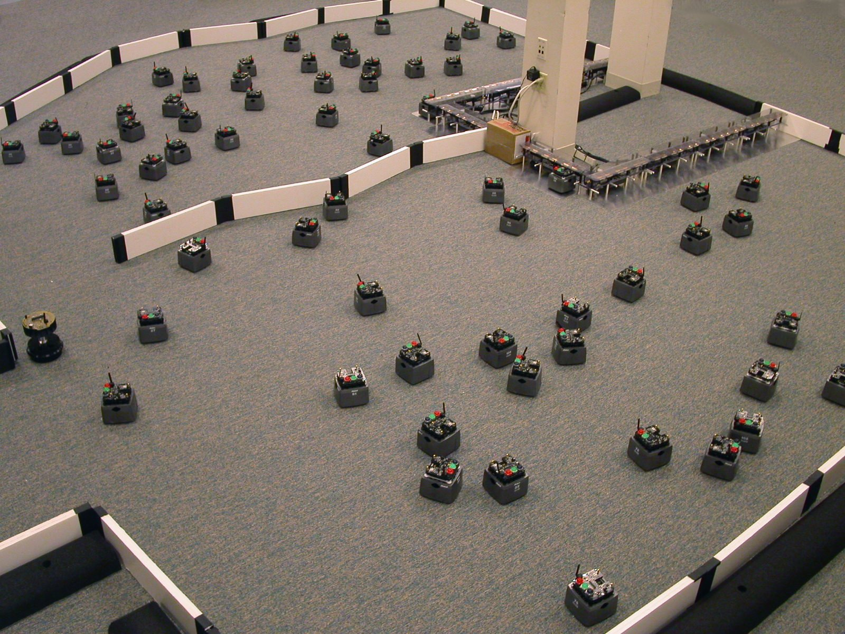
Distributed Computation in MANets
Robot swarm developed by James McLurkin @ Rice University

Slide 2
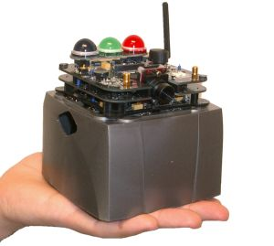
The Setting
Wireless ad-hoc network
Small nodes with sensors, actuators
Chief concerns:
Energy efficiency!
Low computation power
Communication is expensive
Fault tolerance

Slide 3
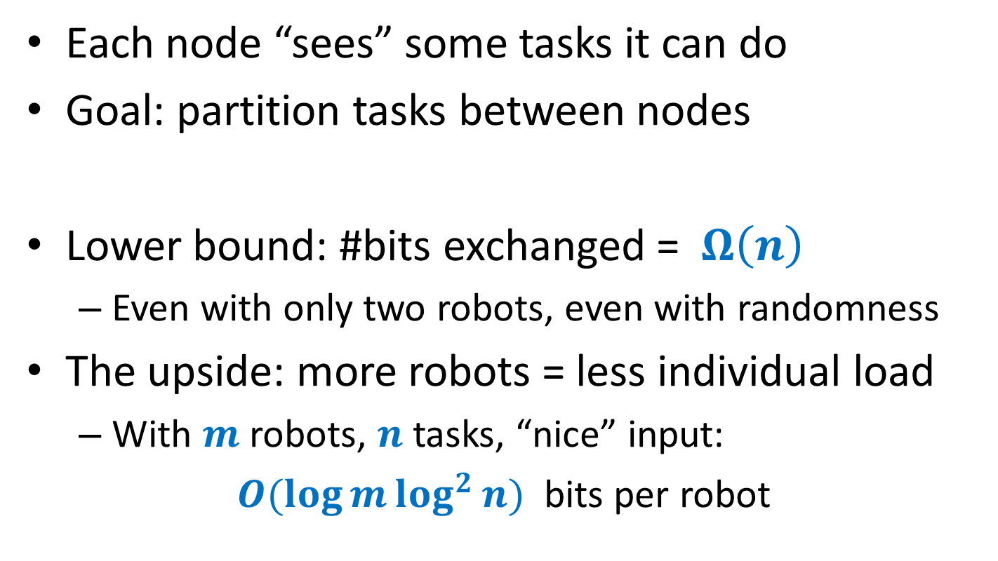
Example: Task Allocation
Each node “sees” some tasks it can do
Goal: partition tasks between nodes
Lower bound: #bits exchanged = $Ω\left(n\right)$
Even with only two robots, even with randomness
The upside: more robots = less individual load
With $m$ robots, $n$ tasks, “nice” input:
$O(\log{m}\log^{2}{n})$ bits per robot

Slide 4
Main Challenges
Understand the interplay between
Computation power
Time required to finish
Communication cost
Tools:
Randomized algorithms
Optimization theory
Communication complexity

