Slide 1
On the interaction between network coding and the physical layer - information theoretic results and a case study
Muriel Médard.

Slide 2
Collaborators
MIT: Georgios Angelopoulos, Anantha Chandrakasan, Flavio du Pin Calmon, Nadia Fawaz (now Technicolor), Bernhard Haeupler (now Microsoft/ CMU), David Karger, Minji Kim (now Oracle), Ben Leong, Arun Paidimarri, Ali ParandehGheibi, Siddharth Ray (now Samsung),
MIT Lincoln Laboratory: Linda Zeger (now Aurora LLC)
Aalto University: Mikko Vehkapera
Caltech: Amir Dana, Michelle Effros, Radhika Gowaikar, Babak Hassibi, Tracey Ho
Chalmers University: Tor Aulin
Harvard: Michael Mitzenmacher
KTH: Jinfeng Du (now MIT), Mikael Skoglund, Ming Xiao
Northeastern: Edmund Yeh
TUM: Ralf Kötter, Mohit Thakur
UCLA: Jun Shi (now Intel)
Stanford: Andrea Goldsmith, Ivana Maric (now Ericsson)
Yale: Yun Xu.

Slide 3
Interaction Among Codes
Coding occurs currently at different layers in the network
Traditionally, it takes place at the physical layer, in point-to-point or small subnetworks
Increasingly, it takes place over the network, either as end-to-end erasure codes, or as network codes, that can or are composed inside the network
There are many results on separation and lack thereof
We consider some of the consequences of equivalence and provide some engineering directions

Slide 4
Overview
Equivalent subnetworks:
  The point-to-point link
  The multiple access channel (MAC)
  Bounding networks
Engineering context:
  High SNR: interference limited
    Concentrate on multiple access
    Approximations
  Low SNR: noise limited
    Remove noise rather than process it
    Converse for relay network
  Coding for erasures
Engineering consequences:
  Low-power chip with physical and packet-level coding

Slide 5
Point-to-Point Equivalence
A network composed by discrete memoryless point-to-point links is equivalent to a network where each link is substituted by a noiseless bit pipe with throughput equal to its capacity. First in multicast, then in general.
Separation of network coding and physical layer coding
How does this extend to networks composed of multi-terminal channels?
Song, Yeung, Cai, “A separation theorem for single-source network coding,”IEEE Trans. Info. Theory, vol. 52, no. 5, 2006
  Kötter, Effros, M., “On a theory of network equivalence”, ITW, June 2009
  Kötter, Effros, M., “On a Theory of Network Equivalence”, IEEE Trans. Info. Theory, vol. 57, no. 2, 2011.

Slide 6
Extending to Multi-terminal Channels
Key idea: create bounding models by equivalent subnetworks.
L.B.
Achievable region changes if transmitting and/or receiving nodes are allowed to cooperate
Feedback can increase capacity.
U.B.
  Kötter, Effros, M., “A Theory of Network Equivalence -- Part II: Multiterminal Channels”, accepted to, IEEE Trans. Info. Theory
  Dana, Gowaikar, Hassibi, Effros, M., “Should we Break a Wireless Network into Subnetworks?” Allerton 2003.
Notes:
Why bit pipe

Slide 7
Example: Two User Gaussian MAC
Similar one for broadcast with independent noise
BSC similar
Other equivalent subnetworks possible
du Pin Calmon, M., Effros, “Equivalent Models for Multi-terminal Channels”, ITW 2011
Cover, Leung, “An achievable rate region for the multiple access
channel with feedback,” IEEE Trans. Inf. Theory, vol. 27, no. 3, 1981.

Slide 8
Overview
Equivalent subnetworks:
  The point-to-point link
  The multiple access channel (MAC)
  Bounding networks
Engineering context:
  High SNR: interference limited
    Concentrate on multiple access
    Approximations
  Low SNR: noise limited
    Remove noise rather than process it
    Converse for relay network
  Coding for erasures
Engineering consequences:
  Low-power chip with physical and packet-level coding

Slide 9
Local High SNR Approximation
Physically degraded broadcast
  Time-sharing in superposition coding
  Hyperedge for common rate
  Edge for private rate
Multiple access
  Cover-Wyner region almost rectangular plus triangle
  Rectangle corresponds to separate edges
  Triangle corresponds to time-shared edge
  (or noiseless finite field MAC)
Effros,, M., Ho, Ray, Karger, Koetter, Hassibi, “Linear Network Codes: A Unified Framework for Source, Channel, and Network Coding,” Advances in Network Information Theory, DIMACS Series in Discrete Mathematics and Theoretical Computer Science, Vol. 66, Ed: Gupta et al., 2004

Slide 10
SNR in the Network
High SNR in a link
  Small noise
  Large gain
  Large transmit power
When gains grow with fixed ratio of their logarithms, local high-SNR MAC decomposition holds approximately for multicast connections:
  Edges and hyperedges are approximately sufficient
  Holds for arbitrary connections, not just multicast
When transmit power grows, amplify and forward at intermediate nodes provides asymptotically multicast capacity – entire network becomes a single MAC, possibly with ISI
Avestimehr, Diggavi, Tse, “A deterministic approach to wireless relay networks,” in Allerton 2007
Avestimehr, Diggavi, Tse, “Wireless network information flow,” Allerton 2007
Avestimehr, Diggavi, Tse, “Wireless network information flow: a deterministic approach,” IEEE Trans. Info. Theory, vol. 57, no. 4, April 2011
Kim, M., “Algebraic Network Coding Approach to Deterministic Wireless Relay Network”, Allerton 2010
  Maric, Goldsmith, M., “Analog Network Coding in the High SNR Regime”, ITA 2010
  Maric, Goldsmith, M., “Analog Network Coding in the High-SNR Regime”, IEEE Wireless Network Coding Workshop 2010
  Maric, Goldsmith, M., “Multihop Analog Network Coding via Amplify-and-Forward: The High SNR Regime”, IEEE Trans. Info. Theory, vol. 58, no. 2, 2012
Xu, Yeh, M. “Approaching Gaussian Relay Network Capacity in the High SNR Regime: End-to-End Lattice Codes”, accepted to WCNC 2014.

Slide 11
Overview
Equivalent subnetworks:
  The point-to-point link
  The multiple access channel (MAC)
  Bounding networks
Engineering context:
  High SNR: interference limited
    Concentrate on multiple access
    Approximations
  Low SNR: noise limited
    Remove noise rather than process it
    Converse for relay network
  Coding for erasures
Engineering consequences:
  Low-power chip with physical and packet-level coding

Slide 12
Beyond Approximations: Low-SNR
Physically degraded broadcast
  No interference in superposition coding
  Hyperedge for common rate
  Edge for private rate
Multiple access
  Both sources achieve almost same rate as in the absence of the other user
  Cover-Wyner MAC region almost rectangular
Point-to-point link to edge equivalence remains

Slide 13
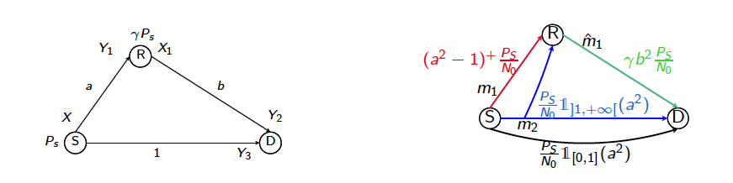
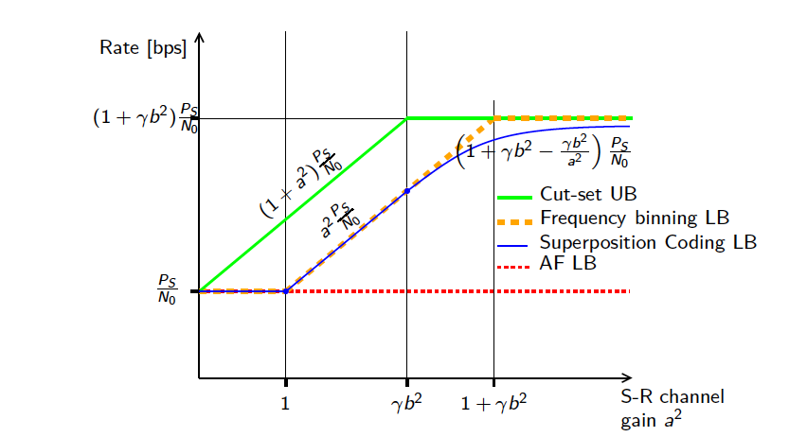
Low SNR
An ∞ capacity on the relay-destination link would be sufficient to achieve the SIMO cut
Kramer, Gastpar,. Gupta, “Cooperative strategies and capacity theorems for relay networks,” IEEE Trans. Inform. Theory vol. 51, no. 9, Sept. 2005.
Kramer, Maric, Yates, “Cooperative communications,” Foundations and Trends in Networking, NOW,, 2006, vol. 1
El Gamal, Mohseni, Zahedi, “Bounds on capacity and minimum energy-per-bit for AWGN relay channels,” IEEE Trans. Inform. Theory, vol.52, no.4, Apr. 2006
Cover, El Gamal, “Capacity theorems for the relay
channel,” IEEE Trans. Inform. Theory, vol.25, no.5, Sept.1979
El Gamal, Kim, Network Information Theory
Fawaz, M., “On the Non-Coherent Wideband Multipath Fading Relay Channel”, ISIT 2010.

Slide 14
Low SNR
Equivalence theory allows us to consider, for a degraded Gaussian broadcast channel
  Hyperedges emanating from the source
  An edge emanating from the relay
Using equivalence on the hyperedges from the source, we can assume a Gaussian input
Convexity of the rate-distortion region implies any estimate short of decoding is highly noisy
Converse
Capacity
Fawaz, M., “A Converse for the Wideband Relay Channel with Physically Degraded Broadcast”, ITW 2011.

Slide 15
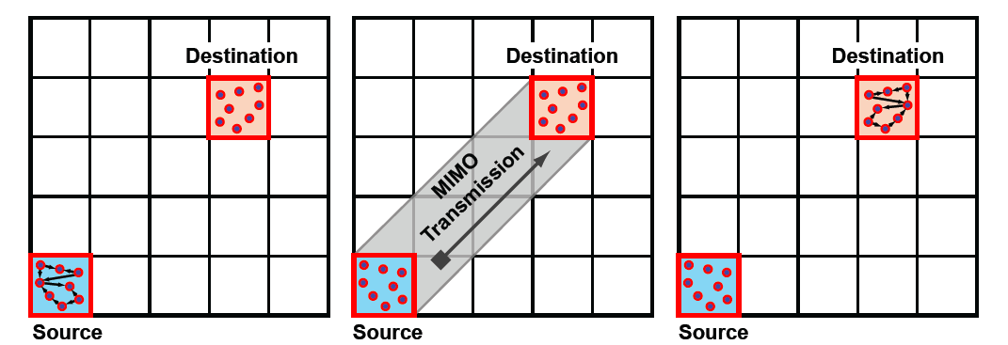
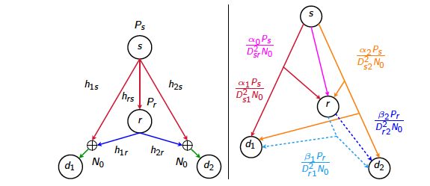
Implications
In scaling over extended networks, MIMO bound is fragile when using fixed quantization for cooperation, as SNR decreases with distance
Achievable hypergraph model for approximating richer topologies
  Allows geometric programming
  Physical layer coding is abstracted into hyperedges, network coding over the hypergraph
Stage 2
Stage 3
Stage 1
Should we have a physical layer that provides hyperedges without erasures?
Thakur, M., “On Optimizing Low SNR Wireless Networks Using Network Coding”, IEEE Globecom 2010
Thakur, Fawaz, M., “Optimal Relay Location and Power Allocation for Low SNR Broadcast Relay Channels”, INFOCOM 2011 Thakur, Fawaz, M., “On the Geometry of Wireless Network Multicast in 2-D”, ISIT 2011
Thakur, Fawaz, M., “Reducibility of Joint Relay Positioning and Flow Optimization Problem”, ISIT 2012.
Courtade, Wesel, “Optimal allocation of redundancy between packet-level erasure coding and physical-layer channel coding in fading channels," IEEE Trans. on Comms, vol. 59, no. 8, 2011
Berger, Zhou, Wen, Willett, Pattipati, “Optimizing joint erasure- and error-correction coding for wireless packet transmissions,” IEEE Trans. on Wireless Comms, vol. 7, no. 11, 2008
Vehkaperä, M., “A throughput-delay trade-off in packetized systems with erasures,” ISIT 2005
Xiao, M., Aulin, “Cross-ayler design of rateless random codes for delay pptimization”, IEEE Trans. on Comms, vol. 59, no. 12, 2011.

Slide 16
Erasures
Erasures may occur at links because of outages, suboptimal MAC with collisions, queuing losses in transport
Coding can be done at physical layer up to the level of yielding erasures
Equivalent subgraphs are compatible
If the connections are multicast, then random linear network coding (RLNC) will suffice to achieve capacity
Same code for both network coding and erasure coding
Results hold under adversarial conditions, with no need for increasing memory at nodes
Ho, M., Koetter, Karger, Effros, Shi, Leong, “A Random Linear Network Coding Approach to Multicast," IEEE Trans. Info. Theory, vol. 52, no. 10, 2006
  Lun, M., Koetter, Effros, “On Coding for Reliable Communication over Packet Networks”, Physical Communication, Vol. 1, No. 1, 2008
Dana, Gowaikar, Palanki, Hassibi, Effros, “Capacity of wireless erasure networks,” IEEE Trans. Info. Theory, vol. 52, no. 3, 2006
Haeupler, “Analyzing Network Coding Gossip Made Easy”, STOC 2011
Haeupler, Kuhn, “Lower Bounds on Information Dissemination in Dynamic Networks”, PODC 2012
Haeupler, M., “One Packet Suffices - Highly Efficient Packetized Network Coding With Finite Memory”, ISIT 2011
Haeupler, Kim, M. “Optimality of Network Coding with Buffers”, ITW 2011.

Slide 17
Overview
Equivalent subnetworks:
  The point-to-point link
  The multiple access channel (MAC)
  Bounding networks
Engineering context:
  High SNR: interference limited
    Concentrate on multiple access
    Approximations
  Low SNR: noise limited
    Remove noise rather than process it
    Converse for relay network
  Coding for erasures
Engineering consequences:
  Low-power chip with physical and packet-level coding

Slide 18
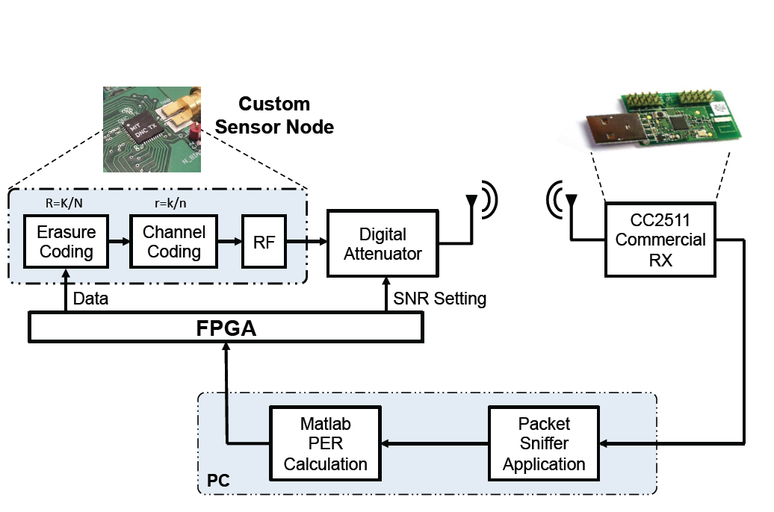
Coding at Different Layers
Matlab program on a PC through an FPGA.
Generic commercial
transceiver (Texas Instruments )
Transmission data rate of 500 kbps
FSK Modulation
Data transmission and coherent demodulation at receiver
Hard Viterbi decoding
and an interleaver of 4 bytes
PC-based packet sniffer software
transfers the data from the CC2511 over a USB interface
CC2511 chip provides the Received Signal Strength
Indicator (RSSI)
Angelopoulos, Paidimarri, Chandrakasan, M., “Experimental Study of the Interplay of Channel and Network Coding in Low Power Sensor Applications”, ICC 2013

Slide 19
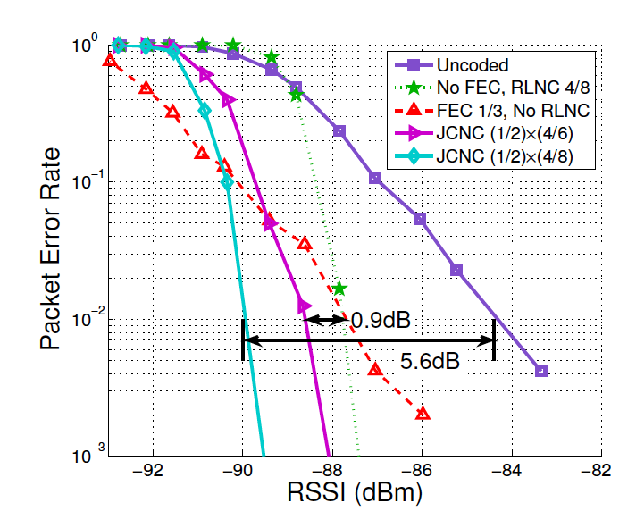
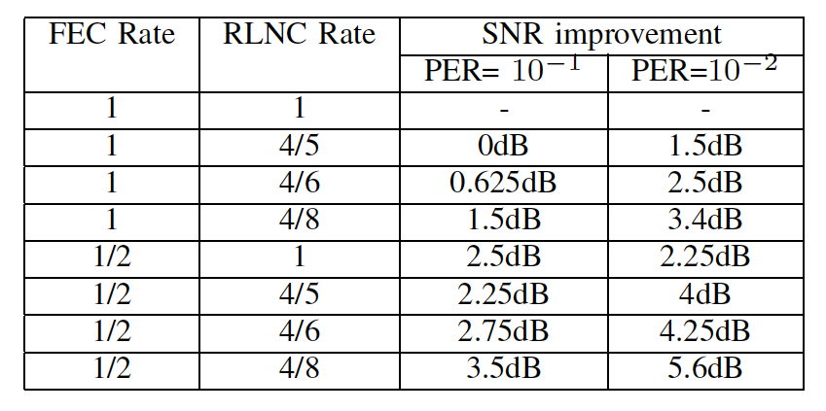
Benefits of Coding

Slide 20
Conclusions
Bounding with edges and hyperedges allows us to separate noise from combinatorial graph-theoretic issues
Instead of bounding the entire network, create equivalent subnetworks for different elements
General approach for approximations, provides operational guidance
New toolbox for converses
Suggests a reduction to erasure channels, to capture simplicity of hyperedges and the richness of network operation
Codes can be used to manage erasures and bottlenecks simultaneously.
Effros, “On capacity outer bounds for a simple family of wireless networks,” Proc. Inf. Theory & App. Workshop, 2010.
Effros, “Capacity bounds for networks of broadcast channels,” ISIT, 2010.
  Du, M., Xiao, Skoglund,, “Lower Bounding Models for Wireless Networks”, ISIT 2013
  Du, Xiao, Skoglund, M., “Wireless Multicast Relay Networks with Limited-Rate Source-Conferencing”, IEEE JSAC, Vol. 31, No. 8, August 2013
Du, M., Xiao, Skoglund, “Scalable capacity bounding models for wireless networks,” arXiv:1401.4189, Jan. 2014.

Slide 21
What About Other Regimes?
The use of hyperedges is important to take into account dependencies
In general, it is difficult to determine how to proceed (see the difficulties with the relay channel)
Equivalence leads to certain bounds for multiple access and broadcast channels, but these bounds may be loose
Separates the issue of physical layer coding from that of network coding
  The new network should be composed by bit pipes. This allows the abstraction of the stochastic nature of the network.
  Instead of bounding the entire network, create bounding components for different elements (e.g. channels)

Slide 22
Conclusions
Physical layer and network coding may be readcases to be limited:
  For point-to-point channels, there is none in capacity
  Low SNR:
    Discard noise rather than propagate it
    Practical implication: simple hypergraph model approximation
  High SNR:
    Interference dominates
    When gain increases, local MAC model is a good approximation
    When transmit power increases, entire network becomes MAC
  In general:
    A growing toolbox based on creating bounds with edges and hyperedges, guided by engineering insight
An example:
  Low power sensor nodes:
    Both PHY and network coding are beneficial
    Coordination between the two may not be necessary
Suggests an approach that is mostly based on separation – empirical study shows promising results
Questions:
  How does it interact with delay?
  Not clear how to combine with queing
Notes:
Nevertheless, these bounds are tight in the sense that there exists network scenarios where there indeed is and equivalence with this model.

Slide 23
References
  G. Angelopoulos, Paidimarri, A., Chandrakasan, A. P., and Médard, M., “Experimental Study of the Interplay of Channel and Network Coding in Low Power Sensor Applications”, ICC WCS 2013
F. du Pin Calmon, Médard, M., and Effros, M., “Equivalent Models for Multi-terminal Channels”, Information Theory Workshop, 2011
N. Fawaz and Médard, M., “On the Non-Coherent Wideband Multipath Fading Relay Channel”, ISIT 2010
N. Fawaz, and Médard, M., “A Converse for the Wideband Relay Channel with Physically Degraded Broadcast”, Information Theory Workshop 2011
  M. Kim and Médard, M., “Algebraic Network Coding Approach to Deterministic Wireless Relay Network”, Allerton Conference, October 2010
  R. Koetter, Effros, M. and Médard, M., “On a theory of network equivalence”, Information Theory Workshop, June 2009
  R. Kötter, Effros, M., Médard, M., “On a Theory of Network Equivalence”, IEEE Transactions on Information Theory, vol. 57, no. 2, February 2011, pp. 972-995
  R. Kötter, Effros,. M., and Médard, M., “A Theory of Network Equivalence -- Part II: Multiterminal Channels”, accepted to IEEE Transactions on Information Theory

Slide 24
References
  R. Koetter and Médard, M., “Beyond Routing: An Algebraic Approach to Network Coding,” Annual Joint Conference of the IEEE Computer and Communications Societies (INFOCOM), Volume 1, pp. 122-130, July 2002
  R. Koetter and Médard, M., “An algebraic approach to network coding and robust networks,” IEEE International Symposium on Information Theory (ISIT), pg. 104, June 2001
  R. Koetter and Médard, M., “Beyond Routing: An Algebraic Approach to Network Coding,” IEEE/ACM Transactions on Networking, Vol. 11, Issue 5, pp. 782-796, October 2003.
  D. S. Lun, Médard, M., Koetter, R., Effros, M., “On Coding for Reliable Communication over Packet Networks”, Physical Communication, Volume 1, Issue 1, March 2008, pp. 3-20
  I. Maric, Goldsmith. A., and Médard, M., “Analog Network Coding in the High SNR Regime”, ITA Workshop, January 2010
  I. Maric, Goldsmith, A., and Médard, M., “Multihop Analog Network Coding via Amplify-and-Forward: The High SNR Regime”, IEEE Transactions on Information Theory, vol. 58, no. 2, February 2012, pp. 793 – 803
A. ParandehGheibi, Sundararajan J.-K. and Médard, M., “Collision Helps - Algebraic Collision Recovery for Wireless Erasure Networks”, IEEE Wireless Network Coding Workshop 2010

Slide 25
References
S. Teerapittayanon, Fouli, K., Médard, M., Montpetit, M.-J., Shi, X., Seskar, I., and Gosain, A., “Network Coding as a WiMAX Link Reliability Mechanism”, MACOM 2012**
S. Teerapittayanon, Fouli, K., Médard, M., Montpetit, M.-J., Shi, X., Seskar, I., and Gosain, A., “Network Coding as a WiMAX Link Reliability Mechanism: An Experimental Demonstration”, MACOM 2012
M. Thakur, Fawaz, N., and Médard, M., “Optimal Relay Location and Power Allocation for Low SNR Broadcast Relay Channels”, INFOCOM 2011
M. Thakur, Fawaz, N., and Médard, M., “Reducibility of Joint Relay Positioning and Flow Optimization Problem”, ISIT 2012
M. Thakur, N. Fawaz, and Médard, M., “On the Geometry of Wireless Network Multicast in 2-D”, ISIT 2011
M. Thakur and Médard, M., “On Optimizing Low SNR Wireless Networks Using Network Coding”, IEEE Globecom 2010 - Communication Theory Symposium
Y. Xu, E. Yeh, M. , Médard, “Approaching Gaussian Relay Network Capacity in the High SNR Regime: End-to-End Lattice Codes”, Arxiv 2013
L. Zeger and M. Médard,“On Scalability of Wireless Networks: A Practical Primer for Large Scale Cooperation”, Arxiv 2013

Slide 26
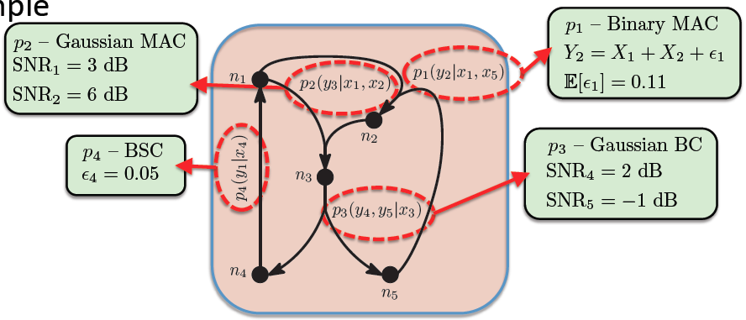
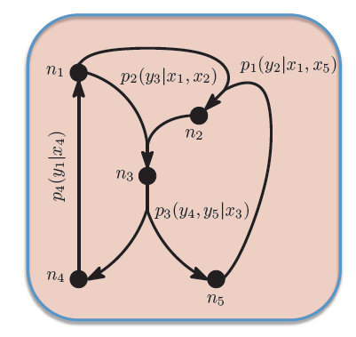
Example

Slide 27
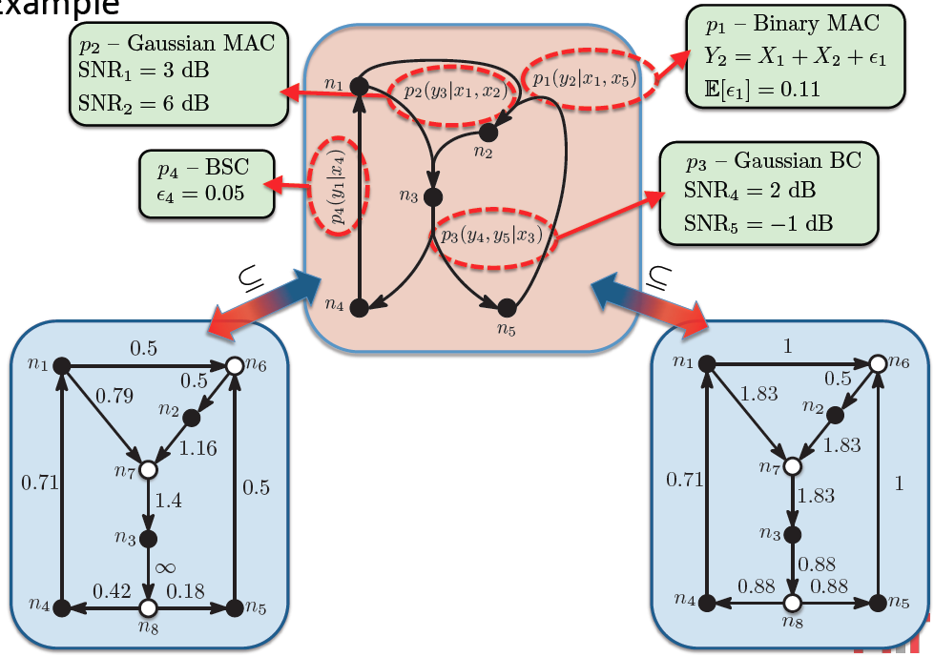
Example

Slide 28
Multihop Wireless Network
Recoding at intermediate nodes, without decoding
FTP
sender
FTP
receiver
1
2
3
4
From given data

Slide 29
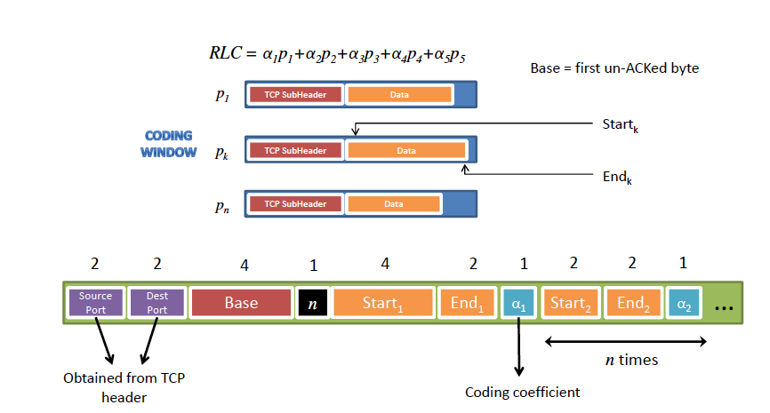
Coding Coefficients Carried within Packet
Sundararajan, Shah, M., Jakubczak, Mitzenmacher, Barros,
“Network Coding Meets TCP: Theory and Implementation”, Proceedings of the IEEE Vol. 99, No. 3, 2011

Slide 30
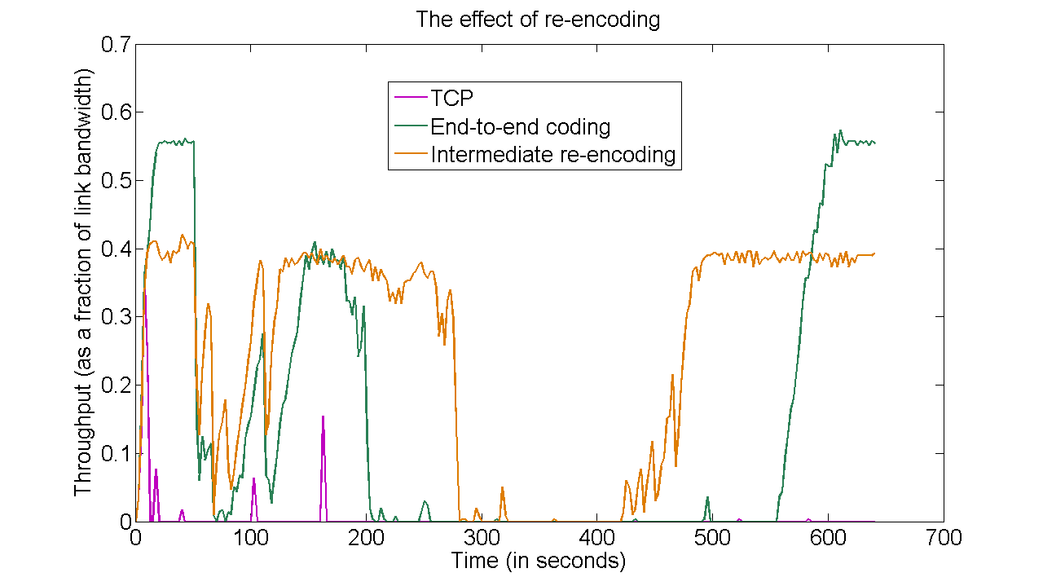
Performance Comparison
TCP | End-to-end coding | Re-encoding at node 3 only
0.0042 Mbps | 0.1420 Mbps | 0.2448 Mbps
Time average throughput (over 641 seconds)
(assuming each link has a bandwidth of 1 Mbps in the absence of erasures)

Slide 31
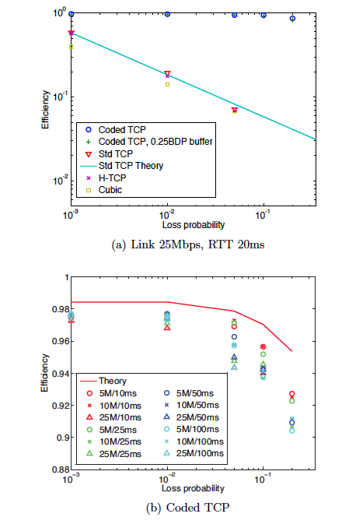
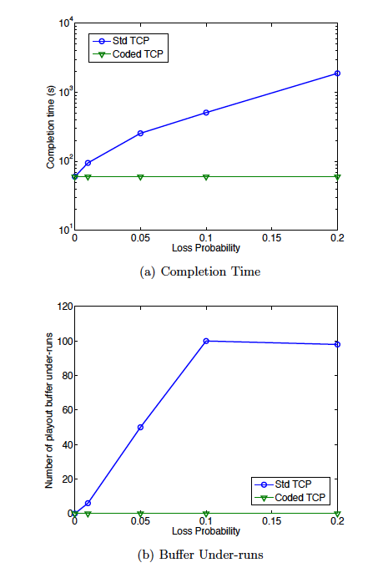
Testbed Measurements
60 s video
Full download
60 s video
Progressive download
Kim, Cloud, ParandehGheibi, Urbina, Fouli, Leith, M. “Network Coded TCP (CTCP) “ arXiv: 1212.2291v2
Kim, Cloud, ParandehGheibi, Urbina, Fouli, Leith, M. “Congestion Control for Coded Transport Layers”, ICC 2014.

Slide 32
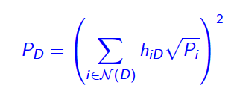
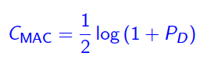
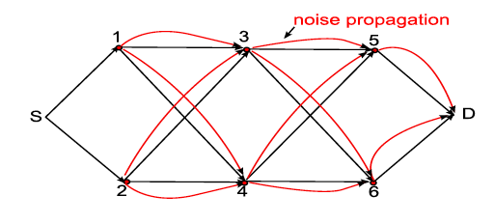
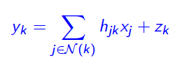
Model
Denote power at destination
MAC cut-set

Slide 33
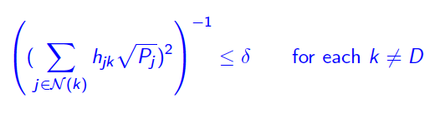
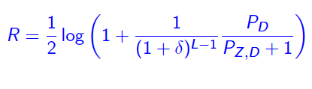



A different view of high SNR
In a layered relay network under high-SNR conditions:
Analog network coding achieves
At high SNR ANC achieves capacity:
Accumulated noise at destination

Slide 36
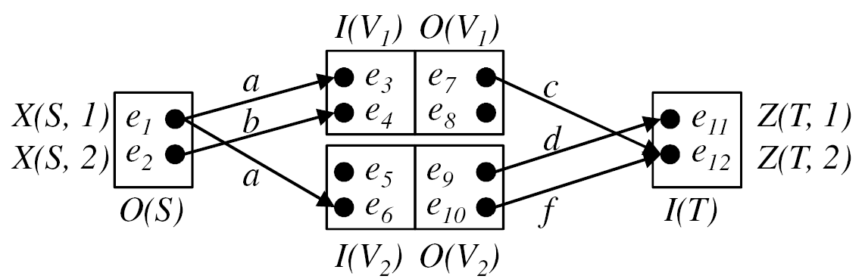
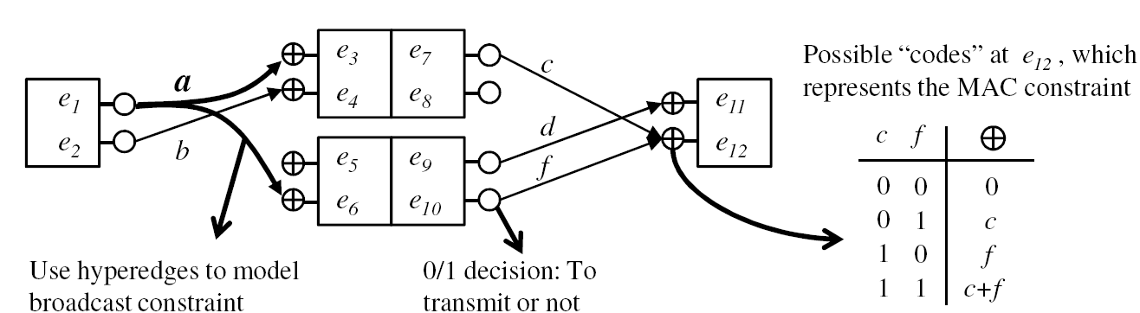
ADT Network Model
Original ADT model [Avestimehr et al. ’07]:
  Broadcast: multiple edges (bit pipes) from the same node
  Interference: additive MAC over binary field
Higher SNR: S-V₁
Higher SNR: S-V₂
Algebraic model:
interference
broadcast

Slide 37
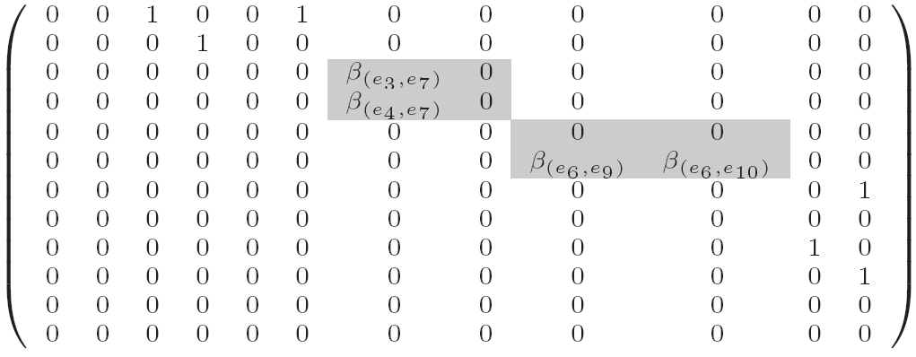
System Matrix
e₃
e₇
c
a
Linear operations
  Coding at the nodes V: β(e_{j}, e_{j’})
    F represents physical structure of the ADT network
    F^{k}: non-zero entry = path of length k between nodes exists
    (I-F)⁻¹ = I + F + F² + F³ + … : connectivity of the network (impulse response of the network)
e₁
e₄
e₈
e₁₁
e₂
b
d
e₁₂
e₅
e₉
f
e₆
e₁₀
Broadcast constraint
(hyperedge)
F =
MAC constraint
(addition)
Internal operations
(network code)

Slide 38
Algebraic Connection
  [Avestimehr et al. ’07] requires optimization over a large set of matrices
[Kim and M. ‘10] ADT network can be expressed with Algebraic Network Coding Formulation [Koetter and M. ’01, ‘02, ’03]:
  Model broadcast constraint with hyper-edge
  Rank of single system matrix M maps to physical min-cut of hypergraph
Prove an algebraic definition of min-cut = rank(M)
    Prove Min-cut Max-flow for unicast/multicast holds
    Extend optimality of linear operations to non-multicast sessions
Show that random linear network coding achieves capacity
Incorporate failures, random erasures [Lun et al ‘08, Dana et al ‘05] and delay (allows cycles within the network) [Koetter and M. ‘02, ’03]

Slide 39
SNR in Networks
High SNR in a link
  Noise → 0
  Large gain
  Large transmit power
Consider diamond network [Schein, Gallager’ 01]
Gain:
  increase a [Avestimehr et al ’07]
Large transmit power
  Amplify-and-forward in the network, ignorant of topology
  Asymptotically optimal

Slide 40
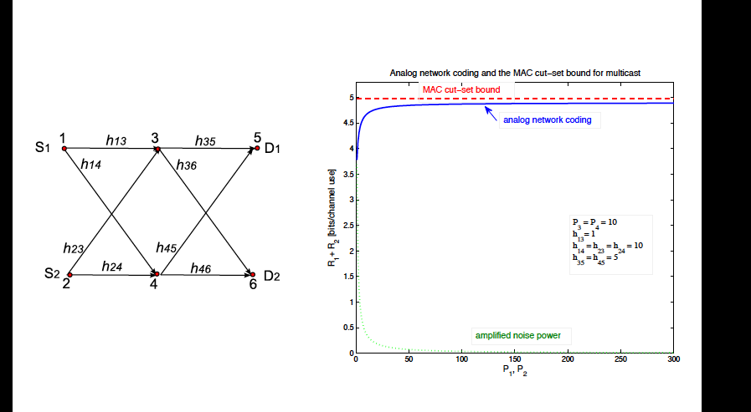
Analog Network Coding Optimal at High SNR
[Maric, Goldsmith, M. ‘10, ‘12]

Slide 41
Low SNR
Equivalence theory allows us to consider, for a degraded broadcast channel
  Hyperedges emanating from the source
  An edge emanating from the relay
Using equivalence on the hyperedges from the source, we can assume a Gaussian input
Convexity of the rate-distortion region implies any estimate short of decoding is highly noisy
In the limit of a large bandwidth, if the relay cannot decode, any given quantization level is insufficient to transmit a noisy version of the data
SIMO bound is loose in low SNR
Problem for virtual MIMO at low SNR
At low SNR, network becomes equivalent to a set of edges and hyperedges
An ∞ capacity on the relay-destination link would be sufficient to achieve the SIMO cut
Capacity
Kramer, Gastpar,. Gupta, “Cooperative strategies and capacity theorems for relay networks,” IEEE Trans. Inform. Theory vol. 51, no. 9, Sept. 2005.
Kramer, Maric, Yates, “Cooperative communications,” Foundations and Trends in Networking, NOW,, 2006, vol. 1
El Gamal, Mohseni, Zahedi, “Bounds on capacity and minimum energy-per-bit for AWGN relay channels,” IEEE Trans. Inform. Theory, vol.52, no.4, Apr. 2006
Cover, El Gamal, “Capacity theorems for the relay
channel,” IEEE Trans. Inform. Theory, vol.25, no.5, Sept.1979
El Gamal, Kim, Network Information Theory
Fawaz, M., “A Converse for the Wideband Relay Channel with Physically Degraded Broadcast”, ITW 2011
Fawaz, M., “On the Non-Coherent Wideband Multipath Fading Relay Channel”, ISIT 2010
Zeger, M. “On Scalability of Wireless Networks: A Practical Primer for Large Scale Cooperation”, Arxiv, 2014

Slide 42
Low SNR
Equivalence theory allows us to consider, for a degraded broadcast channel
  Hyperedges emanating from the source
  An edge emanating from the relay
Using equivalence on the hyperedges from the source, we can assume a Gaussian input
Convexity of the rate-distortion region implies any estimate short of decoding is highly noisy
In the limit of a large bandwidth, if the relay cannot decode, any given quantization level is insufficient to transmit a noisy version of the data
SIMO bound is loose in low SNR
Problem for virtual MIMO at low SNR
At low SNR, network becomes equivalent to a set of edges and hyperedges
An ∞ capacity on the relay-destination link would be sufficient to achieve the SIMO cut
Capacity
Kramer, Gastpar,. Gupta, “Cooperative strategies and capacity theorems for relay networks,” IEEE Trans. Inform. Theory vol. 51, no. 9, Sept. 2005.
Kramer, Maric, Yates, “Cooperative communications,” Foundations and Trends in Networking, NOW,, 2006, vol. 1
El Gamal, Mohseni, Zahedi, “Bounds on capacity and minimum energy-per-bit for AWGN relay channels,” IEEE Trans. Inform. Theory, vol.52, no.4, Apr. 2006
Cover, El Gamal, “Capacity theorems for the relay
channel,” IEEE Trans. Inform. Theory, vol.25, no.5, Sept.1979
El Gamal, Kim, Network Information Theory
Fawaz, M., “A Converse for the Wideband Relay Channel with Physically Degraded Broadcast”, ITW 2011
Fawaz, M., “On the Non-Coherent Wideband Multipath Fading Relay Channel”, ISIT 2010
Zeger, M. “On Scalability of Wireless Networks: A Practical Primer for Large Scale Cooperation”, Arxiv, 2014

