Slide 1
Infinite Randomness Expansion with a Constant Number of Devices
Matthew Coudron, Henry Yuen
MIT EECS
arXiv 1310.6755

Slide 2
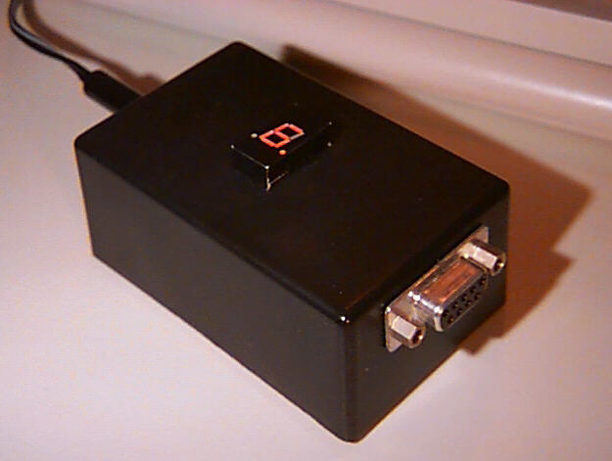
Goal: Testing RNG’s …

Slide 3
Goal: Testing RNG’s …
… in a “black box” manner

Slide 4
Goal: Testing RNG’s …
… in a “black box” manner
“Stealthy Dopant-Level Hardware Trojans”
  [Becker, Regazzoni, Paar, Burleson 2013]

Slide 5
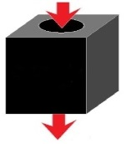
With interactive proofs …
S1 = Input 1
S2 = Input 2
Test = T(S, O)
O1 = Output 1
O2 = Output 2
… we still can’t test that (classical) provers are producing randomness.
Problem: All prover strategies are contained in the convex hull of deterministic strategies (linearity of expectation).

Slide 6
The CHSH game
(Bell’s Theorem - 1964)

Slide 7
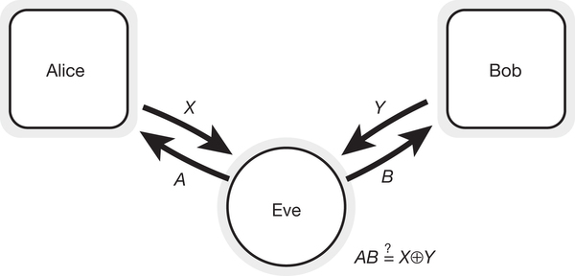


The CHSH game
(Bell’s Theorem - 1964)
$$ω_{C}=0.75$$

Slide 8
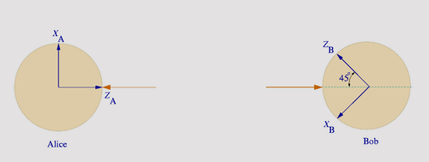


The CHSH game
(Bell’s Theorem - 1964)
$$ω_{C}=0.75$$
${ω_{Q}=cos\left(\frac{π}{8}\right)}^{2}≈0.85355$

Slide 9
Randomness Expansion
Roger Colbeck – PhD Thesis, 2006

Slide 10
Randomness Expansion
S = Input Seed
Roger Colbeck – PhD Thesis, 2006
A
B

Slide 11
Randomness Expansion
S = Input Seed
a = 1
b = 1
Roger Colbeck – PhD Thesis, 2006
A
B

Slide 12
Randomness Expansion
S = Input Seed
a = 1
b = 1
Roger Colbeck – PhD Thesis, 2006
Serial rounds
“Query and Response”
A
B
x
0
a
1
b
1
y
0

Slide 13
Randomness Expansion
S = Input Seed
a = 0
b = 0
Roger Colbeck – PhD Thesis, 2006
Serial rounds
“Query and Response”
A
B
x
1
0
a
0
1
b
0
1
y
0
0

Slide 14
Randomness Expansion
S = Input Seed
a = 0
b = 0
Roger Colbeck – PhD Thesis, 2006
Serial rounds
“Query and Response”
A
B
x
0
1
0
a
0
0
1
b
0
0
1
y
1
0
0

Slide 15
Randomness Expansion
S = Input Seed
a = 1
b = 1
Roger Colbeck – PhD Thesis, 2006
Serial rounds
“Query and Response”
A
B
x
1
0
1
0
a
1
0
0
1
b
1
0
0
1
y
1
1
0
0

Slide 16
Randomness Expansion
S = Input Seed
a = 1
b = 0
Roger Colbeck – PhD Thesis, 2006
Serial rounds
“Query and Response”
A
B
x
0
1
1
0
1
0
1
0
a
1
0
0
1
1
0
0
1
b
0
1
1
0
1
0
0
1
y
0
0
1
0
1
1
0
0
O = Output

Slide 17
Randomness Expansion
S = Input Seed
a = 1
b = 0
Roger Colbeck – PhD Thesis, 2006
Serial rounds
“Query and Response”
A
B
x
0
1
1
0
1
0
1
0
a
1
0
0
1
1
0
0
1
b
0
1
1
0
1
0
0
1
y
0
0
1
0
1
1
0
0
Test
O = Output

Slide 18
Randomness Expansion
S = Input Seed
a = 1
b = 0
Roger Colbeck – PhD Thesis, 2006
Serial rounds
“Query and Response”
A
B
x
0
1
1
0
1
0
1
0
a
1
0
0
1
1
0
0
1
b
0
1
1
0
1
0
0
1
y
0
0
1
0
1
1
0
0
Test
Pass
O has high Min-Entropy (high “randomness”)
O = Output

Slide 19
Randomness Expansion
S = Input Seed
a = 1
b = 0
Roger Colbeck – PhD Thesis, 2006
Serial rounds
“Query and Response”
A
B
x
0
1
1
0
1
0
1
0
a
1
0
0
1
1
0
0
1
b
0
1
1
0
1
0
0
1
y
0
0
1
0
1
1
0
0
Abort Protocol
Fail
Fail
Test
Pass
O has high Min-Entropy (high “randomness”)
O = Output

Slide 20

Randomness Expansion
S = Input Seed
a = 1
b = 0
VV Protocol [Vazirani, Vidick ‘11]
Exponential expansion
n bit seed -> O has $2^{\sqrt[3]{n}}$ Min Entropy
Secure against quantum eavesdropper
A
B
x
0
1
1
0
1
0
1
0
a
1
0
0
1
1
0
0
1
b
0
1
1
0
1
0
0
1
y
0
0
1
0
1
1
0
0
O = Output

Slide 21
Randomness Expansion
S = Input Seed
a = 1
b = 0
VV Protocol [Vazirani, Vidick ‘11]
Exponential expansion
n bit seed -> O has $2^{\sqrt[3]{n}}$ Min Entropy
Secure against quantum eavesdropper
A
B
x
0
1
1
0
1
0
1
0
a
1
0
0
1
1
0
0
1
b
0
1
1
0
1
0
0
1
y
0
0
1
0
1
1
0
0
O = Output

Slide 22
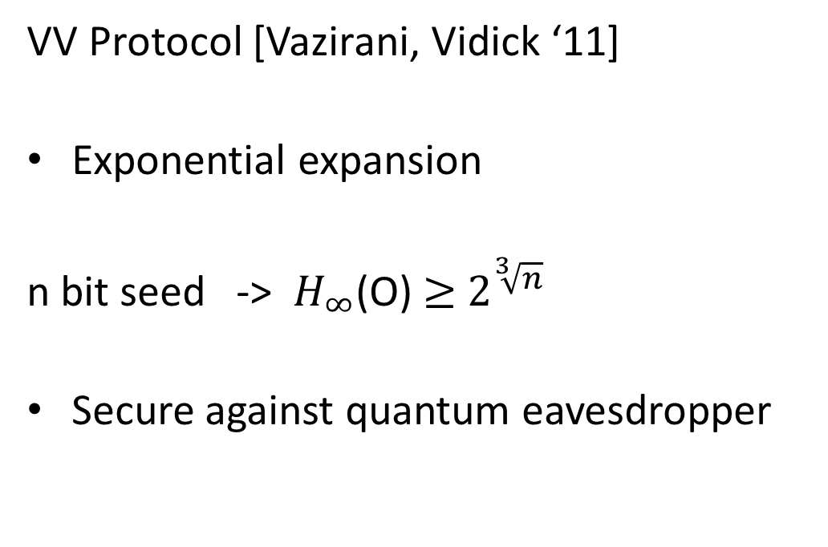
Randomness Expansion
S = Input Seed
a = 1
b = 0
VV Protocol [Vazirani, Vidick ‘11]
Exponential expansion
n bit seed -> $H_{∞}^{}$(O) $≥$ $2^{\sqrt[3]{n}}$
Secure against quantum eavesdropper
A
B
x
0
1
1
0
1
0
1
0
a
1
0
0
1
1
0
0
1
b
0
1
1
0
1
0
0
1
y
0
0
1
0
1
1
0
0
O = Output

Slide 23
Randomness Expansion
S = Input Seed
a = 1
b = 0
VV Protocol [Vazirani, Vidick ‘11]
Exponential expansion
n bit seed -> $H_{∞}^{}$(O) $≥$ $2^{\sqrt[3]{n}}$
Secure against quantum eavesdropper
A
B
x
0
1
1
0
1
0
1
0
a
1
0
0
1
1
0
0
1
b
0
1
1
0
1
0
0
1
y
0
0
1
0
1
1
0
0
O = Output

Slide 24

Randomness Expansion
S = Input Seed
a = 1
b = 0
VV Protocol [Vazirani, Vidick ‘11]
Exponential expansion
n bit seed -> $H_{∞}^{}$(O) $≥$ $2^{\sqrt[3]{n}}$
Secure against quantum eavesdropper
A
B
x
0
1
1
0
1
0
1
0
a
1
0
0
1
1
0
0
1
b
0
1
1
0
1
0
0
1
y
0
0
1
0
1
1
0
0
E
O = Output

Slide 25
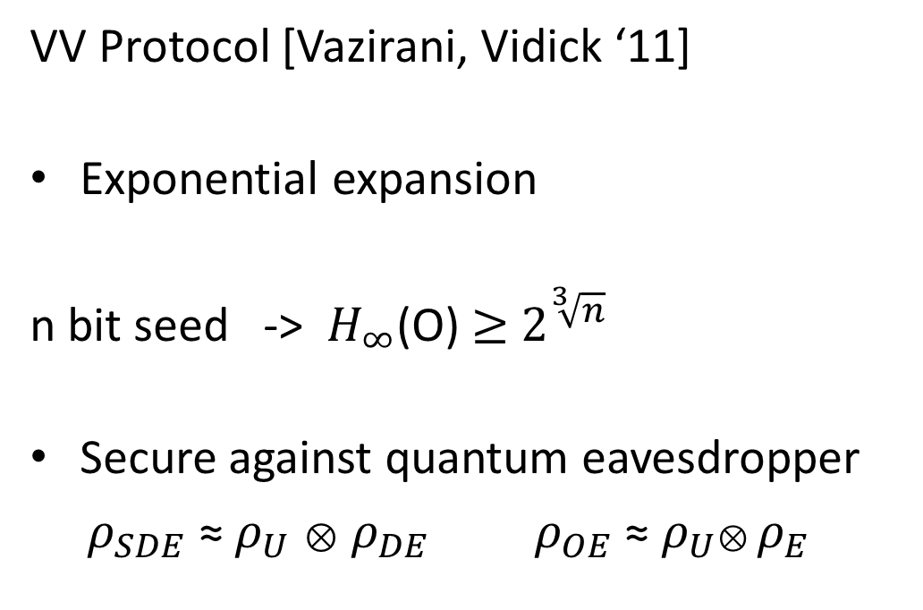
Randomness Expansion
S = Input Seed
a = 1
b = 0
VV Protocol [Vazirani, Vidick ‘11]
Exponential expansion
n bit seed -> $H_{∞}^{}$(O) $≥$ $2^{\sqrt[3]{n}}$
Secure against quantum eavesdropper
$ρ_{SDE}$ ≈ $ρ_{U}$ ⊗ $ρ_{DE}$ $ρ_{OE}$ ≈ $ρ_{U}$⊗ $ρ_{E}$
A
B
x
0
1
1
0
1
0
1
0
a
1
0
0
1
1
0
0
1
b
0
1
1
0
1
0
0
1
y
0
0
1
0
1
1
0
0
E
O = Output

Slide 26
Question
What is the greatest possible rate of randomness expansion? Exponential? Higher?

Slide 27
Question
What is the greatest possible rate of randomness expansion? Exponential? Higher?
Doubly exponential upper bound for analysis of existing non-adaptive protocols. [C, Vidick, Yuen]

Slide 28
Question
What is the greatest possible rate of randomness expansion? Exponential? Higher?
Doubly exponential upper bound for analysis of existing non-adaptive protocols. [C, Vidick, Yuen]
Our Result:
Infinite randomness expansion with 8 devices. (We can also do 6)

Slide 29
Input Seed
Compose?
a = 1
b = 0
A
B
x
0
1
1
0
1
0
1
0
a
1
0
0
1
1
0
0
1
b
0
1
1
0
1
0
0
1
y
0
0
1
0
1
1
0
0
EXTRACTOR
O

Slide 30
Input Seed
Compose?
a = 1
b = 0
A
B
x
0
1
1
0
1
0
1
0
a
1
0
0
1
1
0
0
1
b
0
1
1
0
1
0
0
1
y
0
0
1
0
1
1
0
0
EXTRACTOR
O

Slide 31
Input Seed
Compose?
EXTRACTOR
a = 1
b = 0
a = 1
b = 0
A
B
A
B
x
0
1
1
0
1
0
1
0
a
1
0
0
1
1
0
0
1
b
0
1
1
0
1
0
0
1
y
0
0
1
0
1
1
0
0
x
0
1
1
0
1
0
1
0
a
1
0
0
1
1
0
0
1
b
0
1
1
0
1
0
0
1
y
0
0
1
0
1
1
0
0
EXTRACTOR
O
O

Slide 32
Compose?
Group 1
Group 2
S₁
S₂
A
B
A
B
EXTRACTOR
O₁
O₂

Slide 33
Compose?
Group 1
Group 2
S₁
S₂
A
B
A
B
EXTRACTOR
O₁
O₂
Secure Against Eavesdropper

Slide 34
Compose?
Group 1
Group 2
S₁
S₂
A
B
A
B
E
EXTRACTOR
O₁
O₂
Secure Against Eavesdropper

Slide 35
Compose?
Group 1
Group 2
S₁
S₂
A
B
A
B
E
EXTRACTOR
O₁
O₂
Secure Against Eavesdropper
$ρ_{S_{1}G_{1}G_{2}}$ ≈ $ρ_{U}$ ⊗ $ρ_{G_{1}G_{2}}$ $ρ_{O_{1}G_{2}}$ ≈ $ρ_{U}$ ⊗ $ρ_{G_{2}}$

Slide 36
Alternate?
Group 1
Group 2
EXTRACTOR
S₂
A
B
A
B
EXTRACTOR
O₂

Slide 37
Alternate?
Group 1
Group 2
EXTRACTOR
S₂
A
B
A
B
EXTRACTOR
O₂

Slide 38
Alternate?
Group 1
Group 2
EXTRACTOR
S₂
A
B
A
B
EXTRACTOR
O₂
Secure Against Eavesdropper

Slide 39
Alternate?
Group 1
Group 2
EXTRACTOR
S₂
A
B
A
B
E
EXTRACTOR
O₂
Secure Against Eavesdropper

Slide 40
Alternate?
Group 1
Group 2
EXTRACTOR
S₂
A
B
A
B
E
EXTRACTOR
O₂
Secure Against Eavesdropper
$ρ_{S_{2}G_{2}G_{1}}$ ≈ $ρ_{U}$ ⊗ $ρ_{G_{2}G_{1}}$ $ρ_{O_{2}G_{1}}$ ≈ $ρ_{U}$ ⊗ $ρ_{G_{1}}$

Slide 41
Alternate?
Group 1
Group 2
EXTRACTOR
S₂
A
B
A
B
E
EXTRACTOR
O₂
Secure Against Eavesdropper
$ρ_{S_{2}G_{2}G_{1}}$ ≈ $ρ_{U}$ ⊗ $ρ_{G_{2}G_{1}}$ $ρ_{O_{2}G_{1}}$ ≈ $ρ_{U}$ ⊗ $ρ_{G_{1}}$

Slide 42
Compose?
Group 1
Group 2
S₁
S₂
A
B
A
B
EXTRACTOR
O₁
O₂

Slide 43
Alternate?
Group 1
Group 2
EXTRACTOR
S₂
A
B
A
B
E
EXTRACTOR
O₂
Secure Against Eavesdropper
$ρ_{S_{2}G_{2}G_{1}}$ ≈ $ρ_{U}$ ⊗ $ρ_{G_{2}G_{1}}$ $ρ_{O_{2}G_{1}}$ ≈ $ρ_{U}$ ⊗ $ρ_{G_{1}}$

Slide 44
Alternate?
Group 1
Group 2
EXTRACTOR
S₂
A
B
A
B
E
EXTRACTOR
O₂
Secure Against Eavesdropper
$ρ_{S_{2}G_{2}G_{1}}$ ≈ $ρ_{U}$ ⊗ $ρ_{G_{2}G_{1}}$ $ρ_{O_{2}G_{1}}$ ≈ $ρ_{U}$ ⊗ $ρ_{G_{1}}$

Slide 45
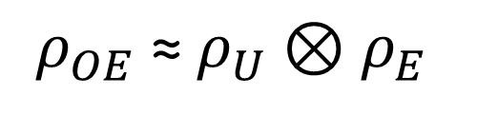
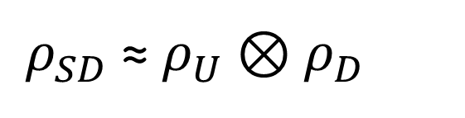
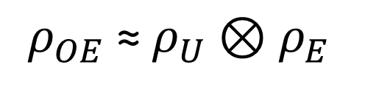
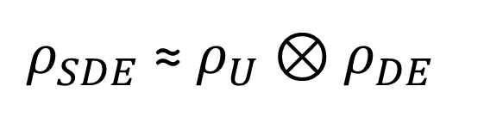
Input Security
Secure Against Q. Eavesdropper
“Input Secure”
$ρ_{SDE}$ ≈ $ρ_{U}$ ⊗ $ρ_{DE}$
$ρ_{SD}$ ≈ $ρ_{U}$ ⊗ $ρ_{D}$
$$ρ_{OE}\text{ ≈ }ρ_{U}\text{ ⊗} ρ_{E}$$
$$ρ_{OE}\text{ ≈ }ρ_{U}\text{ ⊗} ρ_{E}$$
Provably input secure randomness expansion protocol Infinite randomness expansion.
Can we obtain input security in a randomness expansion protocol?
Randomness Extractors are provably not input secure.

Slide 46
Input Security
Secure Against Q. Eavesdropper
“Input Secure”
$ρ_{SDE}$ ≈ $ρ_{U}$ ⊗ $ρ_{DE}$
$ρ_{SD}$ ≈ $ρ_{U}$ ⊗ $ρ_{D}$
$$ρ_{OE}\text{ ≈ }ρ_{U}\text{ ⊗} ρ_{E}$$
$$ρ_{OE}\text{ ≈ }ρ_{U}\text{ ⊗} ρ_{E}$$
Provably input secure randomness expansion protocol Infinite randomness expansion.
Can we obtain input security in a randomness expansion protocol?
Randomness Extractors are provably not input secure.

Slide 47
Input Security
Secure Against Q. Eavesdropper
“Input Secure”
$ρ_{SDE}$ ≈ $ρ_{U}$ ⊗ $ρ_{DE}$
$ρ_{SD}$ ≈ $ρ_{U}$ ⊗ $ρ_{D}$
$$ρ_{OE}\text{ ≈ }ρ_{U}\text{ ⊗} ρ_{E}$$
$$ρ_{OE}\text{ ≈ }ρ_{U}\text{ ⊗} ρ_{E}$$
Provably input secure randomness expansion protocol Infinite randomness expansion.
Can we obtain input security in a randomness expansion protocol?
Randomness Extractors are provably not input secure.

Slide 48
A New Tool
S = Input Seed
a = 1
b = 0
[Reichardt, Unger, Vazirani 2012]
“RUV” Protocol
Device Independent protocol
Gives a test for special structure in the devices’ strategy.
Certifies that devices are employing the ideal CHSH strategy in certain rounds.
A
B
x
0
1
1
0
1
0
1
0
a
1
0
0
1
1
0
0
1
b
0
1
1
0
1
0
0
1
y
0
0
1
0
1
1
0
0

Slide 49
Input Secure?
a = 1
b = 0
The RUV protocol seems Input Secure!
.
A
B
x
0
1
1
0
1
0
1
0
a
1
0
0
1
1
0
0
1
b
0
1
1
0
1
0
0
1
y
0
0
1
0
1
1
0
0

Slide 50
Input Secure?
a = 1
b = 0
The RUV protocol seems Input Secure!
.
A
B
x
0
1
1
0
1
0
1
0
a
1
0
0
1
1
0
0
1
b
0
1
1
0
1
0
0
1
y
0
0
1
0
1
1
0
0

Slide 51
Input Secure?
E
a = 1
b = 0
The RUV protocol seems Input Secure!
.
A
B
x
0
1
1
0
1
0
1
0
a
1
0
0
1
1
0
0
1
b
0
1
1
0
1
0
0
1
y
0
0
1
0
1
1
0
0

Slide 52
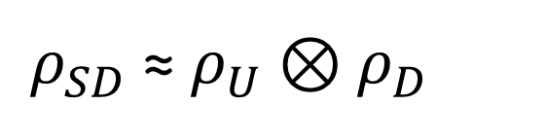
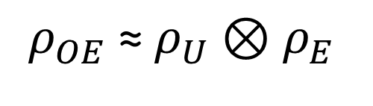
Input Secure?
E
a = 1
b = 0
The RUV protocol seems Input Secure!
.
A
B
x
0
1
1
0
1
0
1
0
a
1
0
0
1
1
0
0
1
b
0
1
1
0
1
0
0
1
y
0
0
1
0
1
1
0
0
“Input Secure”
$ρ_{SD}$ ≈ $ρ_{U}$ ⊗ $ρ_{D}$
$$ρ_{OE}\text{ ≈ }ρ_{U}\text{ ⊗} ρ_{E}$$

Slide 53
Input Secure?
E
a = 1
b = 0
The RUV protocol seems Input Secure!
However:
1) Not randomness expanding.
A
B
x
0
1
1
0
1
0
1
0
a
1
0
0
1
1
0
0
1
b
0
1
1
0
1
0
0
1
y
0
0
1
0
1
1
0
0
“Input Secure”
$ρ_{SD}$ ≈ $ρ_{U}$ ⊗ $ρ_{D}$
$$ρ_{OE}\text{ ≈ }ρ_{U}\text{ ⊗} ρ_{E}$$

Slide 54
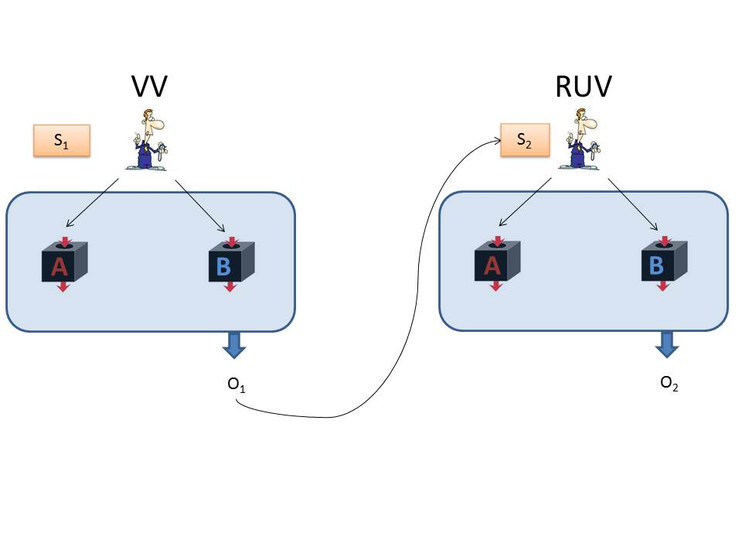
Obtaining Expansion
VV
  Exponential Expansion
  Q. Secure
RUV:
  Polynomial Contraction
Net:
  Exponential Expansion

Slide 55
Input Secure?
E
a = 1
b = 0
This RUV protocol seems Input Secure!
However:
1) Not randomness expanding.
2) Not input secure conditioned on passing.
A
B
x
0
1
1
0
1
0
1
0
a
1
0
0
1
1
0
0
1
b
0
1
1
0
1
0
0
1
y
0
0
1
0
1
1
0
0
“Input Secure”
$ρ_{SD}$ ≈ $ρ_{U}$ ⊗ $ρ_{D}$
$$ρ_{OE}\text{ ≈ }ρ_{U}\text{ ⊗} ρ_{E}$$

Slide 56
Input Security revisited
a = 1
We only use the output of RUV in the event that the protocol passes
In general conditioning on this event can reveal output information to the eavesdropper
This would invalidate the Input Security gained from RUV
b = 0
A
B
x
0
1
1
0
1
0
1
0
a
1
0
0
1
1
0
0
1
b
0
1
1
0
1
0
0
1
y
0
0
1
0
1
1
0
0

Slide 57
Input Security revisited
a = 1
We only use the output of RUV in the event that the protocol passes
In general conditioning on this event can reveal output information to the eavesdropper
This would invalidate the Input Security gained from RUV
b = 0
A
B
x
0
1
1
0
1
0
1
0
a
1
0
0
1
1
0
0
1
b
0
1
1
0
1
0
0
1
y
0
0
1
0
1
1
0
0
E

Slide 58
Input Security revisited
a = 1
We only use the output of RUV in the event that the protocol passes
In general conditioning on this event can reveal output information to the eavesdropper
This would invalidate the Input Security gained from RUV
b = 0
A
B
x
0
1
1
0
1
0
1
0
a
1
0
0
1
1
0
0
1
b
0
1
1
0
1
0
0
1
y
0
0
1
0
1
1
0
0
E

Slide 59
Input Security: The Solution
Divide the output X into blocks
On average each block will be nearly unentangled with the combined system FE
Output a random block
a = 1
b = 0
A
B
x
0
1
1
0
1
0
1
0
a
1
0
0
1
1
0
0
1
b
0
1
1
0
1
0
0
1
y
0
0
1
0
1
1
0
0
X₁
X₂
X
F
E
Pass | Fail
F = 1 | F = 0
X₃

Slide 60
Input Security: The Solution
Divide the output X into blocks
On average each block will be nearly unentangled with the combined system FE
Output a random block
a = 1
b = 0
A
B
x
0
1
1
0
1
0
1
0
a
1
0
0
1
1
0
0
1
b
0
1
1
0
1
0
0
1
y
0
0
1
0
1
1
0
0
X₁
X₂
X
F
E
Pass | Fail
F = 1 | F = 0
X₃

Slide 61
Input Security: The Solution
Divide the output X into blocks
On average each block will be nearly unentangled with the combined system FE
Output a random block
a = 1
b = 0
A
B
x
0
1
1
0
1
0
1
0
a
1
0
0
1
1
0
0
1
b
0
1
1
0
1
0
0
1
y
0
0
1
0
1
1
0
0
X₁
X₂
X
F
E
Pass | Fail
F = 1 | F = 0
X₃

Slide 62
Input Security: The Solution
Divide the output X into blocks
On average each block will be nearly unentangled with the combined system FE
Output a random block
a = 1
b = 0
A
B
x
0
1
1
0
1
0
1
0
a
1
0
0
1
1
0
0
1
b
0
1
1
0
1
0
0
1
y
0
0
1
0
1
1
0
0
X₁
X₂
X
F
E
Pass | Fail
F = 1 | F = 0
X₃

Slide 63

Input Security: The Solution
$$I\left(X:E\right)≈0$$
$$I\left(X:FE\right)≤2 H\left(F\right)≤2$$
$$2≥I\left(X:FE\right)= \sum_{i}{I\left(X_{i}:FE | X_{<i}\right)}≥\sum_{i}{I(X_{i}:FE)}$$
a = 1
b = 0
A
B
x
0
1
1
0
1
0
1
0
a
1
0
0
1
1
0
0
1
b
0
1
1
0
1
0
0
1
y
0
0
1
0
1
1
0
0
X₁
X₂
X
F
E
Pass | Fail
F = 1 | F = 0
X₃

Slide 64
Input Security: The Solution
$$I\left(X:E\right)≈0$$
$$I\left(X:FE\right)≤2 H\left(F\right)≤2$$
$$2≥I\left(X:FE\right)= \sum_{i}{I\left(X_{i}:FE | X_{<i}\right)}≥\sum_{i}{I(X_{i}:FE)}$$
a = 1
b = 0
A
B
x
0
1
1
0
1
0
1
0
a
1
0
0
1
1
0
0
1
b
0
1
1
0
1
0
0
1
y
0
0
1
0
1
1
0
0
X₁
X₂
X
F
E
Pass | Fail
F = 1 | F = 0
X₃

Slide 65
Input Security: The Solution
$$I\left(X:E\right)≈0$$
$$I\left(X:FE\right)≤2 H\left(F\right)≤2$$
$$2≥I\left(X:FE\right)= \sum_{i}{I\left(X_{i}:FE | X_{<i}\right)}≥\sum_{i}{I(X_{i}:FE)}$$
a = 1
b = 0
A
B
x
0
1
1
0
1
0
1
0
a
1
0
0
1
1
0
0
1
b
0
1
1
0
1
0
0
1
y
0
0
1
0
1
1
0
0
X₁
X₂
X
F
E
Pass | Fail
F = 1 | F = 0
X₃

Slide 66
Input Security: The Solution
$$I\left(X:E\right)≈0$$
$$I\left(X:FE\right)≤2 H\left(F\right)≤2$$
$$2≥I\left(X:FE\right)= \sum_{i}{I\left(X_{i}:FE | X_{<i}\right)}≥\sum_{i}{I(X_{i}:FE)}$$
a = 1
b = 0
A
B
x
0
1
1
0
1
0
1
0
a
1
0
0
1
1
0
0
1
b
0
1
1
0
1
0
0
1
y
0
0
1
0
1
1
0
0
X₁
X₂
X
F
E
Pass | Fail
F = 1 | F = 0
X₃

Slide 67

Input Security: The Solution
$\frac{1}{N}\sum_{i}{I(X_{i}:FE)}≤\frac{1}{N}$ $I(X:FE)≤\frac{2}{N}$
Pinsker’s Inequality
$$\frac{1}{N}\sum_{i}{{||{ ρ}_{X_{i}FE} −ρ_{X_{i}⊗}ρ_{FE} ||}^{2}}≤\frac{1}{N}\sum_{i}{I(X_{i}:FE)}≤\frac{2}{N}$$
a = 1
b = 0
A
B
x
0
1
1
0
1
0
1
0
a
1
0
0
1
1
0
0
1
b
0
1
1
0
1
0
0
1
y
0
0
1
0
1
1
0
0
X₁
X₂
X
F
E
Pass | Fail
F = 1 | F = 0
X₃

Slide 68
Input Security: The Solution
$\frac{1}{N}\sum_{i}{I(X_{i}:FE)}≤\frac{1}{N}$ $I(X:FE)≤\frac{2}{N}$
Pinsker’s Inequality
$$\frac{1}{N}\sum_{i}{{||{ ρ}_{X_{i}FE} −ρ_{X_{i}⊗}ρ_{FE} ||}^{2}}≤\frac{1}{N}\sum_{i}{I(X_{i}:FE)}≤\frac{2}{N}$$
a = 1
b = 0
A
B
x
0
1
1
0
1
0
1
0
a
1
0
0
1
1
0
0
1
b
0
1
1
0
1
0
0
1
y
0
0
1
0
1
1
0
0
X₁
X₂
X
F
E
Pass | Fail
F = 1 | F = 0
X₃

Slide 69
Input Security: The Solution
$\frac{1}{N}\sum_{i}{I(X_{i}:FE)}≤\frac{1}{N}$ $I(X:FE)≤\frac{2}{N}$
Pinsker’s Inequality
$$\frac{1}{N}\sum_{i}{{||{ ρ}_{X_{i}FE} −ρ_{X_{i}⊗}ρ_{FE} ||}^{2}}≤\frac{1}{N}\sum_{i}{I(X_{i}:FE)}≤\frac{2}{N}$$
a = 1
b = 0
A
B
x
0
1
1
0
1
0
1
0
a
1
0
0
1
1
0
0
1
b
0
1
1
0
1
0
0
1
y
0
0
1
0
1
1
0
0
X₁
X₂
X
F
E
Pass | Fail
F = 1 | F = 0
X₃

Slide 70
Input Security: The Solution
$\frac{1}{N}\sum_{i}{I(X_{i}:FE)}≤\frac{1}{N}$ $I(X:FE)≤\frac{2}{N}$
Pinsker’s Inequality
$$\frac{1}{N}\sum_{i}{{||{ ρ}_{X_{i}FE} −ρ_{X_{i}⊗}ρ_{FE} ||}^{2}}≤\frac{1}{N}\sum_{i}{I(X_{i}:FE)}≤\frac{2}{N}$$
a = 1
b = 0
A
B
x
0
1
1
0
1
0
1
0
a
1
0
0
1
1
0
0
1
b
0
1
1
0
1
0
0
1
y
0
0
1
0
1
1
0
0
X₁
X₂
X
F
E
Pass | Fail
F = 1 | F = 0
X₃

Slide 71
Selecting Random Blocks
Our solution selects output blocks at random….
….using an input seed unknown to the devices
But could the seed be correlated with the position of “bad” blocks?
a = 1
b = 0
A
B
x
0
1
1
0
1
0
1
0
a
1
0
0
1
1
0
0
1
b
0
1
1
0
1
0
0
1
y
0
0
1
0
1
1
0
0
X₁
X₂
X
X₃
E

Slide 72
Selecting Random Blocks
Our solution selects output blocks at random….
….using an input seed unknown to the devices
But could the seed be correlated with the position of “bad” blocks?
a = 1
b = 0
A
B
x
0
1
1
0
1
0
1
0
a
1
0
0
1
1
0
0
1
b
0
1
1
0
1
0
0
1
y
0
0
1
0
1
1
0
0
X₁
X₂
X
X₃
E

Slide 73
Selecting Random Blocks
Our solution selects output blocks at random….
….using an input seed unknown to the devices
But could the seed be correlated with the position of “bad” blocks?
a = 1
b = 0
A
B
x
0
1
1
0
1
0
1
0
a
1
0
0
1
1
0
0
1
b
0
1
1
0
1
0
0
1
y
0
0
1
0
1
1
0
0
X₁
X₂
X
X₃
E

Slide 74
Selecting Random Blocks
Such adversarial correlations can be ruled out using a purification and simulation argument.
This implies full input security for this composition of VV and RUV.
a = 1
b = 0
A
B
x
0
1
1
0
1
0
1
0
a
1
0
0
1
1
0
0
1
b
0
1
1
0
1
0
0
1
y
0
0
1
0
1
1
0
0
X₁
X₂
X
X₃
E

Slide 75
Selecting Random Blocks
Such adversarial correlations can be ruled out using a purification and simulation argument.
This implies full input security for this composition of VV and RUV.
a = 1
b = 0
A
B
x
0
1
1
0
1
0
1
0
a
1
0
0
1
1
0
0
1
b
0
1
1
0
1
0
0
1
y
0
0
1
0
1
1
0
0
X₁
X₂
X
X₃
E

Slide 76


Our Protocol
VV
VV
S = Input Seed
A
B
A
B
EXTRACTOR
EXTRACTOR
RUV
RUV
A
B
A
B

Slide 77
Our Protocol
VV
VV
S = Input Seed
A
B
A
B
EXTRACTOR
EXTRACTOR
RUV
RUV
A
B
A
B

Slide 78
Our Protocol
VV
VV
S = Input Seed
A
B
A
B
EXTRACTOR
EXTRACTOR
RUV
RUV
A
B
A
B

Slide 79
Our Protocol
VV
VV
S = Input Seed
A
B
A
B
EXTRACTOR
EXTRACTOR
RUV
RUV
A
B
A
B

Slide 80
Our Protocol
VV
VV
S = Input Seed
A
B
A
B
EXTRACTOR
EXTRACTOR
RUV
RUV
A
B
A
B

Slide 81
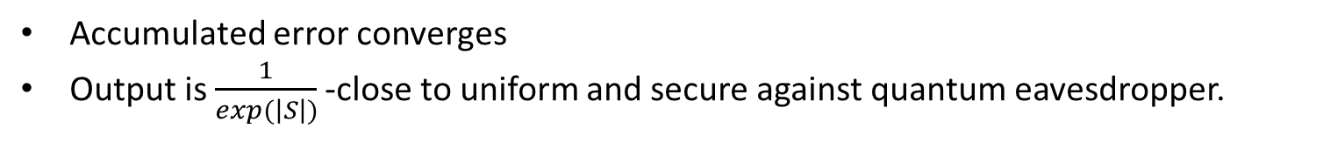
Infinite Randomness Expansion
VV
VV
S = Input Seed
A
B
A
B
RUV
RUV
A
B
A
B
Accumulated error converges
Output is $\frac{1}{exp(\left|S\right|)}$-close to uniform and secure against quantum eavesdropper.

Slide 82
Related Work and Open Problems
Robust protocols [Miller, Shi], [Chung, Shi, Wu]
  MS gives a protocol for robust exponential expansion with two devices.
  The results of MS and CSW can be combined to give a provably robust infinite expansion protocol using four devices.
Extracting from a min-entropy source (without an independent seed) [Chung, Shi, Wu]
  Different proof and application for “Input Security”

