Slide 1
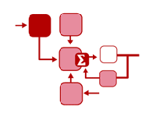

Efficient crowd-sourcing
David Karger Sewoong Oh Devavrat Shah
MIT + UIUC

Slide 2
A classical example
A patient is asked: rate your pain on scale 1-10
  Medical student gets answer : 5
  Intern gets answer : 8
  Fellow gets answer : 4.5
  Doctor gets answer : 6
So what is the “right” amount of pain?
Crowd-sourcing
  Pain of patient = task
  Answer of patient = completion of task by a worker

Slide 3
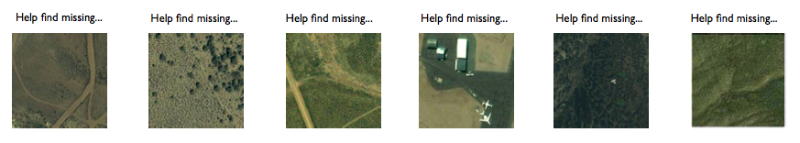
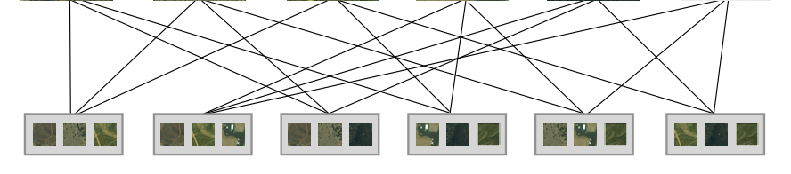
Contemporary example

Slide 4
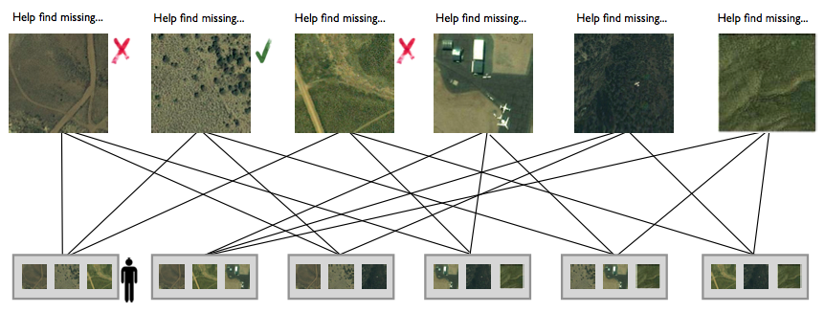
Contemporary example

Slide 5
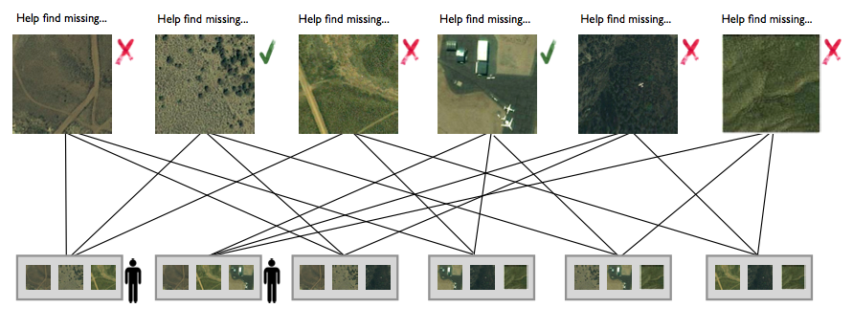
Contemporary example

Slide 6
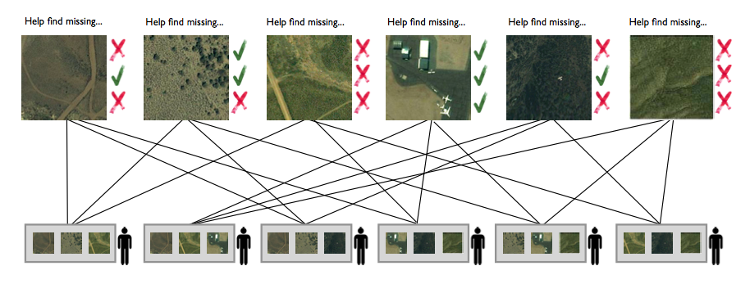
Contemporary example
Goal: reliable estimate the tasks with min’l cost
Key operational questions:
  Task assignment
  Inferring the “answers”

Slide 7
Model a la Dawid and Skene ‘79
N tasks
  Denote by t₁, t₂, …, t_{N} – “true” value in {1,..,K}
M workers
  Denote by w₁, w₂, …, w_{M} – “confusion” matrix
    Worker j: confusion matrix P^{j}=[P^{j}_{kl}]
    Worker j’s answer: is l for task with value k with prob. P^{j}_{kl}
Binary symmetric case
  K = 2: tasks takes value +1 or -1
  Correct answer w.p. p^{j}

Slide 8


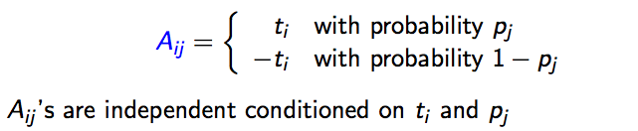

Model a la Dawid and Skene ‘79
t₁
t₂
t_{N-1}
t_{N}
A_{2M}
A_{N2}
A₁₁
A_{N-1} ₁
w₁
w₂
w_{M-1}
w_{M}
Binary tasks:
Worker reliability:
Necessary assumption: we know

Slide 9
Question
t₁
t₂
t_{N-1}
t_{N}
A_{2M}
A_{N2}
A₁₁
A_{N-1} ₁
w₁
w₂
w_{M-1}
w_{M}
Goal: given N tasks
  To obtain answer correctly w.p. at least 1-ε
  What is the minimal number of questions (edges) needed?
  How to assign them, and how to infer tasks values?

Slide 10
Task assignment
t₁
t₂
t_{N-1}
t_{N}
A_{2M}
A_{N2}
A₁₁
A_{N-1} ₁
w₁
w₂
w_{M-1}
w_{M}
Task assignment graph
  Random regular graph
  Or, regular graph w large girth

Slide 11


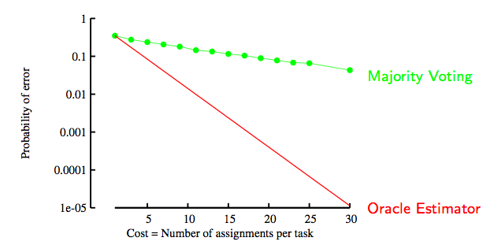
Inferring answers
Majority:
Oracle:
t₁
t₂
t_{N-1}
t_{N}
A_{2M}
A_{N2}
A₁₁
A_{N-1} ₁
w₁
w₂
w_{M-1}
w_{M}

Slide 12

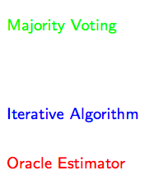
Inferring answers
Majority:
Oracle:
Our Approach:
t₁
t₂
t_{N-1}
t_{N}
A_{2M}
A_{N2}
A₁₁
A_{N-1} ₁
w₁
w₂
w_{M-1}
w_{M}

Slide 13
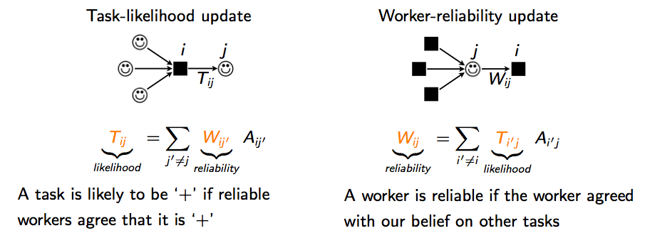
Inferring answers
Iteratively learn
  Message-passing
    O(# edges) operations
  Approximation of
    Maximum Likelihood
t₁
t₂
t_{N-1}
t_{N}
A_{2M}
A_{N2}
A₁₁
A_{N-1} ₁
w₁
w₂
w_{M-1}
w_{M}

Slide 14
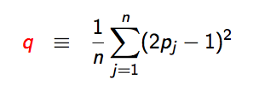
Inferring answers
Crowd Quality
t₁
t₂
t_{N-1}
t_{N}
A_{2M}
A_{N2}
A₁₁
A_{N-1} ₁
w₁
w₂
w_{M-1}
w_{M}
Theorem (Karger-Oh-Shah).
  Let n tasks assigned to n workers as per
    an (l,l) random regular graph
  Let ql > √2
  Then, for all n large enough (i.e. n =Ω(l^{O(log(1/q))} e^{lq})))
  after O(log (1/q)) iterations of the algorithm

Slide 15
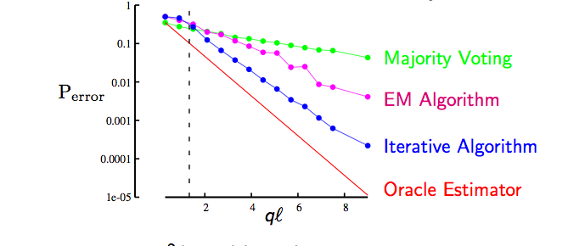
How good?
To achieve target P_{error} ≤ε, we need
  Per task budget l = Θ(1/q log (1/ε))
And this is minimax optimal
Under majority voting (with any graph choice)
  Per task budget required is l = Ω(1/q² log (1/ε))
no significant gain by knowing side-information
(golden question, reputation, …!)

Slide 16
Adaptive solution
Theorem (Karger-Oh-Shah).
  Given any adaptive algorithm,
    let Δ be the average number of workers required per task
    to achieve desired P_{error} ≤ε
  Then there exists {p_{j}} with quality q so that
gain through adaptivity is limited

Slide 17
Model from Dawid-Skene ’79
Theorem (Karger-Oh-Shah).
To achieve reliability 1-ε, per task redundancy scales as
K/q (log 1/ε + log K)
Through reducing K-ary problem to K-binary problems
(and dealing with few asymmetries)

Slide 18
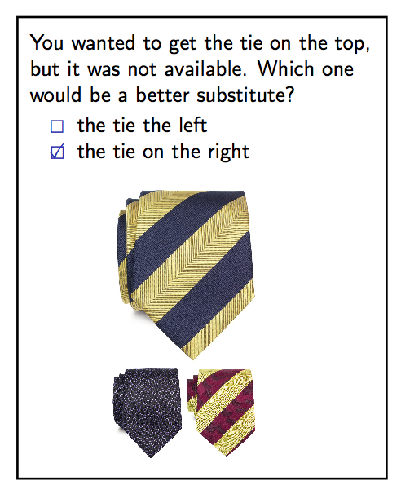
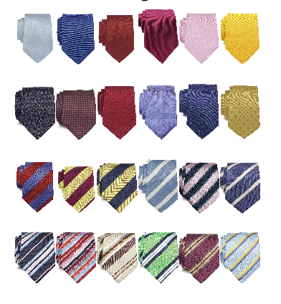
Experiments: Amazon MTurk
Learning similarities
  Recommendations
  Searching, …

Slide 19
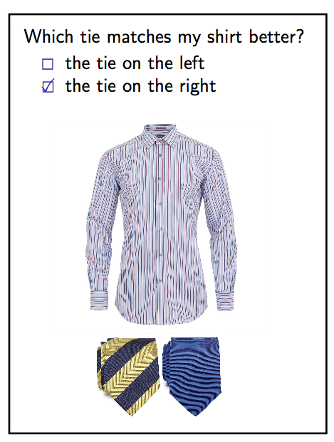
Experiments: Amazon MTurk
Learning similarities
  Recommendations
  Searching, …

Slide 20
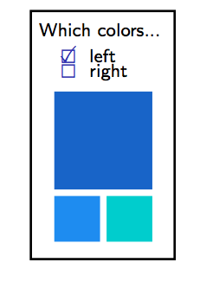
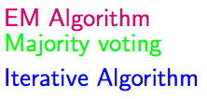
Experiments: Amazon MTurk

Slide 21
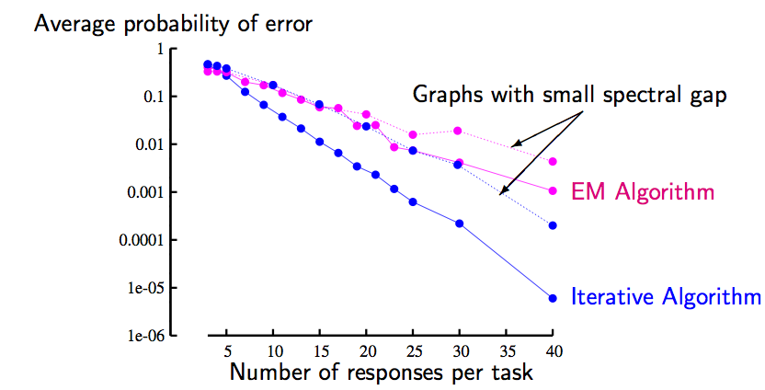
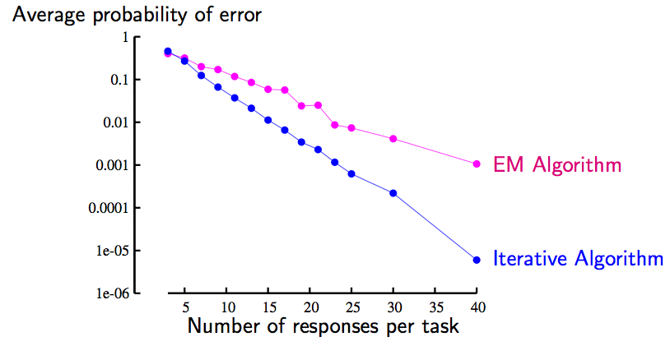
Task Assignment: Why Random Graph

Slide 22
Remarks
Crow-sourcing
  Regular graph + message passing
  Useful for designing surveys/taking polls
Algorithmically
  Iterative algorithm is like power-iteration
Beyond stand-alone tasks
  Learning global structure, e.g. ranking

