Slide 1
Locally correctable codes from lifting
Alan Guo
MIT CSAIL
Joint work with
Swastik Kopparty (Rutgers) and Madhu Sudan (Microsoft Research)

Slide 2
Talk outline
Error correcting codes
Locally correctable codes
Our contributions
  New high rate LCCs
  General framework of “lifting” codes
  New lower bounds for Nikodym sets
Notes:
To start, here’s an outline of the talk.
First, I’ll briefly define error correcting codes, why they’re relevant, and give an example: Reed-Solomon code.
Next, I’ll define locally correctable codes, briefly describe why we care about them, and then give an example.
Right after that, I’ll dive into our paper’s contributions. I’ll start out with the main idea, give an analysis in a very special simple case, then just briefly state our general results, and if time permits I’ll talk about one neat application of our results to combinatorics.

Slide 3
Talk outline
Error correcting codes
Locally correctable codes
Our contributions
  New high rate LCCs
  General framework of “lifting” codes
  New lower bounds for Nikodym sets
Notes:
To start, here’s an outline of the talk.
First, I’ll briefly define error correcting codes, why they’re relevant, and give an example: Reed-Solomon code.
Next, I’ll define locally correctable codes, briefly describe why we care about them, and then give an example.
Right after that, I’ll dive into our paper’s contributions. I’ll start out with the main idea, give an analysis in a very special simple case, then just briefly state our general results, and if time permits I’ll talk about one neat application of our results to combinatorics.

Slide 4
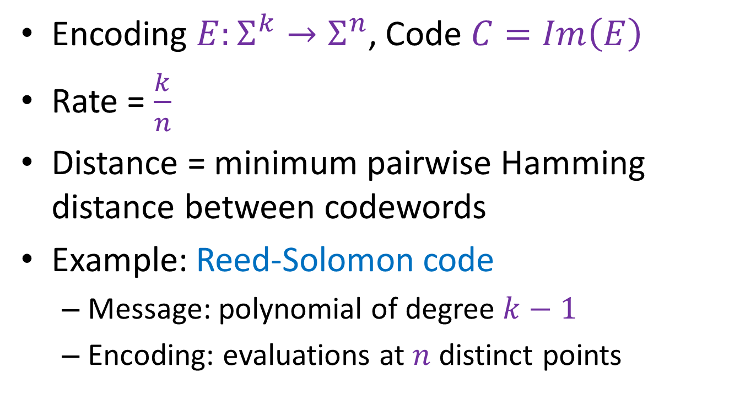
Error correcting codes
Encoding $E:Σ^{k}→Σ^{n}$, Code $C=Im\left(E\right)$
Rate = $\frac{k}{n}$
Distance = minimum pairwise Hamming distance between codewords
Example: Reed-Solomon code
  Message: polynomial of degree $k−1$
  Encoding: evaluations at $n$ distinct points
Notes:
As you may know, error correcting codes are used to encode messages so that they can be sent across noisy channels and still retain enough information to recover the original message.
They’re given by an encoding function, and the code is the image of the function.
The rate is k/n, and the distance is the minimum pairwise Hamming distance between codewords (# coordinates different). Normalized. Linear codes, minimum weight codeword.
An example of an ECC is RS. RS codes are MDS.

Slide 5
Talk outline
Error correcting codes
Locally correctable codes
Our contributions
  New high rate LCCs
  General framework for “lifting” codes
  New lower bounds for Nikodym sets
Notes:
To start, here’s an outline of the talk.
First, I’ll briefly define error correcting codes, why they’re relevant, and give an example: Reed-Solomon code.
Next, I’ll define locally correctable codes, briefly describe why we care about them, and then give an example.
Right after that, I’ll dive into our paper’s contributions. I’ll start out with the main idea, give an analysis in a very special simple case, then just briefly state our general results, and if time permits I’ll talk about one neat application of our results to combinatorics.

Slide 6
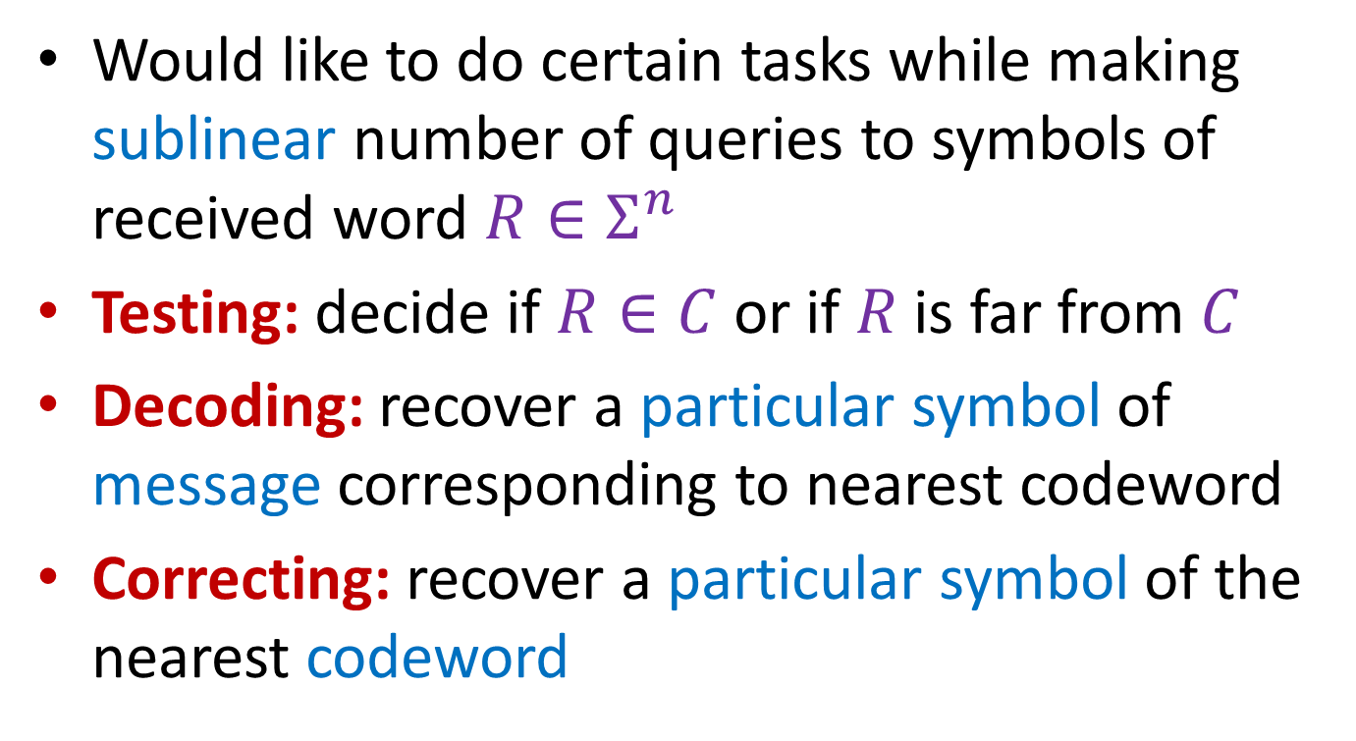
Locality
Would like to do certain tasks while making sublinear number of queries to symbols of received word $R∈Σ^{n}$
Testing: decide if $R∈C$ or if $R$ is far from $C$
Decoding: recover a particular symbol of message corresponding to nearest codeword
Correcting: recover a particular symbol of the nearest codeword

Slide 7
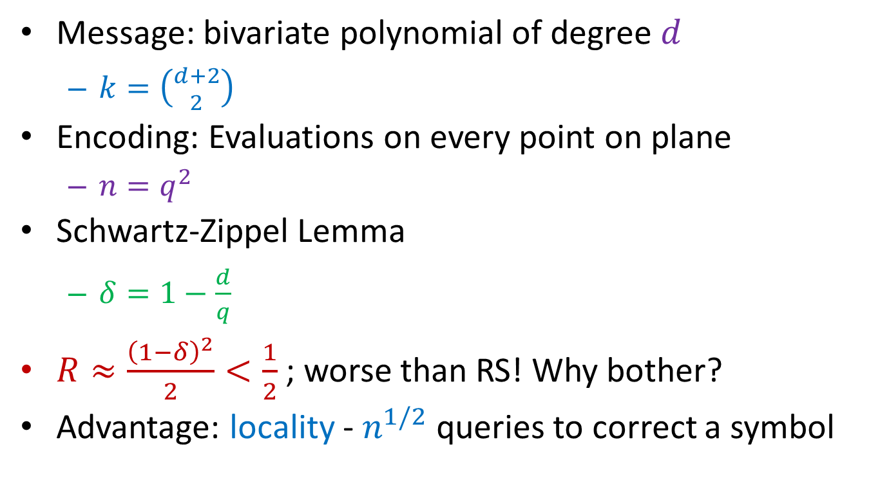
Bivariate polynomial codes
Message: bivariate polynomial of degree $d$
  $k=\left({d+2 \atop 2}\right)$
Encoding: Evaluations on every point on plane
  $n=q^{2}$
Schwartz-Zippel Lemma
  $δ=1−\frac{d}{q}$
$R≈\frac{{\left(1−δ\right)}^{2}}{2}<\frac{1}{2}$ ; worse than RS! Why bother?
Advantage: locality - $n^{1/2}$ queries to correct a symbol
Notes:
We could also take codes to be encodings of polynomials of TWO variables. Our message is the list of coefficients of the polynomial, and the encoding is again the evaluations at every point on the plane.
Why would we do this when RS are MDS? Locality!

Slide 8
Local correctability
Notes:
We can locally correct a bivariate polynomial code as follows.
The idea is to pick a line and decode as a univariate polynomial on the line.
This implies local decodability.

Slide 9
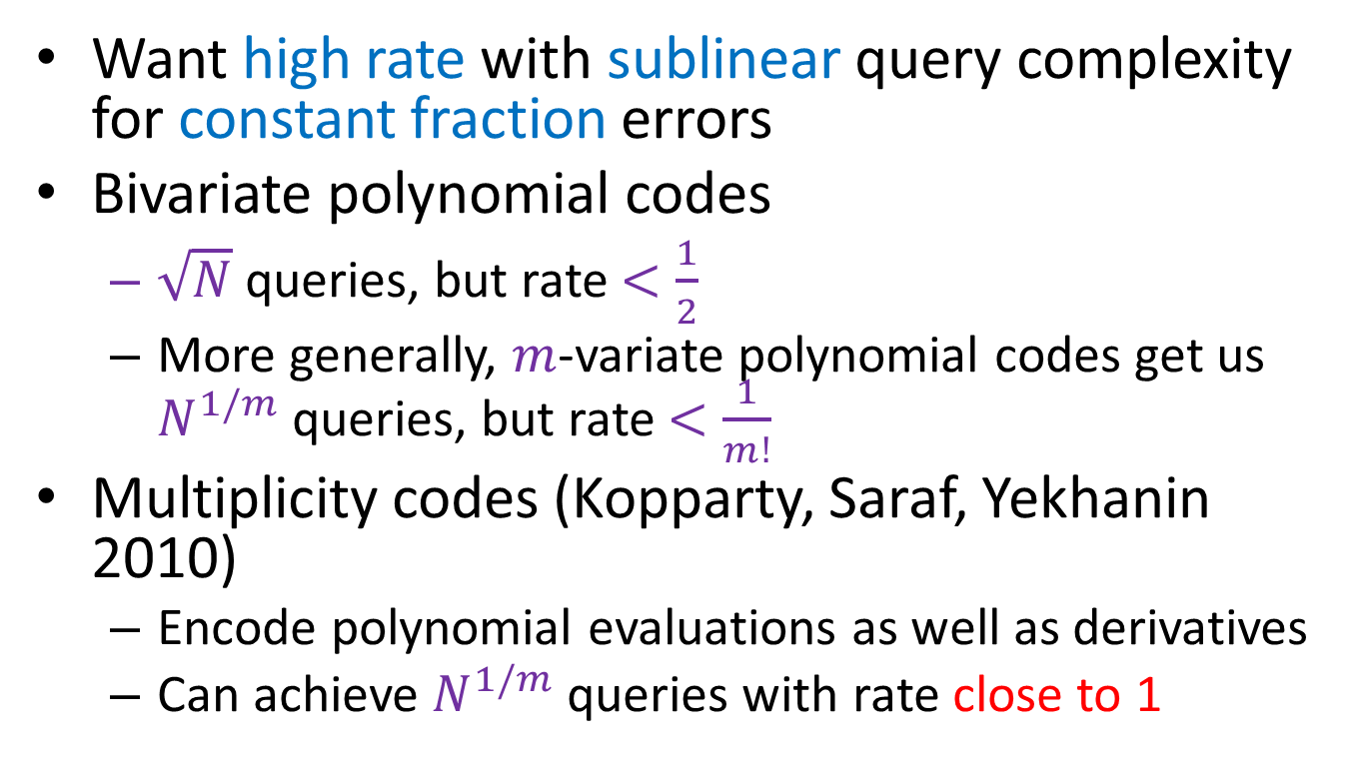
A brief history of LCCs
Want high rate with sublinear query complexity for constant fraction errors
Bivariate polynomial codes
  $\sqrt{N}$ queries, but rate $<\frac{1}{2}$
  More generally, $m$-variate polynomial codes get us $N^{1/m}$ queries, but rate $<\frac{1}{m!}$
Multiplicity codes (Kopparty, Saraf, Yekhanin 2010)
  Encode polynomial evaluations as well as derivatives
  Can achieve $N^{1/m}$ queries with rate close to 1
Notes:
Now I’ll give a very brief, incomplete history of LDCs. In particular, I’ll only mention the history of developments in the regime to which our contributions are relevant.
The regime we’re talking about is the one where we want high rate, sublinear query complexity, for constant fraction errors.
So how do bivariate polynomial codes do? Well, we get sqrtN query complexity, but frankly the rate’s not very good. Even worse, if you add more variables to lower the query complexity, the rate gets catastrophically bad.
In 2010, a breakthrough by KSY showed that so-called multiplicity codes, where you encode polynomial evaluations along with derivatives, can get sublinear query complexity AND rate arbitrarily close to 1.

Slide 10
Talk outline
Error correcting codes
Locally correctable codes
Our contributions
  New high rate LCCs
  General framework for “lifting” codes
  New lower bounds for Nikodym sets
Notes:
To start, here’s an outline of the talk.
First, I’ll briefly define error correcting codes, why they’re relevant, and give an example: Reed-Solomon code.
Next, I’ll define locally correctable codes, briefly describe why we care about them, and then give an example.
Right after that, I’ll dive into our paper’s contributions. I’ll start out with the main idea, give an analysis in a very special simple case, then just briefly state our general results, and if time permits I’ll talk about one neat application of our results to combinatorics.

Slide 11

Our contributions
New codes with $N^{ε}$ queries and rate close to 1
General study of “lifted codes”
New lower bounds for Nikodym sets
Notes:
So what have we done?
Well, we given first linear codes with rate close to 1 (and sublinear queries)
General study of lifted codes
These new codes yield lower bounds for so-called Nikodym sets for finite fields.

Slide 12
Talk outline
Error correcting codes
Locally correctable codes
Our contributions
  New high rate LCCs
  General framework for “lifting” codes
  New lower bounds for Nikodym sets
Notes:
To start, here’s an outline of the talk.
First, I’ll briefly define error correcting codes, why they’re relevant, and give an example: Reed-Solomon code.
Next, I’ll define locally correctable codes, briefly describe why we care about them, and then give an example.
Right after that, I’ll dive into our paper’s contributions. I’ll start out with the main idea, give an analysis in a very special simple case, then just briefly state our general results, and if time permits I’ll talk about one neat application of our results to combinatorics.

Slide 13
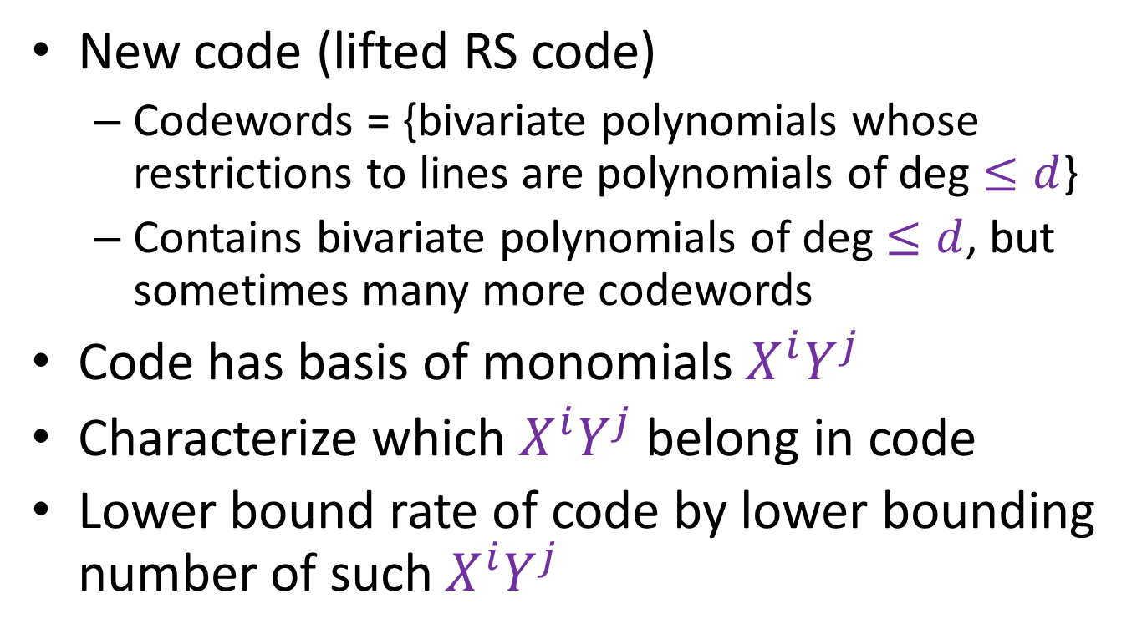
Main idea
New code (lifted RS code)
  Codewords = {bivariate polynomials whose restrictions to lines are polynomials of deg $≤d$}
  Contains bivariate polynomials of deg $≤d$, but sometimes many more codewords
Code has basis of monomials $X^{i}Y^{j}$
Characterize which $X^{i}Y^{j}$ belong in code
Lower bound rate of code by lower bounding number of such $X^{i}Y^{j}$

Slide 14
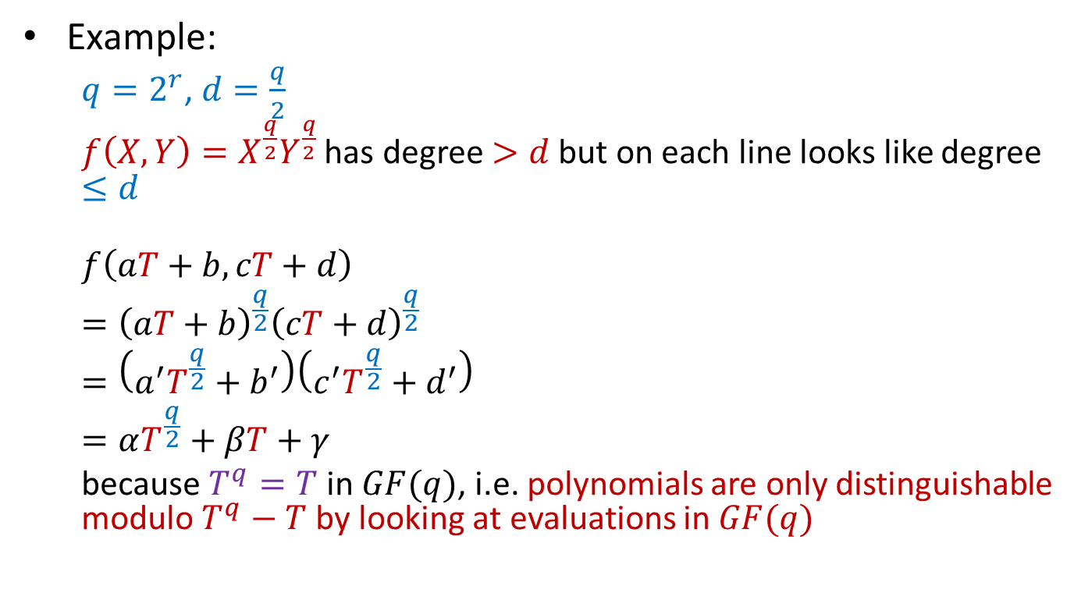
Main idea
Example:
  $q=2^{r}$, $d=\frac{q}{2}$
  $f\left(X,Y\right)=X^{\frac{q}{2}}Y^{\frac{q}{2}}$ has degree $>d$ but on each line looks like degree $≤d$
  $$f\left(aT+b,cT+d\right)$$
  $$={\left(aT+b\right)}^{\frac{q}{2}}{\left(cT+d\right)}^{\frac{q}{2}}$$
  $$=\left(a^{′}T^{\frac{q}{2}}+b^{′}\right)\left(c^{′}T^{\frac{q}{2}}+d^{′}\right)$$
  $$=αT^{\frac{q}{2}}+βT+γ$$
  because $T^{q}=T$ in $GF(q)$, i.e. polynomials are only distinguishable modulo $T^{q}−T$ by looking at evaluations in $GF(q)$

Slide 15
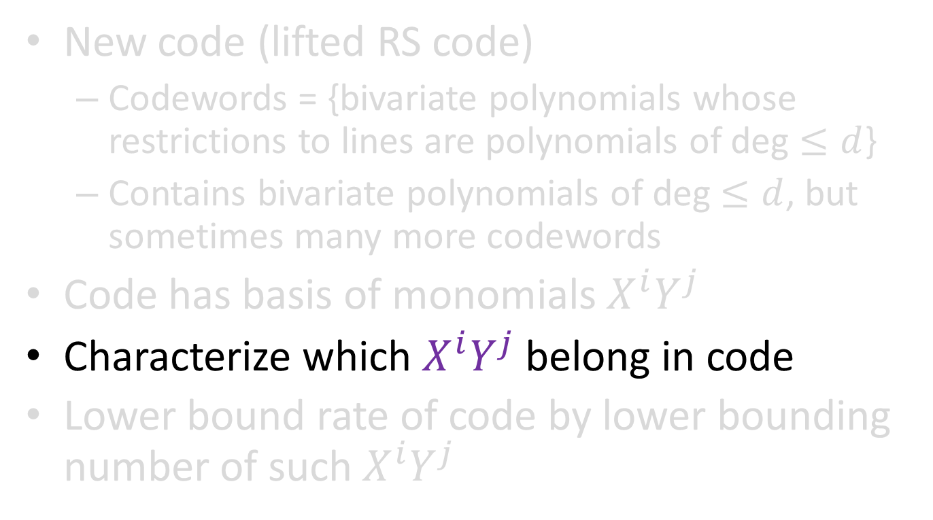
Main idea
New code (lifted RS code)
  Codewords = {bivariate polynomials whose restrictions to lines are polynomials of deg $≤d$}
  Contains bivariate polynomials of deg $≤d$, but sometimes many more codewords
Code has basis of monomials $X^{i}Y^{j}$
Characterize which $X^{i}Y^{j}$ belong in code
Lower bound rate of code by lower bounding number of such $X^{i}Y^{j}$

Slide 16
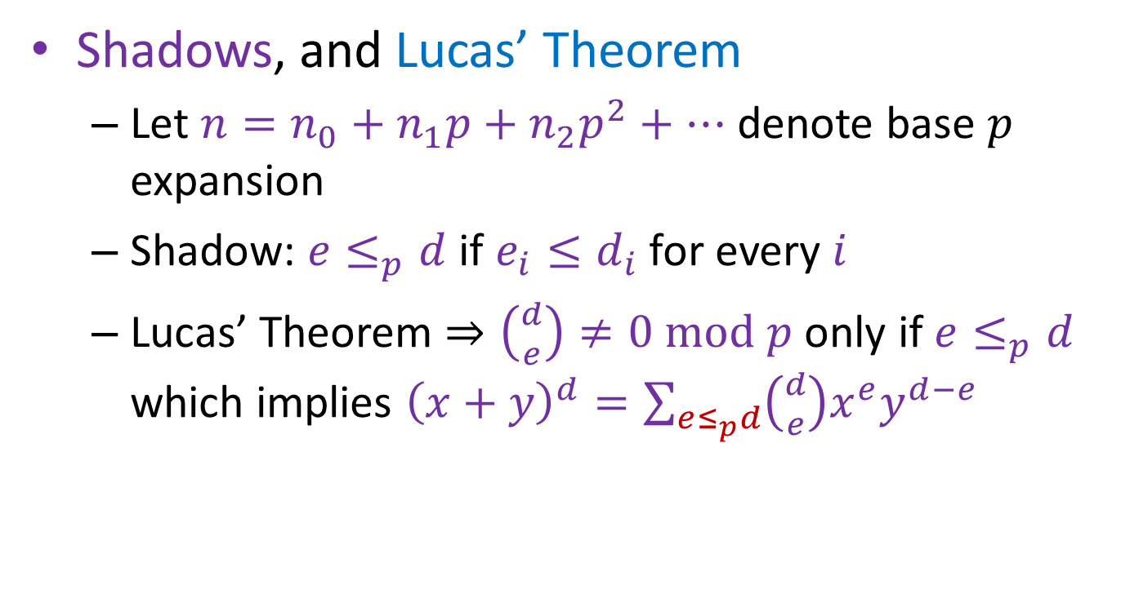
Dimension of lifted RS code
Shadows, and Lucas’ Theorem
  Let $n=n_{0}+n_{1}p+n_{2}p^{2}+⋯$ denote base $p$ expansion
  Shadow: $e≤_{p}d$ if $e_{i}≤d_{i}$ for every $i$
  Lucas’ Theorem $⇒\left({d \atop e}\right)≠0 mod p$ only if $e≤_{p}d$ which implies ${\left(x+y\right)}^{d}=\sum_{e≤_{p}d}{\left({d \atop e}\right)x^{e}y^{d−e}}$
Notes:
Well, so the real question is why DOES it work over non-prime fields?
This is explained by “shadows” and Lucas’ Theorem.

Slide 17
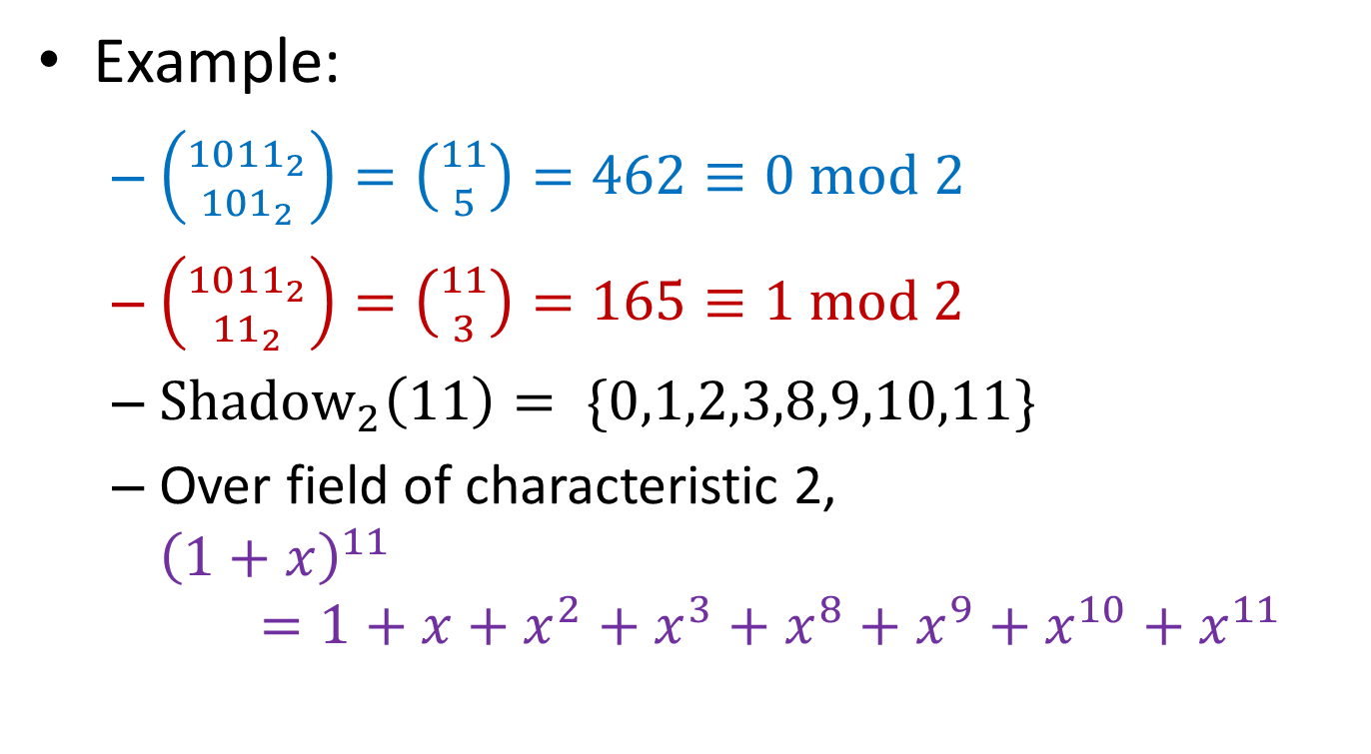
Dimension of lifted RS code
Example:
  $\left({{1011}_{2} \atop {101}_{2}}\right)=\left({11 \atop 5}\right)=462≡0 \text{mod}\text{ 2}$
  $\left({{1011}_{2} \atop {11}_{2}}\right)=\left({11 \atop 3}\right)=165≡1 \text{mod} 2$
  ${\text{Shadow}}_{2}\left(11\right)= \{0,1,2,3,8,9,10,11\}$
  Over field of characteristic 2,
  ${\left(1+x\right)}^{11}=1+x+x^{2}+x^{3}+x^{8}+x^{9}+x^{10}+x^{11}$
Notes:
Well, so the real question is why DOES it work over non-prime fields?
This is explained by “shadows” and Lucas’ Theorem.

Slide 18
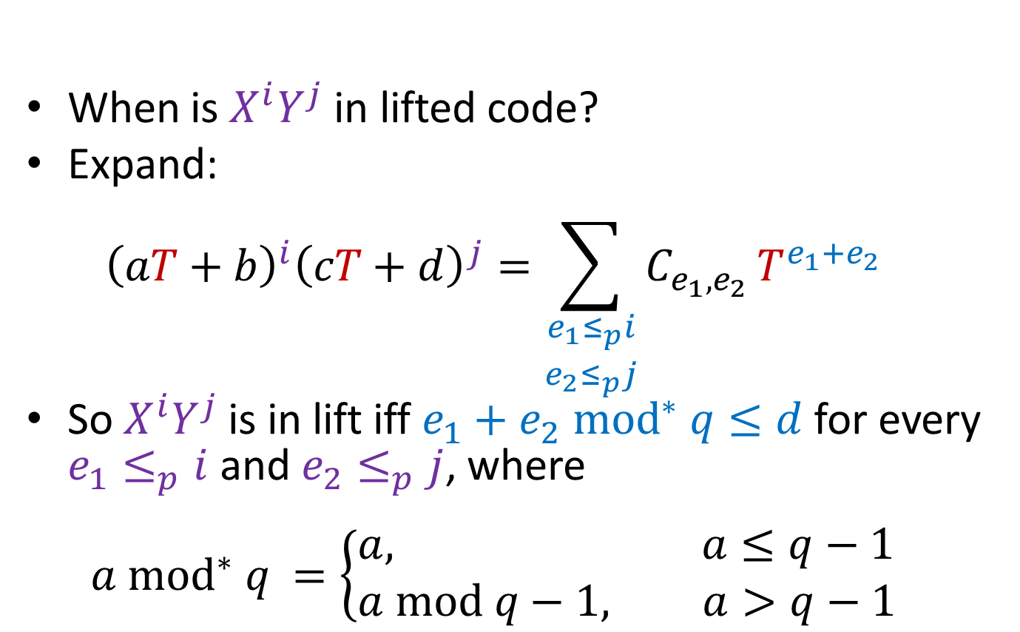
Dimension of lifted RS code
When is $X^{i}Y^{j}$ in lifted code?
Expand:
${\left(aT+b\right)}^{i}{\left(cT+d\right)}^{j}=\sum_{\begin{aligned}e_{1}≤_{p}i \\ e_{2}≤_{p}j\end{aligned}}{C_{e_{1},e_{2} }T^{e_{1}+e_{2}}}$
So $X^{i}Y^{j}$ is in lift iff $e_{1}+e_{2}{ mod}^{∗} q≤d$ for every $e_{1}≤_{p}i$ and ${e_{2}≤}_{p}j$, where
$a {\text{mod}}^{∗} q =\left\{\begin{aligned}&a, a≤q−1 \\ &a \text{mod} q−1, a>q−1\end{aligned}\right.$
Notes:
Well, so the real question is why DOES it work over non-prime fields?
This is explained by “shadows” and Lucas’ Theorem.

Slide 19




Dimension of lifted RS code
$q=16$, $d=\left(1−2^{−1}\right)q−1=7$
$$j$$
$$j$$
$$i$$
$$i$$
Reed-Muller
Lifted Reed-Solomon
Notes:
So we want to know the rate of our code, aka we want to find the dimension of our code.
Just need to lower bound the number of “imposter monomials”

Slide 20

Dimension of lifted RS code
$q=16$, $d=\left(1−2^{−2}\right)q−1=11$
$$j$$
$$j$$
$$i$$
$$i$$
Reed-Muller
Lifted Reed-Solomon
Notes:
So we want to know the rate of our code, aka we want to find the dimension of our code.
Just need to lower bound the number of “imposter monomials”

Slide 21

Dimension of lifted RS code
$q=16$, $d=\left(1−2^{−3}\right)q−1=13$
$$j$$
$$j$$
$$i$$
$$i$$
Reed-Muller
Lifted Reed-Solomon
Notes:
So we want to know the rate of our code, aka we want to find the dimension of our code.
Just need to lower bound the number of “imposter monomials”

Slide 22

Dimension of lifted RS code
$q=16$, $d=\left(1−2^{−4}\right)q−1=14$
$$j$$
$$j$$
$$i$$
$$i$$
Reed-Muller
Lifted Reed-Solomon
Notes:
So we want to know the rate of our code, aka we want to find the dimension of our code.
Just need to lower bound the number of “imposter monomials”

Slide 23
Talk outline
Error correcting codes
Locally correctable codes
Our contributions
  New high rate LCCs
  General framework for “lifting” codes
  New lower bounds for Nikodym sets
Notes:
To start, here’s an outline of the talk.
First, I’ll briefly define error correcting codes, why they’re relevant, and give an example: Reed-Solomon code.
Next, I’ll define locally correctable codes, briefly describe why we care about them, and then give an example.
Right after that, I’ll dive into our paper’s contributions. I’ll start out with the main idea, give an analysis in a very special simple case, then just briefly state our general results, and if time permits I’ll talk about one neat application of our results to combinatorics.

Slide 24
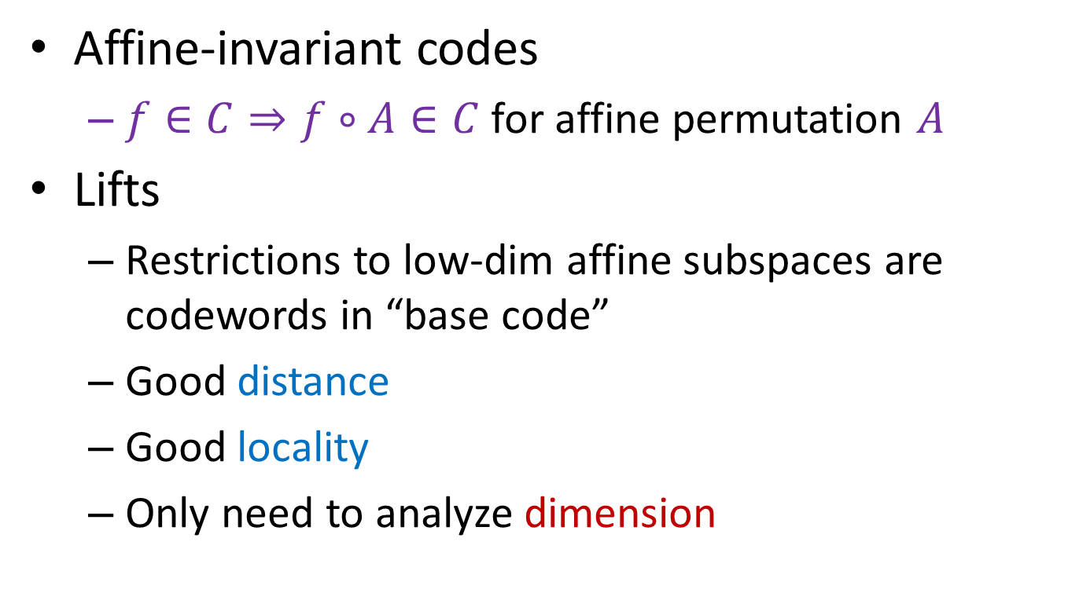
General results
Affine-invariant codes
  $f∈C⇒f∘A∈C$ for affine permutation $A$
Lifts
  Restrictions to low-dim affine subspaces are codewords in “base code”
  Good distance
  Good locality
  Only need to analyze dimension
Notes:
So in general, you can define this lifting operation for any affine-invariant code.
(What are affine-invariant codes?)
(What are lifts?)
Lifts get us good distance, locality, generically. Only need to analyze dimension for specific lifts.

Slide 25
Talk outline
Error correcting codes
Locally correctable codes
Our contributions
  New high rate LCCs
  General framework for “lifting” codes
  New lower bounds for Nikodym sets
Notes:
To start, here’s an outline of the talk.
First, I’ll briefly define error correcting codes, why they’re relevant, and give an example: Reed-Solomon code.
Next, I’ll define locally correctable codes, briefly describe why we care about them, and then give an example.
Right after that, I’ll dive into our paper’s contributions. I’ll start out with the main idea, give an analysis in a very special simple case, then just briefly state our general results, and if time permits I’ll talk about one neat application of our results to combinatorics.

Slide 26
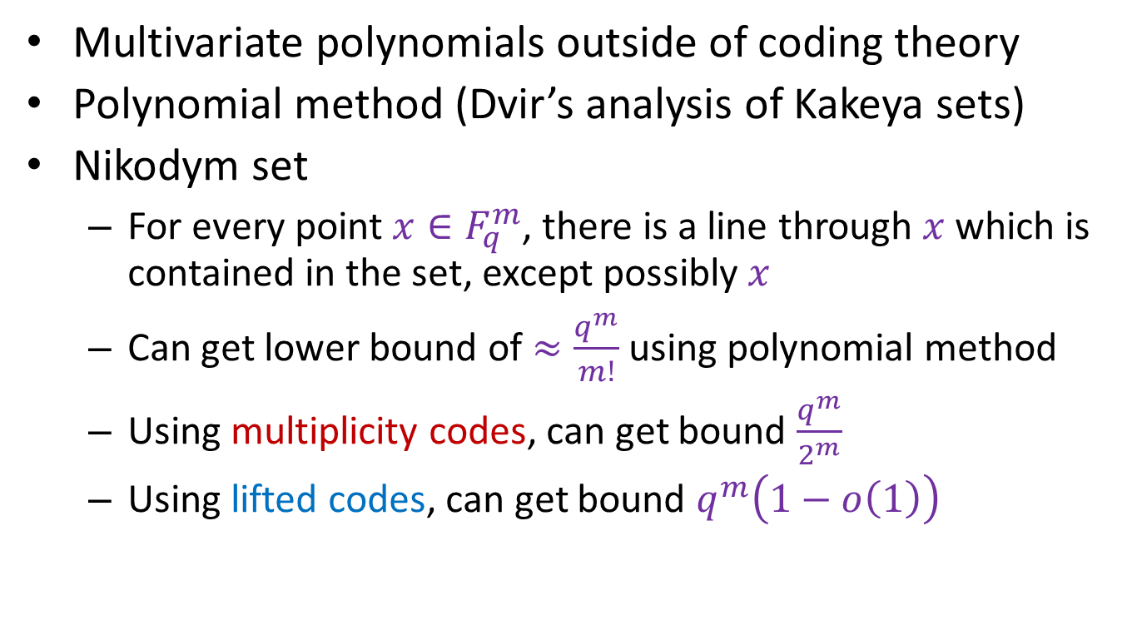
Application to Nikodym sets
Multivariate polynomials outside of coding theory
Polynomial method (Dvir’s analysis of Kakeya sets)
Nikodym set
  For every point $x∈F_{q}^{m}$, there is a line through $x$ which is contained in the set, except possibly $x$
  Can get lower bound of $≈\frac{q^{m}}{m!}$ using polynomial method
  Using multiplicity codes, can get bound $\frac{q^{m}}{2^{m}}$
  Using lifted codes, can get bound $q^{m}\left(1−o\left(1\right)\right)$
Notes:
Finally, I’ll end with a cute application to lower bounding the size of Nikdoym sets.
So multivariate polynomials, not surprisingly, are used outside of coding theory.
For example, can be used in so-called polynomial method, often used to bound size of combinatorial objects with certain structure.
Nikodym sets.

Slide 27
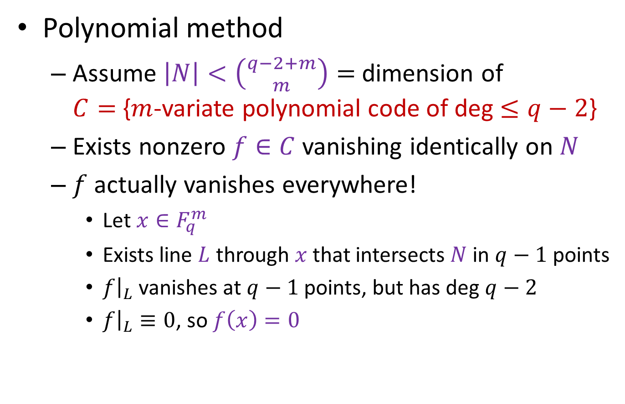
Application to Nikodym sets
Polynomial method
  Assume $\left|N\right|<\left({q−2+m \atop m}\right)=$ dimension of
  $C=${$m$-variate polynomial code of deg $≤q−2$}
  Exists nonzero $f∈C$ vanishing identically on $N$
  $f$ actually vanishes everywhere!
    Let $x∈F_{q}^{m}$
    Exists line $L$ through $x$ that intersects $N$ in $q−1$ points
    $f{\left.​\right|}_{L}$ vanishes at $q−1$ points, but has deg $q−2$
    $f{\left.​\right|}_{L}≡0$, so $f\left(x\right)=0$
Notes:
Finally, I’ll end with a cute application to lower bounding the size of Nikdoym sets.
So multivariate polynomials, not surprisingly, are used outside of coding theory.
For example, can be used in so-called polynomial method, often used to bound size of combinatorial objects with certain structure.
Nikodym sets.

Slide 28
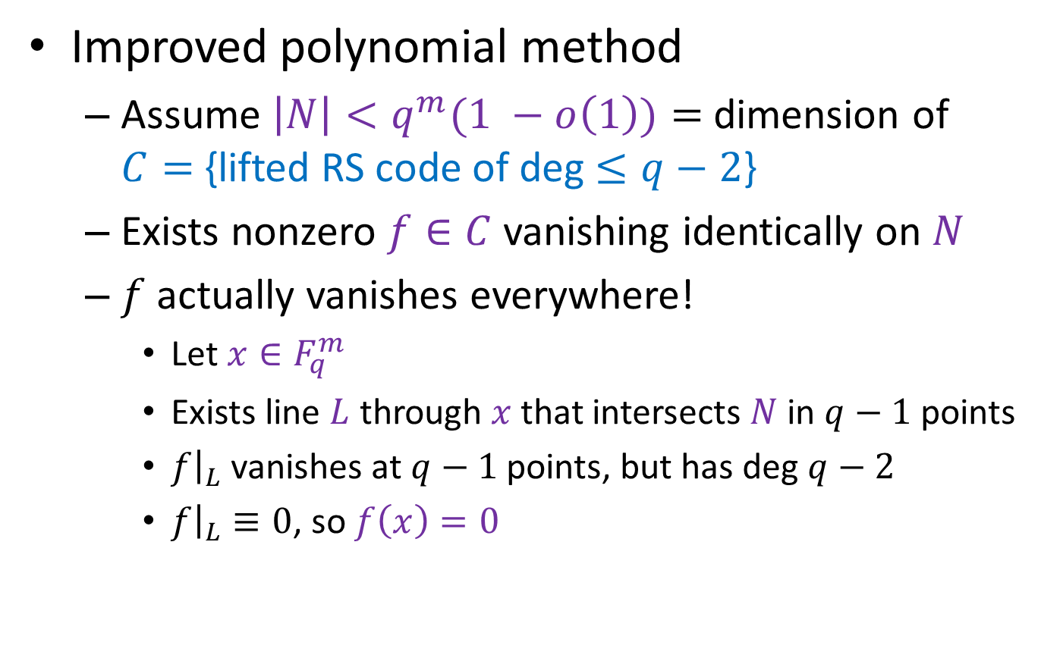
Application to Nikodym sets
Improved polynomial method
  Assume $\left|N\right|<q^{m}(1 −o\left(1\right))=$ dimension of
  $C=${lifted RS code of deg $≤q−2$}
  Exists nonzero $f∈C$ vanishing identically on $N$
  $f$ actually vanishes everywhere!
    Let $x∈F_{q}^{m}$
    Exists line $L$ through $x$ that intersects $N$ in $q−1$ points
    $f{\left.​\right|}_{L}$ vanishes at $q−1$ points, but has deg $q−2$
    $f{\left.​\right|}_{L}≡0$, so $f\left(x\right)=0$
Notes:
Finally, I’ll end with a cute application to lower bounding the size of Nikdoym sets.
So multivariate polynomials, not surprisingly, are used outside of coding theory.
For example, can be used in so-called polynomial method, often used to bound size of combinatorial objects with certain structure.
Nikodym sets.

Slide 29
Summary
Lifting
  Natural operation
  Build longer codes from short ones
  Preserve distance
  Gain locality
  Can get high rate
Applications outside of coding theory
  Improve polynomial method (e.g. Nikodym sets)
Notes:
Finally, I’ll end with a cute application to lower bounding the size of Nikdoym sets.
So multivariate polynomials, not surprisingly, are used outside of coding theory.
For example, can be used in so-called polynomial method, often used to bound size of combinatorial objects with certain structure.
Nikodym sets.

Slide 30
Thank you!

