Slide 1
Large Scale Machine Learning for Content Recommendation and Computational Advertising
Deepak Agarwal, Director, Machine Learning and Relevance Science, LinkedIn, USA
CSOI, Big Data Workshop, Waikiki, March 19th 2013

Slide 2
Disclaimer
Opinions expressed are mine and in no way represent the official position of LinkedIn
Material inspired by work done at LinkedIn and Yahoo!

Slide 3






Main Collaborators: several others at both Y! and LinkedIn
I won’t be here without them, extremely lucky to work with such talented individuals
Bee-Chung Chen
Liang Zhang
Bo Long
Paul Ogilvie
Jonathan Traupman
Nagaraj Kota

Slide 4
Item Recommendation problem
Arises in advertising and content
Serve the “best” items (in different contexts) to users in an automated fashion to optimize long-term business objectives
Business Objectives
User engagement, Revenue,…

Slide 5
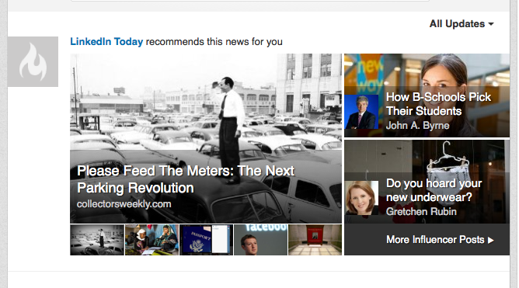
LinkedIn Today: Content Module
Objective: Serve content to maximize engagement
metrics like CTR (or weighted CTR)

Slide 6

Similar problem:
Content recommendation on Yahoo! front page
Today module
Recommend content links
(out of 30-40, editorially programmed)
4 slots exposed, F1 has maximum exposure
Routes traffic to other Y! properties
F1
F2
F3
F4
NEWS
Notes:
Important module, 100s of millions of user visits.

Slide 7
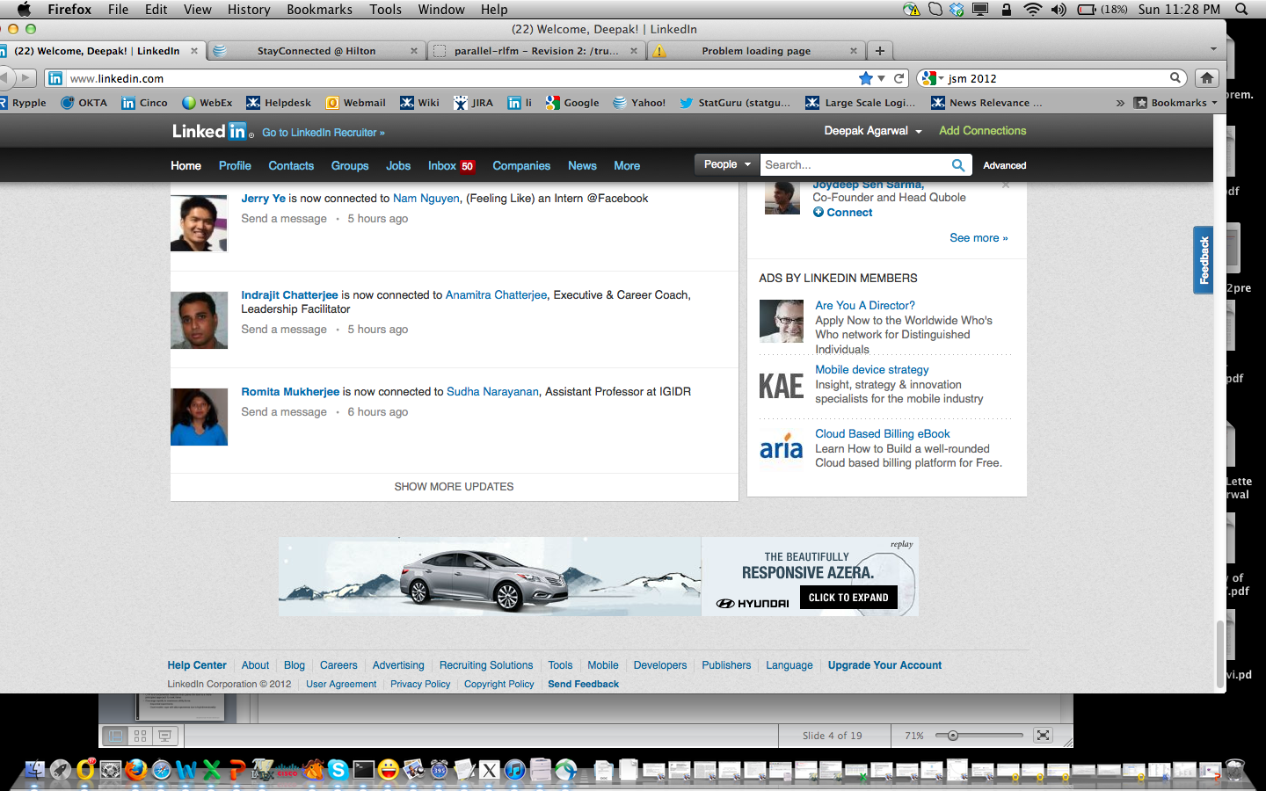
LinkedIn Ads: Match ads to users visiting LinkedIn

Slide 8

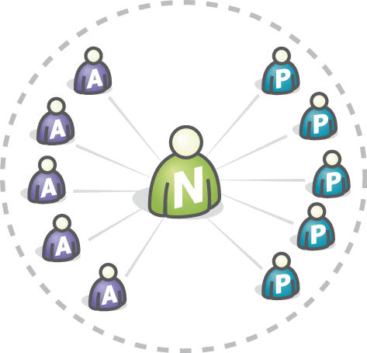

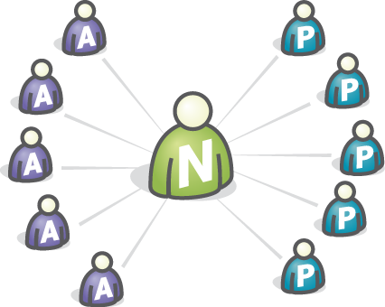

Right Media Ad Exchange: Unified Marketplace
Bids $0.75 via Network…
Bids $0.50
Bids $0.60
AdSense
Ad.com
Bids $0.65—WINS!
Has ad impression to sell --
AUCTIONS
… which becomes $0.45 bid
Match ads to page views on publisher sites

Slide 9
High level picture
Item Recommendation system: thousands
of computations in sub-seconds
Server
http request
User Interacts
e.g. click,
does nothing
Machine Learning
Models Updated in
Batch mode: e.g. once every
30 mins

Slide 10
High level overview: Item Recommendation System
User Info
Updated in batch:
Activity, profile
Pre-filter
SPAM,editorial,,..
Feature extraction
NLP, cllustering,..
Item Index
Id, meta-data
ML/
Statistical
Models
Score Items
P(Click), P(share),
Semantic-relevance
score,….
User-item interaction
Data: batch process
Rank Items:
sort by score (CTR,bid*CTR,..)
combine scores using Multi-obj optim,
Threshold on some scores,….

Slide 11
ML/Statistical models for scoring
Several days
Right Media Ad exchange
LinkedIn Ads
Item lifetime
Few days
ITEM
LIFETIME
LinkedIn Today
Yahoo! Front Page
Few hours
100
1000
100k
1M
100M
Number of items
Scored by ML
Traffic volume

Slide 12
Summary of Machine learning deployments
Yahoo! Front page Today Module (2008-2011): 300% improvement in click-through rates
  Similar algorithms delivered via a self-serve platform, adopted by several Yahoo! Properties (2011): Significant improvement in engagement across Yahoo! Network
Fully deployed on LinkedIn Today Module (2012): Significant improvement in click-through rates (numbers not revealed due to reasons of confidentiality)
Yahoo! RightMedia exchange (2012): Fully deployed algorithms to estimate response rates (CTR, conversion rates). Significant improvement in revenue (numbers not revealed due to reasons of confidentiality)
LinkedIn self-serve ads (2012): Tests on large fraction of traffic shows significant improvements. Deployment in progress.

Slide 13
Broad Themes
Curse of dimensionality
  Large number of observations (rows), large number of potential features (columns)
  Use domain knowledge and machine learning to reduce the “effective” dimension (constraints on parameters reduce degrees of freedom)
    I will give examples as we move along
We often assume our job is to analyze “Big Data” but we often have control on what data to collect through clever experimentation
  This can fundamentally change solutions
Think of computation and models together for Big data
Optimization: What we are trying to optimize is often complex, ML models to work in harmony with optimization
  Pareto optimality with competing objectives

Slide 14
Statistical Problem
Rank items (from an admissible pool) for user visits in some context to maximize a utility of interest
Examples of utility functions
  Click-rates (CTR)
  Share-rates (CTR* [Share|Click] )
  Revenue per page-view = CTR*bid (more complex due to second price auction)
CTR is a fundamental measure that opens the door to a more principled approach to rank items
Converge rapidly to maximum utility items
  Sequential decision making process (explore/exploit)

Slide 15

LinkedIn Today, Yahoo! Today Module:
Choose Items to maximize CTR
This is an “Explore/Exploit” Problem
Algorithm selects
item j from a set of candidates
User i
with
user features
(e.g., industry,
behavioral features,
Demographic features,……)
(i, j) : response y_{ij}
visits
(click or not)
Which item should we select?
• The item with highest predicted CTR
• An item for which we need data to
predict its CTR
Exploit
Explore
Notes:
During time interval t
User visits to the webpage
Some item inventory at our disposal
Decision problem: for each visit, select an item to display
each display generates a response
Goal: choose items to maximize expected clicks

Slide 16
The Explore/Exploit Problem (to maximize CTR)
Problem definition: Pick k items from a pool of N for a large number of serves to maximize the number of clicks on the picked items
Easy!? Pick the items having the highest click-through rates (CTRs)
But …
  The system is highly dynamic:
    Items come and go with short lifetimes
    CTR of each item may change over time
  How much traffic should be allocated to explore new items to achieve optimal performance ?
    Too little → Unreliable CTR estimates due to “starvation”
    Too much → Little traffic to exploit the high CTR items

Slide 17
Y! front Page Application
Simplify: Maximize CTR on first slot (F1)
Item Pool
  Editorially selected for high quality and brand image
  Few articles in the pool but item pool dynamic

Slide 18
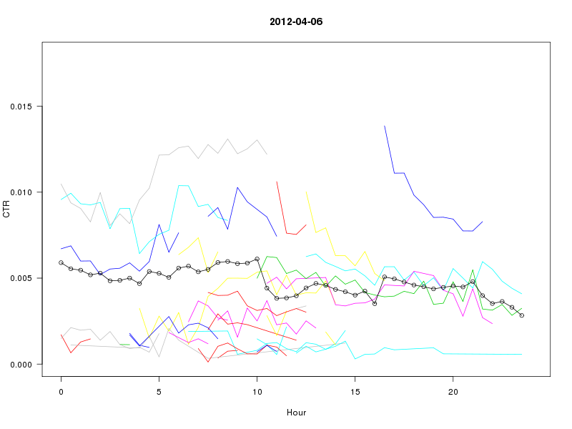
CTR Curves of Items on LinkedIn Today
CTR

Slide 19
Impact of repeat item views on a given user
Same user is shown an item multiple times (despite not clicking)

Slide 20
Simple algorithm to estimate most popular item with small but dynamic item pool
Simple Explore/Exploit scheme
  ε% explore: with a small probability (e.g. 5%), choose an item at random from the pool
  (100−ε)% exploit: with large probability (e.g. 95%), choose highest scoring CTR item
Temporal Smoothing
  Item CTRs change over time, provide more weight to recent data in estimating item CTRs
    Kalman filter, moving average
Discount item score with repeat views
  CTR(item) for a given user drops with repeat views by some “discount” factor (estimated from data)
Segmented most popular
  Perform separate most-popular for each user segment

Slide 21

Time series Model: Kalman filter
Dynamic Gamma-Poisson: click-rate evolves over time in a multiplicative fashion
Estimated Click-rate distribution at time t+1
  Prior mean:
  Prior variance:
High CTR items more adaptive

Slide 22

More economical exploration? Better bandit solutions
Consider two armed problem
p₁ >
p₂
(unknown payoff probabilities)
The gambler has 1000 plays, what is the best way to experiment ?
(to maximize total expected reward)
This is called the “multi-armed bandit” problem, have been studied for a long time.
Optimal solution: Play the arm that has maximum potential of being good
Optimism in the face of uncertainty

Slide 23
Item Recommendation: Bandits?
Two Items: Item 1 CTR= 2/100 ; Item 2 CTR= 250/10000
  Greedy: Show Item 2 to all; not a good idea
  Item 1 CTR estimate noisy; item could be potentially better
    Invest in Item 1 for better overall performance on average
  Exploit what is known to be good, explore what is potentially good
Item 2
Probability density
Item 1
CTR

Slide 24
Bayes 2x2: Two items, two intervals
now
N₀ views
N₁ views
time
t=0
t=1
Two time intervals t ∈ {0, 1}
Two items
  Certain item with CTR q₀ and q₁, Var(q₀) = Var(q₁) = 0
  Uncertain item i with CTR p₀ ~ Beta(a, b)
Interval 0: What fraction x of views to give to item i
  Give fraction (1−x) of views to the certain item
  Let c ~ Binomial(p₀, xN₀) denote the number of clicks on item i
Interval 1: Always give all the views to the better item
  Give all the views to item i iff E[p₁ | c, x] > q₁
Find x that maximizes the expected total number of clicks
Decide: x

Slide 25
Bayes 2x2 Optimal Solution
Estimated CTR
Certain item: q₀, q₁
Uncertain item:
Expected total number of clicks
E[#clicks] if we always show the certain item
Gain(x, q₀, q₁)
Gain of exploring the uncertain item using x
Gain(x, q₀, q₁) = Expected number of additional clicks if we explore the uncertain item with fraction x of views in interval 0, compared to a scheme that only shows the certain item in both intervals
Goal: argmax_{x} Gain(x, q₀, q₁)

Slide 26
Normal Approximation
Assume is approximately normal
After the normal approximation, the Bayesian optimal solution x can be found in time O(log N₀)

Slide 27
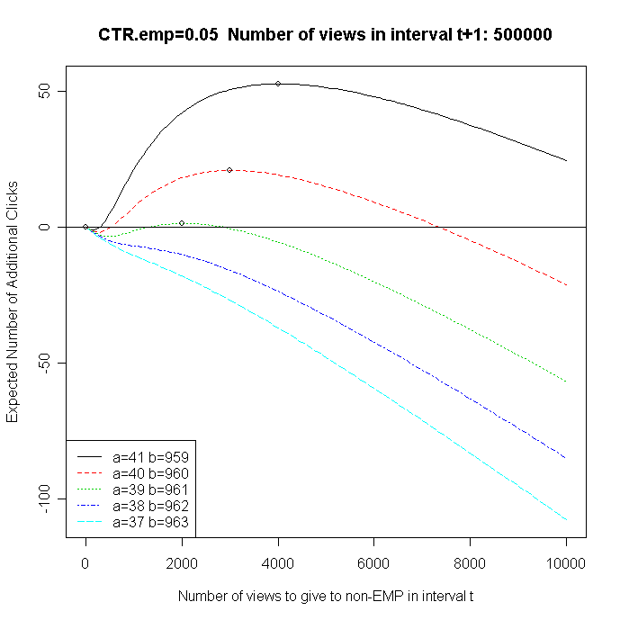
Gain as a function of xN₀
Gain
xN₀: Number of views given to the uncertain item at t=0

Slide 28
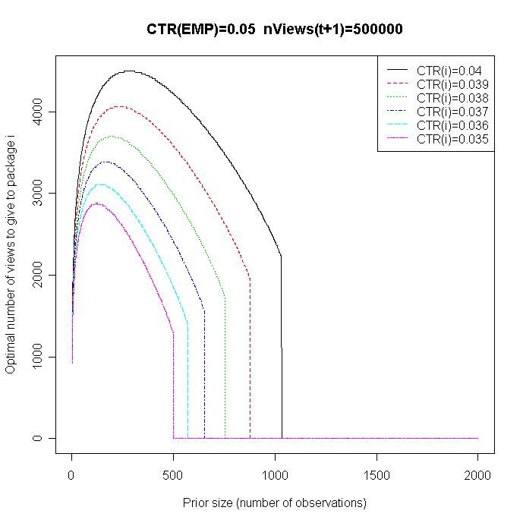
Optimal xN₀ as a function of prior size
Optimal number of views for exploring the uncertain item
Prior effective sample size of the uncertain item

Slide 29
Bayes K×2: K Items, Two Stages
now
N₀ views
N₁ views
time
K items
  p_{i,t}: CTR of item i, p_{i,t} ~ P(θ_{i,t}).
  Let θ_{t} = [θ_{1,t}, … θ_{K,t}]
  μ(θ_{i,t}) = E[p_{i,t}]
Stage 0: Explore each item to refine its CTR estimate
  Give x_{i,0}⋅N₀ page views to item i
Stage 1: Show the item with the highest estimated CTR
  Give x_{i,1}(θ₁)⋅N₁ page views to item i
Find x_{i,0} and x_{i,1}, for all i, that
  max {∑_{i} N₀⋅x_{i,0}⋅μ(θ_{i,0}) + ∑_{i} N₁⋅E_{θ1}[x_{i,1}(θ₁)⋅μ(θ_{i,1})]}
  subject to ∑_{i} x_{i,0} = 1, and ∑_{i} x_{i,1}(θ₁) = 1, for every possible θ₁
Prior θ₀
t=0
θ₁
t=1
Decide: x_{i,0}
Decide: x_{i,1}(θ₁)

Slide 30
Bayes K×2: Relaxation
Optimization problem
  max_{x} {∑_{i} N₀⋅x_{i,0}⋅μ(θ_{i,0}) + ∑_{i} N₁⋅E_{θ1}[x_{i,1}(θ₁)⋅μ(θ_{i,1})]}
  subject to ∑_{i} x_{i,0} = 1, and ∑_{i} x_{i,1}(θ₁) = 1, for every possible θ₁
Relaxed optimization
  max_{x} { ∑_{i} N₀⋅x_{i,0}⋅μ(θ_{i,0}) + ∑_{i} N₁⋅E_{θ1}[x_{i,1}(θ₁)⋅μ(θ_{i,1})] }
  subject to ∑_{i} x_{i,0} = 1 and E_{θ1}[ ∑_{i} x_{i,1}(θ₁) ] = 1
Apply Lagrange multipliers
  Separability: Fixing the multiplier values, the relaxed bayes K×2 problem now becomes K independent bayes 2×2 problems (where the CTR of the certain item is the multiplier)
  Convexity: The objective function is convex in the multipliers

Slide 31
General Case
The Bayes K×2 solution can be extended to including item lifetimes
Non-stationary CTR is tracked using dynamic models
  E.g., Kalman filter, down-weighting old observations
Extensions to personalized recommendation
  Segmented explore/exploit: Partition user-feature space into segments (e.g., by a decision tree), and then explore/exploit most popular stories for each segment
  First cut solution to Bayesian explore/exploit with regression models

Slide 32
Experimental Results
One month Y! Front Page data
  1% bucket of completely randomized data
  This data is used to provide item lifetimes, the number page view in each interval, and the CTR of each item over time, based on which we simulate clicks
  16 items per interval
Performance metric
  Let S denote a serving scheme
  Let Opt denote the optimal scheme given the true CTR of each item
  Regret = (#click(Opt) − #clicks(S)) / #clicks(Opt)

Slide 33
Y! Front Page data (16 items per interval)

Slide 34
More Details on the Bayes Optimal Solution
Agarwal, Chen, Elango. Explore-Exploit Schemes for Web Content Optimization, ICDM 2009
  (Best Research Paper Award)

Slide 35
Explore/Exploit with large item pool/personalized recommendation
Obtaining optimal solution difficult in practice
Heuristic that is popularly used:
  Reduce dimension through a supervised learning approach that predicts CTR using various user and item features for “exploit” phase
  Explore by adding some randomization in an optimistic way
Widely used supervised learning approach
  Logistic Regression with smoothing, multi-hierarchy smoothing
Exploration schemes
  Epsilon-greedy, restricted epsilon-greedy, Thompson sampling, UCB

Slide 36
DATA
CONTEXT
Select
Item j with
item covariates Z_{j}
(keywords, content categories, ...)
User i
(User, context) covariates x_{it}
(profile information, device id,
first degree connections, browse information,…)
(i, j) : response y_{ij}
visits
(click/no-click)
Notes:
During time interval t
User visits to the webpage
Some item inventory at our disposal
Decision problem: for each visit, select an item to display
each display generates a response
Goal: choose items to maximize expected clicks

Slide 37
Illustrate with Y! front Page Application
Simplify: Maximize CTR on first slot (F1)
Article Pool
  Editorially selected for high quality and brand image
  Few articles in the pool but article pool dynamic
We want to provide personalized recommendations
  Users with many prior visits see recommendations “tailored” to their taste, others see the best for the “group” they belong to

Slide 38
Types of user covariates
Demographics, geo:
  Not useful in front-page application
Browse behavior: activity on Y! network ( x_{it} )
  Previous visits to property, search, ad views, clicks,..
  This is useful for the front-page application
Latent user factors based on previous clicks on the module ( u_{i} )
  Useful for active module users, obtained via factor models(more later)
    Teases out module affinity that is not captured through other user information, based on past user interactions with the module

Slide 39
Approach: Online + Offline
Offline computation
  Intensive computations done infrequently (once a day/week) to update parameters that are less time-sensitive
Online computation
  Lightweight computations frequent (once every 5-10 minutes) to update parameters that are time-sensitive
  Exploration also done online

Slide 40
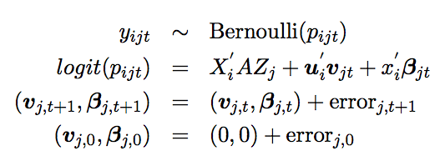

Online computation: per-item online logistic regression
For item j, the state-space model is
Item coefficients are update online via Kalman-filter

Slide 41
Explore/Exploit
Three schemes (all work reasonably well for the front page application)
  epsilon-greedy: Show article with maximum posterior mean except with a small probability epsilon, choose an article at random.
  Upper confidence bound (UCB): Show article with maximum score, where score = post-mean + k. post-std
  Thompson sampling: Draw a sample (v,β) from posterior to compute article CTR and show article with maximum drawn CTR

Slide 42
Computing the user latent factors( the u’s)
Computing user latent factors
  This is computed offline once a day using retrospective (user,item) interaction data for last X days (X = 30 in our case)
  Computations are done on Hadoop

Slide 43
Factorization Methods
Matrix factorization
  Models each user/item as a vector of factors (learned from data)
rating that user i
gives item j
K << M, N
M = number of users
N = number of items
⇔
factor vector of user i
factor vector of item j
user i
u_{i}’
item j
u_{i} = (1,2)
user i
V
item j
v_{j}
v_{j} = (1, -1)
Y
U

Slide 44
How to Handle Cold Start?
Matrix factorization provides no factors for new users/items
Simple idea [KDD’09]
  Predict their factor values based on given features (not learnt)
    For new user i, predict u_{i} based on x_{i} (user feature vector)
u_{i} ~ G x_{i}
Example features
isFemale
isAge0-20
…
isInBayArea
…
G
factor vector
of user i
regression
coefficient matrix
x_{i}
: feature vector of user i

Slide 45
Full Specification of RLFM
Regression-based Latent Factor Model
rating that user i
gives item j
x_{i} = feature vector of user i
x_{j} = feature vector of item j
x_{ij} = feature vector of (i, j)
Bias of user i:
Popularity of item j:
Factors of user i:
Factors of item j:
b, g, d, G, D are regression functions
Any regression model can be used here!!

Slide 46
Regression based Latent Factor Model
regression weight matrix
user/item-specific correction terms (learnt from data)

Slide 47
Role of shrinkage (consider Guassian for simplicity)
For new user/article, factor estimates based on covariates
For old user, factor estimates
Linear combination of prior regression function and user feedback on items

Slide 48
Estimating the Regression function via EM
Maximize
Integral cannot be computed in closed form,
approximated by Monte Carlo using Gibbs Sampling
For logistic, we use ARS (Gilks and Wild) to sample the latent factors within the Gibbs sampler

Slide 49
Scaling to large data on via distributed computing (e.g. Hadoop)
Randomly partition by users
Run separate model on each partition
  Care taken to initialize each partition model with same values, constraints on factors ensure “identifiability of parameters” within each partition
Create ensembles by using different user partitions, average across ensembles to obtain estimates of user factors and regression functions
  Estimates of user factors in ensembles uncorrelated, averaging reduces variance

Slide 50
Data Example
1B events, 8M users, 6K articles
Offline training produced user factor u_{i}
Our Baseline: logistic without user feature u_{i}
Overall click lift by including u_{i}: 9.7%,
Heavy users (> 10 clicks last month): 26%
Cold users (not seen in the past): 3%

Slide 51
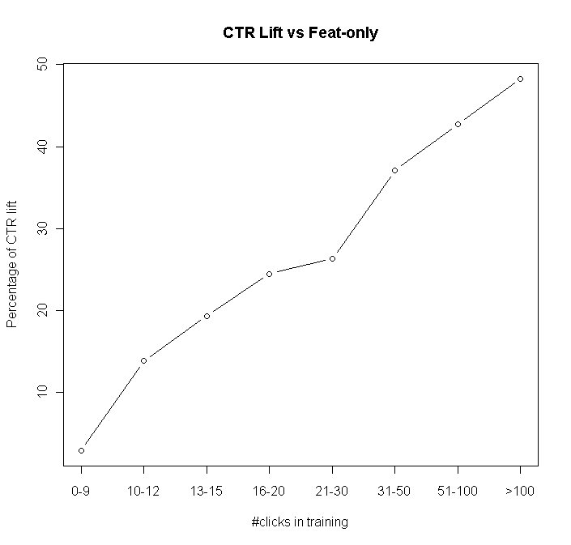
Click-lift for heavy users
CTR LIFT Relative to NO u_{i}
Logistic Model

Slide 52

Multiple Objectives: An example in Content Optimization
Recommender
EDITORIAL
AD SERVER
DISPLAY ADVERTISING Revenue
Clicks on FP links influence downstream supply distribution
content
SPORTS
NEWS
Downstream engagement
(Time spent)
OMG
FINANCE

Slide 53
Multiple Objectives
What do we want to optimize?
One objective: Maximize clicks
But consider the following
  Article 1: CTR=5%, utility per click = 5
  Article 2: CTR=4.9%, utility per click=10
    By promoting 2, we lose 1 click/100 visits, gain 5 utils
If we do this for a large number of visits --- lose some clicks but obtain significant gains in utility?
  E.g. lose 5% relative CTR, gain 40% in utility (e.g revenue, time spent)

Slide 54
An example of Multi-Objective Optimization
(Details: Agarwal et al, SIGIR 2012)
Lagrange multiplier

Slide 55

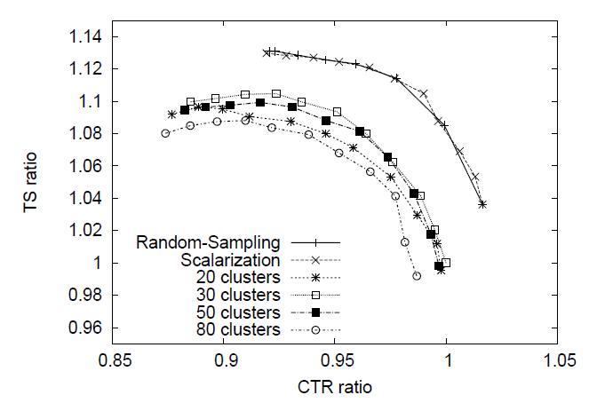
Example: Yahoo! Front Page Application
Personalized

Slide 56
Now to Computational Advertising
Background on Advertising
Background on Display Advertising
  Guaranteed Delivery : Inventory sold in futures market
  Spot Market --- Ad-exchange, Real-time bidder (RTB)
Statistical Challenges with examples

Slide 57
The two basic forms of advertising
Brand advertising
  creates a distinct favorable image
Direct-marketing
  Advertising that strives to solicit a "direct response”: buy, subscribe, vote, donate, etc, now or soon

Slide 58
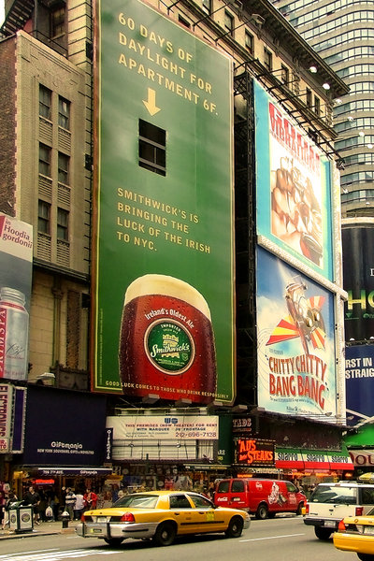
Brand advertising …

Slide 59
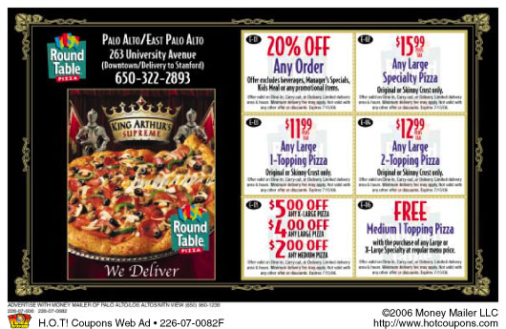
Sometimes both Brand and Performance

Slide 60
Web Advertising
There are lots of ads on the web …
100s of billions of advertising dollars
spent online per year (e-marketer)

Slide 61
Online advertising: 6000 ft. Overview
Pick ads
Ads
Advertisers
Content
Ad Network
User
Examples:
Yahoo, Google, MSN, RightMedia, …
Content Provider
Notes:
This only shows one scenario; that of content match. Let’s add Sponsored Search (Replace Content with Query) and
Have a new slide for display advertising. This also does not provide info for the revenue model (shall we add it here or later).

Slide 62
Web Advertising: Comes in different flavors
Sponsored (“Paid” ) Search
  Small text links in response to query to a search engine
Display Advertising
  Graphical, banner, rich media; appears in several contexts like visiting a webpage, checking e-mails, on a social network,….
  Goals of such advertising campaigns differ
    Brand Awareness
    Performance (users are targeted to take some action, soon)
      More akin to direct marketing in offline world

Slide 63
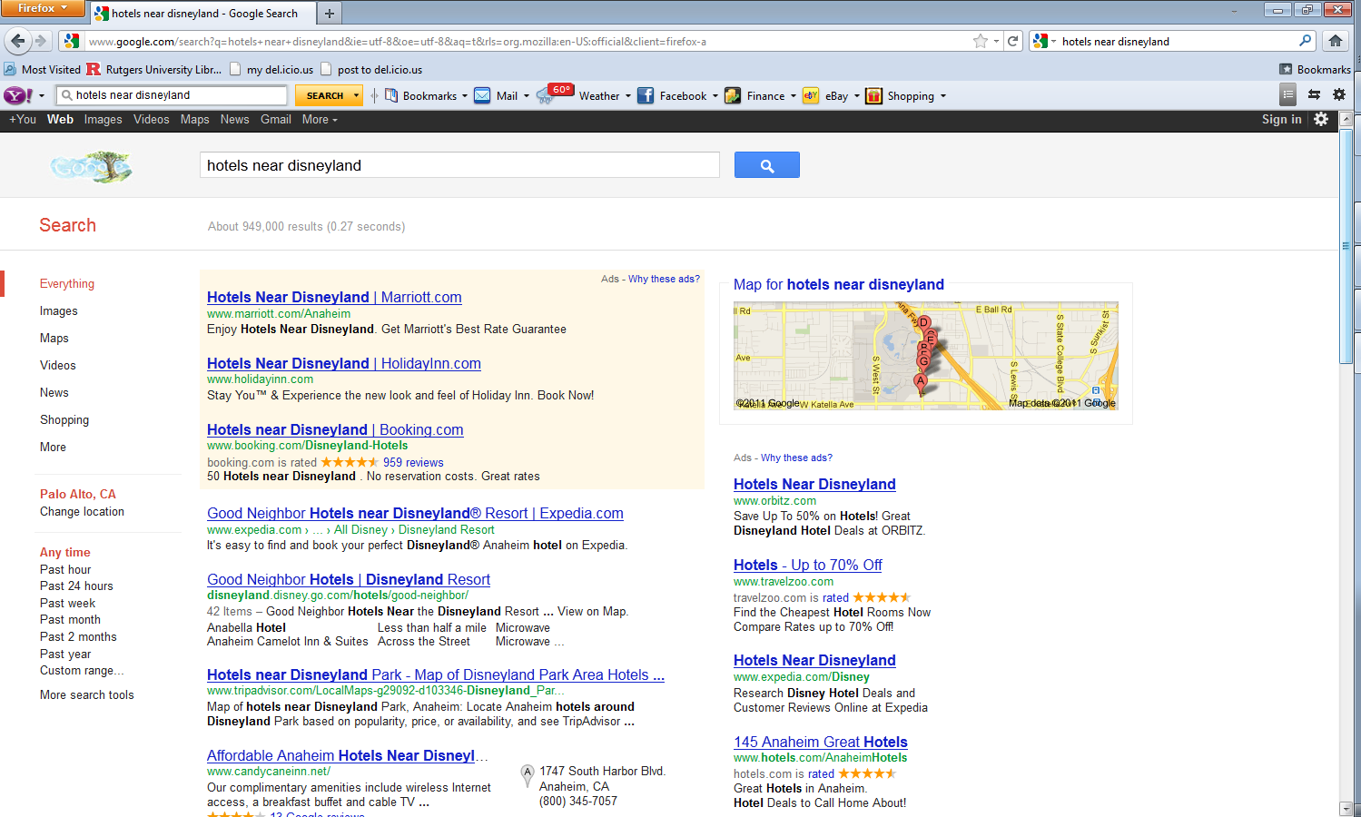
Paid Search: Advertise Text Links

Slide 64
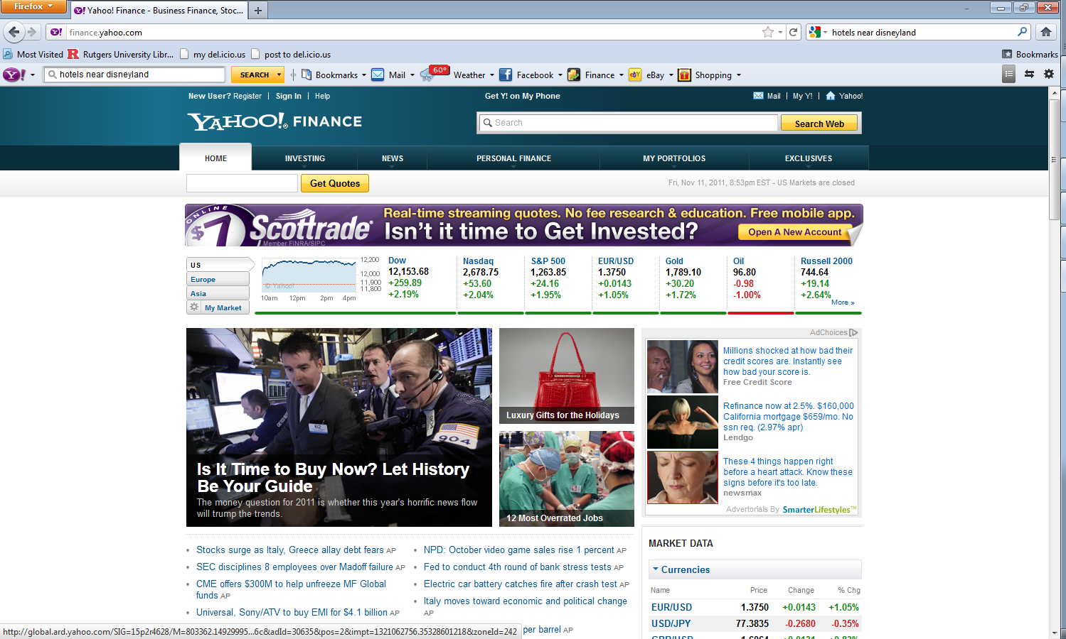
Display Advertising: Examples

Slide 65
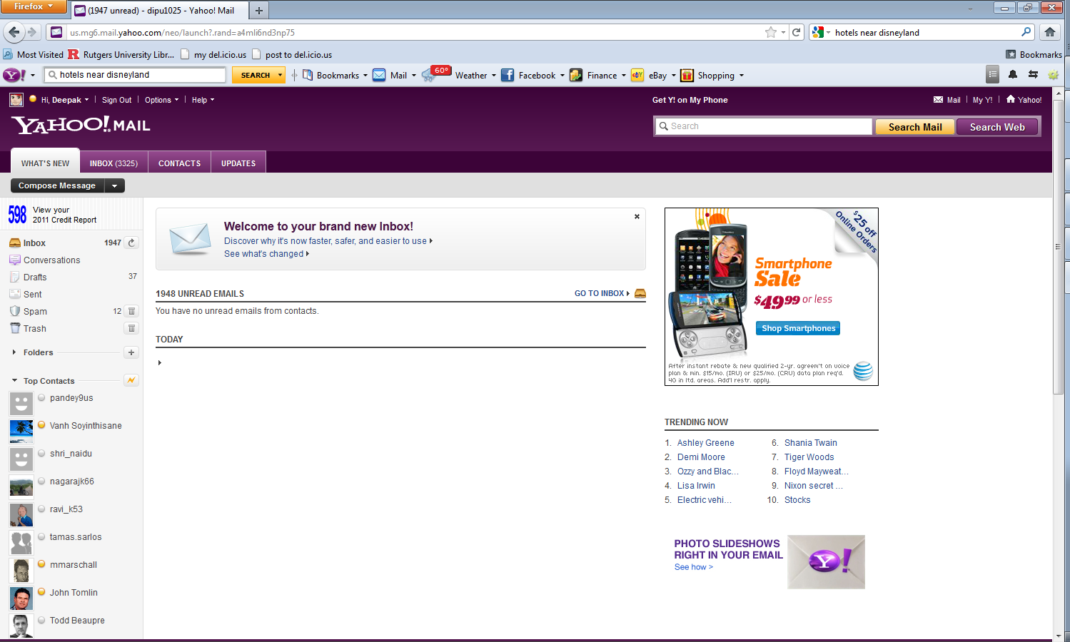
Display Advertising: Examples

Slide 66
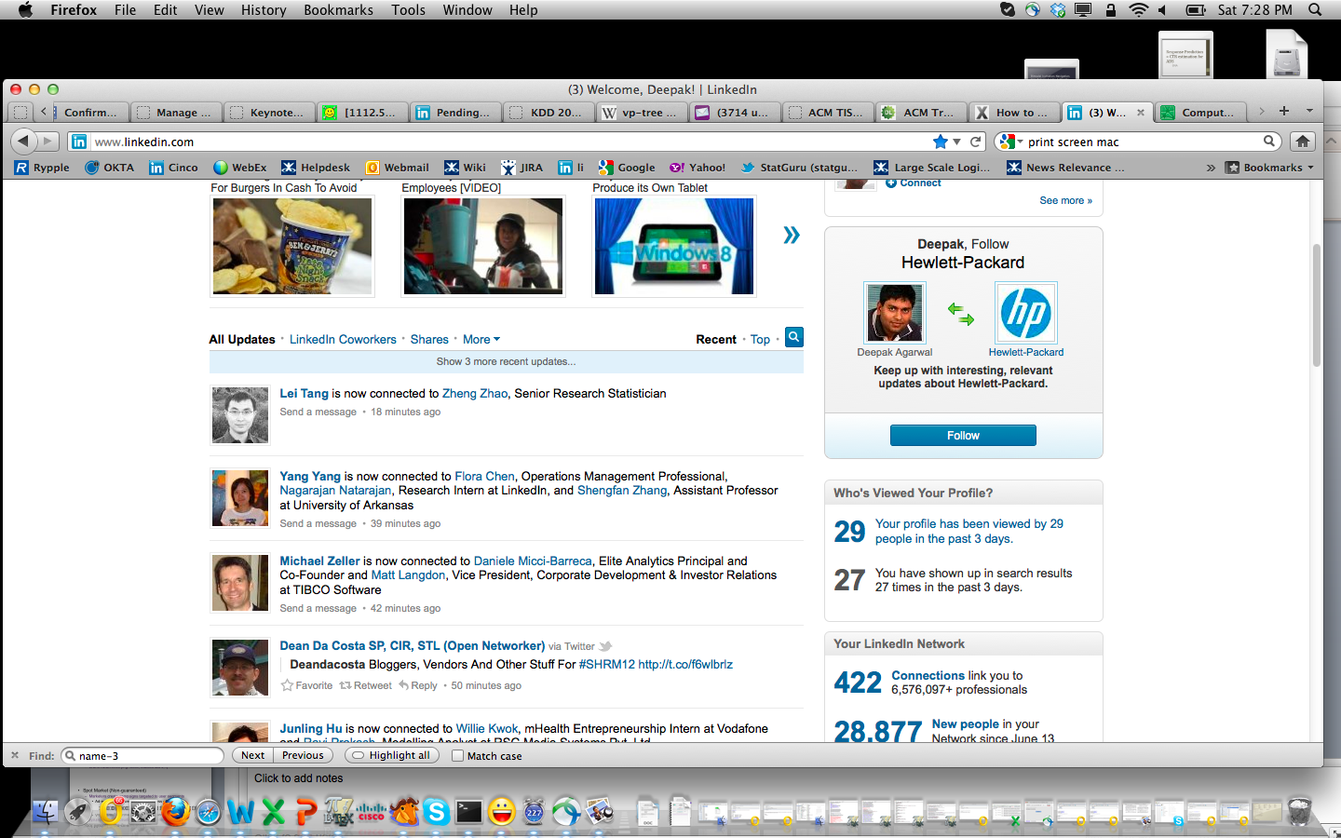
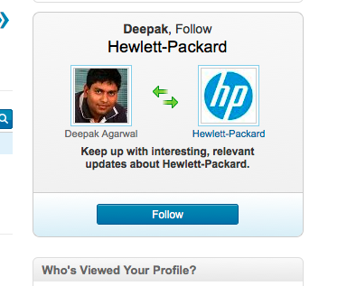
LinkedIn company follow ad

Slide 67
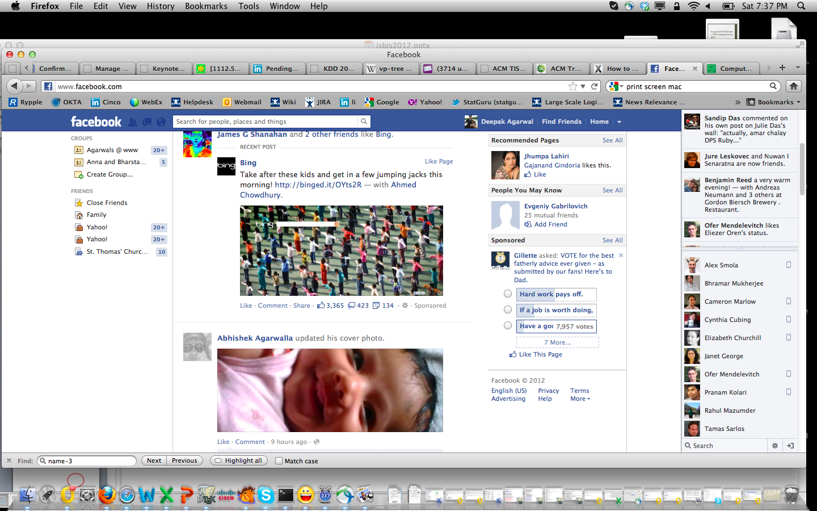
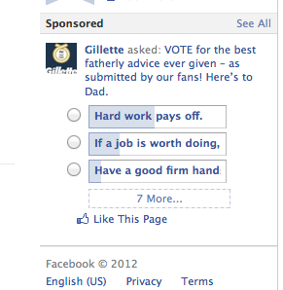
Brand Ad on Facebook

Slide 68
Paid Search Ads versus Display Ads
Paid Search
Display
Context (Query) important
Small text links
Performance based
  Clicks, conversions
Advertisers can cherry-pick instances
Reaching desired audience
Graphical, banner, Rich media
  Text, logos, videos,..
Hybrid
  Brand, performance
Bulk buy by marketers
  But things evolving
    Ad exchanges, Real-time bidder (RTB)

Slide 69
Display Advertising Models
Futures Market (Guaranteed Delivery)
  Brand Awareness (e.g. Gillette, Coke, McDonalds, GM,..)
Spot Market (Non-guaranteed)
  Marketers create targeted campaigns
    Ad-exchanges have made this process efficient
      Connects buyers and sellers in a stock-market style market
    Several portals like LinkedIn and Facebook have self-serve systems to book such campaigns

Slide 70
Guaranteed Delivery (Futures Market)
Revenue Model: Cost per ad impression(CPM)
  Ads are bought in bulk targeted to users based on demographics and other behavioral features
    GM ads on LinkedIn shown to “males above 55”
    Mortgage ad shown to “everybody on Y! ”
  Slots booked in advance and guaranteed
    “e.g. 2M targeted ad impressions Jan next year”
    Prices significantly higher than spot market
      Higher quality inventory delivered to maintain mark-up

Slide 71
Measuring effectiveness of brand advertising
  "Half the money I spend on advertising is wasted; the trouble is, I don't know which half." - John Wanamaker
Typically
  Number of visits and engagement on advertiser website
  Increase in number of searches for specific keywords
  Increase in offline sales in the long-run
How?
  Randomized design (treatment = ad exposure, control = no exposure)
  Sample surveys
  Covariate shift (Propensity score matching)
Several statistical challenges (experimental design, causal inference from observational data, survey methodology)

Slide 72
Guaranteed delivery
Fundamental Problem: Guarantee impressions (with overlapping inventory)
Predict Supply
Incorporate/Predict Demand
Find the optimal allocation
  subject to supply and demand constraints
Young
US
4
2
1
3
2
2
1
s_{i}
LI Homepage
Female
x_{ij}
d_{j}
Notes:
72
Gives rise to an allocation problem: who should supply to what contracts? Several feasible solutions; which one is best? Find the optimal one given demand and supply?

Slide 73
Example
Supply Pools
Young
US
US, Y, nF
Supply = 2
Price = 1
Demand
4
2
1
3
2
2
US & Y
(2)
1
US, Y, F
Supply = 3
Price = 5
LI Homepage
Female
Supply Pools
How should we distribute impressions from the supply pools to satisfy this demand?

Slide 74
Example (Cherry-picking)
Cherry-picking:
Fulfill demands at least cost
Supply Pools
US, Y, nF
Supply = 2
Price = 1
Demand
(2)
US & Y
(2)
US, Y, F
Supply = 3
Price = 5
How should we distribute impressions from the supply pools to satisfy this demand?

Slide 75
Example (Fairness)
Cherry-picking:
Fulfill demands at least cost
Fairness:
Equitable distribution of available supply pools
Agarwal and Tomlin, INFORMS, 2010
Ghosh et al, EC, 2011
Supply Pools
US, Y, nF
Supply = 2
Cost = 1
Demand
(1)
US & Y
(2)
(1)
US, Y, F
Supply = 3
Cost = 5
How should we distribute impressions from the supply pools to satisfy this demand?

Slide 76
The optimization problem
Maximize Value of remnant inventory (to be sold in spot market)
  Subject to “fairness” constraints (to maintain high quality of inventory in the guaranteed market)
  Subject to supply and demand constraints
Can be solved efficiently through a flow program
Key statistical input: Supply forecasts

Slide 77
Various component of a Guaranteed Delivery system

Slide 78
OFFLINE COMPONENTS
Field Sales
Team, sells
Products
(segments)
Advertisers
Supply forecasts
Admission Control
should the new contract request be admitted?
(solve VIA LP)
Contracts signed,
Negotiations involved
Demand forecasts & booked inventory
Pricing
Engine

Slide 79
ONLINE SERVING
Near Real Time Optimization
On Line Ad Serving
Stochastic Supply
Allocation Plan
(from LP)
Opportunity
Contract Statistics
Stochastic Demand
Ads

Slide 80
High dimensional Forecasting
Supply forecasts important input required both at booking time (admission control) and serving time
Problem: Given historical time series data in a high dimensional space (trillions of combinations), forecast number of visits for an arbitrary query for a future time horizon
  E.g.: Male visits from Hawaii on LinkedIn next year in January
Challenging statistical problem
  Curse of dimensionality & massive data
  arbitrary query subset
  latency constraints
    Forecasting High-dimensional data, Agarwal et al, SIGMOD, 2011

Slide 81
Spot Market

Slide 82
Unified Marketplace (Ad exchange)
Publishers, Ad-networks, advertisers participate together in a singe exchange
Clearing house for publishers, better ROI for advertisers, better liquidity, buying and selling is easier
Advertisers
Sports Accessories
Online Education
Car Insurance
submit ads to the network
Intermediaries
display ads for the network
www.cars.com
www.elearners.com
www.sportsauthority.com
Publishers

Slide 83


Overview: The Open Exchange
Bids $0.75 via Network…
Bids $0.50
Bids $0.60
AdSense
Ad.com
Bids $0.65—WINS!
Has ad impression to sell --
AUCTIONS
… which becomes $0.45 bid
Transparency and value

Slide 84
Unified scale: Expected CPM
Campaigns are CPC, CPA, CPM
They may all participate in an auction together
Converting to a common denomination
  Requires absolute estimates of click-through rates (CTR) and conversion rates.
  Challenging statistical problem

Slide 85

Recall problem scenario on Ad-exchange
Response rates
(click, conversion,
ad-view)
Bids
conversion
Auction
Statistical
model
Select argmax f(bid, rate)
Click
Ads
Pick best ads
Advertisers
Page
Ad Network
User
Publisher
Notes:
This only shows one scenario; that of content match. Let’s add Sponsored Search (Replace Content with Query) and
Have a new slide for display advertising. This also does not provide info for the revenue model (shall we add it here or later).

Slide 86
Statistical Issues in Conducting Auctions
f(bid, rate) (e.g. f = bid*rate)
  Response rates (Click-rate, conversion rate) to be estimated
High dimensional regression problem
Response obtained via interaction among few heavy-tailed categorical variables (opportunity and ad)
  Total levels for categorical variables : millions and changes over time
  Response rate: very small (e.g. 1 in 10k or less)
Opportunity=(publisher, context, user)
ad

Slide 87
Data for Response Rate Estimation
Features
  User X_{u} : Declared, Inferred (e.g. based on tracking, could have significant measurement error) (x_{ud}, x_{uf})
  Publisher X_{i}: Characteristics of publisher page
    (e.g. Business news page? Related to Medicine industry? Other covariates based on NLP of landing page)
  Context X_{c}: location where ad was shown,device, etc.
  Ad X_{j}: advertiser type, campaign keywords, NLP on ad landing page

Slide 88
Building a good predictive model
We can build f(X_{u}, X_{i,} X_{c,} X_{j} ) to predict CTR
  Interactions important, high-dimensional regression problem
  Methods used (e.g. logistic regression with L2 penalty)
    Billions of observations, hundreds of millions of covariates (sparse)
Is this enough? Not quite
  Covariates not enough to capture interactions, modeling residual interactions at resolution of ads/campaign important
    Ephemeral features, warm start
  Variable dimension: New ads/campaigns routinely introduced, old ones disappear (runs out of budget)

Slide 89
Factor Model to reduce dimension of parameters
Model Fitting based on an MCEM algorithm
Scales up in a distributed computing environment
More details: Agarwal et al, WWW 2012

Slide 90
Exploiting hierarchical structure
Agarwal et al, KDD 2007, 2010, 2011

Slide 91
Model Setup
baseline
P_{o,j} =
f(
)
λ_{ij}
X_{o}
x_{j}
residual
i
j
E_{ij} = ∑_{(u,c)} f(x_{i}, x_{u},x_{c} x_{j}) (Expected clicks)
S_{ij} ~ Poisson(E_{ij} λ_{ij})
,

Slide 92
Hierarchical Smoothing of residuals
Assuming two hierarchies (Publisher and advertiser)
Advertiser
Pub type
Account-id
Pub
campaign
cell z = (i,j)
Ad
(S_{z}, E_{z}, λ_{z})
Advertiser
Pub type
Account-id
Pub
campaign
z
Ad
(S_{z}, E_{z}, λ_{z})

Slide 93
Spike and Slab prior on random effects
Prior on node states: IID Spike and Slab prior
  Encourage parsimonious solutions
    Several cell states have residual of 1
  Agarwal and Kota, KDD 2010, 2011

Slide 94
Accuracy: Average test log-likelihood
CC
COARSE: Only Advertiser id in the model
FINE: Only ad-id in the model
Log 1,II,III: Different variations of logistic

Slide 95
Model Parsimony
With spike and slab prior
Parsimony
data | #Parameters | #selected
CLICK | ~16.5M | 150K

Slide 96
Computation at serve time
At serve time (when a user visits a website), thousands of qualifying ads have to be scored to select the top-k within a few milliseconds
Accurate but computationally expensive models may not satisfy latency requirements
  Parsimony along with accuracy is important
Typical solution used: two-phase approach
  Phase 1: simpler but fast to compute model to narrow down the candidates
  Phase 2: more accurate but more expensive model to select top-k
Important to keep this aspect in mind when building models
  Model approximation: Langford et al, NIPS 08, Agarwal et al, WSDM 2011

Slide 97
Need uncertainty estimates
Goal is to maximize revenue
  Unnecessary to build a model that is accurate everywhere, more important to be accurate for things that matter!
  E.g. Not much gain in improving accuracy for low ranked ads
Explore/exploit
  Spend more experimental budget on ads that appear to be potentially good (even if the estimated mean is low due to small sample size)

Slide 98
Advanced advertising Eco-System
New technologies
  Real-time bidder: change bid dynamically, cherry-pick users
      Track users based on cookie information
      New intermediaries: sell user data (BlueKai,….)
  Demand side platforms: single unified platform to buy inventories on multiple ad-exchanges
  Optimal bidding strategies for arbitrage

Slide 99
To Summarize
Display advertising is an evolving and multi-billion dollar industry that supports a large swath of internet eco-system
Plenty of statistical challenges
  High dimensional forecasting that feeds into optimization
  Measuring brand effectiveness
  Estimating rates of rare events in high dimensions
  Sequential designs (explore/exploit) requires uncertainty estimates
  Constructing user-profiles based on tracking data
  Targeting users to maximize performance
  Optimal bidding strategies in real-time bidding systems
New challenges
  Mobile ads, Social ads
At LinkedIn
  Job Ads, Company follows, Hiring solutions

Slide 100
Training Logistic Regression
Too much data to fit on a single machine
  Billions of observations, millions of features
A Naïve approach
  Partition the data and run logistic regression for each partition
  Take the mean of the learned coefficients
  Problem: Not guaranteed to converge to the model from single machine!
Alternating Direction Method of Multipliers (ADMM)
  Boyd et al. 2011 (based on earlier work from the 70s)
  Set up a constraint that each partition’s coefficient = global consensus
  Solve the optimization problem using Lagrange Multipliers

Slide 101
Large Scale Logistic Regression via ADMM
Iteration 1
BIG DATA
Partition 1
Partition 2
Partition 3
Partition K
Logistic
Regression
Logistic
Regression
Logistic
Regression
Logistic
Regression
Consensus
Computation

Slide 102
Large Scale Logistic Regression via ADMM
Iteration 1
BIG DATA
Partition 1
Partition 2
Partition 3
Partition K
Logistic
Regression
Logistic
Regression
Logistic
Regression
Logistic
Regression
Consensus
Computation

Slide 103
Large Scale Logistic Regression via ADMM
Iteration 2
BIG DATA
Partition 1
Partition 2
Partition 3
Partition K
Logistic
Regression
Logistic
Regression
Logistic
Regression
Logistic
Regression
Consensus
Computation

Slide 104
Convergence Study (Avg Optimization Objective Score on Test)

Slide 105
Large Scale Logistic Regression via ADMM
Notation:
  (A, b): data
  x_{i}: Coefficients for partition i
  z: Consensus coefficient vector
  r(z): penalty component such as ||z||₂
Problem
ADMM
Per-partition
Regression
Consensus
Computation

Slide 106
ADMM in practice: Lessons learnt
Lessons and Improvements
  Initialization is very important
    Use the mean of the partitions’ coefficients to start
    Reduces number of iterations by about 50% relative to random start
  Adaptive step size (learning rate)
    Exponential decay of learning rate balances global convergence with exploration within partitions
  Together, these optimizations speed-up training time by 4x

Slide 107
Solution strategy for item-recommendation problem
Fit large scale logistic regression model on historic data to obtain estimates of feature interactions (cold-start estimates)
  Caution: Include the fine-grained id-features (old items seen in the past) in the model to avoid bias in cold-start estimates
Warm-start model updated frequently (e.g. every few hours, minutes) using cold-start estimates as offset
  Dimension reduction: Factor models, multi-hierarchy smoothing,..
The cold-start model is updated more infrequently (e.g. once a day)
Introduce exploration (to avoid item starvation) by using heuristics like epsilon-greedy, Thompson sampling, UCB

Slide 108
Summary
Large scale Machine Learning plays an important role in computational advertising and content recommendation
Several such problems can be cast as explore/exploit tradeoff
Estimating interactions in high-dimensional sparse data via supervised learning important for efficient exploration and exploitation
Scaling such models to Big Data is a challenging statistical problem
Combining offline + online modeling with classical explore/exploit algorithm is a good practical strategy

Slide 109
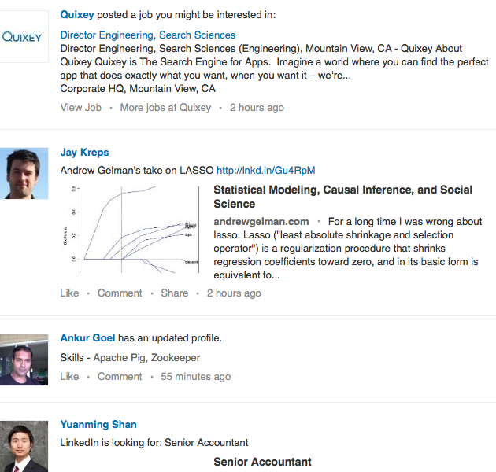
Feed Recommendation

Slide 110
Feed Recommendation
Content liquidity depends on the graph (Social)
Content can also be pushed by a publisher (LinkedIn)
We can slot ads (Advertising)
Multiple response types (clicks, shares, likes, comments)
Goal: Maximize Revenue and Engagement (Best Tradeoff)

Slide 111
Other challenges
3Ms: Multi-response, Multi-context modeling to optimize Multiple Objectives
  Multi-response: Clicks, share, comments, likes,.. (preliminary work at CIKM 2012)
  Multi-context: Mobile, Desktop, Email,..(preliminary work at SIGKDD 2011)
  Multi-objective: Tradeoff in engagement, revenue, viral activities
    Preliminary work at SIGIR 2012, SIGKDD 2011
Scaling model computations at run-time to avoid latency issues
  Predictive Indexing (preliminary work at WSDM 2012)

