Slide 1
Center for Science of Information
Center for Science of Information:
From Information Reduction to
Knowledge Extraction
Big Data Workshop
Waikiki, March 18-20, 2013

Slide 2
Mission and Center Goals
Advance science and technology through a new quantitative understanding of the representation, communication and processing of information in biological, physical, social and engineering systems.
Some Specific Center’s Goals:
define core theoretical principles governing transfer of information,
develop metrics and methods for information,
apply to problems in physical and social sciences, and engineering,
offer a venue for multi-disciplinary long-term collaborations,
explore effective ways to educate students,
train the next generation of researchers,
broaden participation of underrepresented groups,
transfer advances in research to education and industry
R
E
S
E
A
R
C
H
Education
&
Diversity
Knowledge Transfer

Slide 3
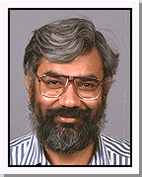
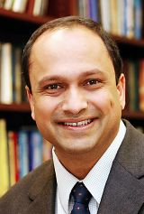
Integrated Research
Create a shared intellectual space, integral to the Center’s activities, providing a collaborative research environment that crosses disciplinary and institutional boundaries.
S. Subramaniam A. Grama
Research Thrusts:
1. Life Sciences
2. Communication
3. Knowledge Extraction (Big/Small Data)
David Tse T. Weissman
S. Kulkarni M. Atallah

Slide 4
Knowledge Extraction
Big Data Characteristics :
Large (peta and exa scale)
Noisy (high rate of false positives and negatives)
Multiscale (interaction at vastly different levels of abstractions)
Dynamic (temporal and spatial changes)
Heterogeneous (high variability over space and time)
Distributed (collected and stored at distributed locations)
Elastic (flexibility to data model and clustering capabilities)
Small Data:
Limited amount of data, often insufficient to extract information
(e.g., classification of twitter messages)

Slide 5
Analysis of Big/Small Data
Some characteristics of analysis techniques :
Results are typically probabilistic (formulations must quantify and optimize statistical significance - deterministic formulations on noisy data are not meaningful).
Overfitting to noisy data is a major problem.
Distribution agnostic formulations (say, based on simple counts and frequencies are not meaningful).
Provide rigorously validated solutions.
Dynamic and heterogeneous datasets require significant formal basis:
Ad-hoc solutions do not work at scale!
We need new foundation and fundamental results

Slide 6
Grand Challenges
1. Data Representation and Analysis (Big Data)
Succinct Data Structures (compressed structures that lend themselves to operations efficiently)
Metrics: tradeoff storage efficiency and query cost
Validations on specific data (sequences, networks, structures, high dim. sets)
Streaming Data (correlation and anomaly detection, semantics, association)
Generative Models for data (dynamic model generations)
Identifying statistically correlated graph modules (e.g., given a graph with edges weighted by node correlations and a generative model for graphs, identify the most statistically significantly correlated sun-networks)
Information theoretic methods for inference of causality from data and modeling of agents.
Complexity of flux models/networks

Slide 7
Grand Challenges
2. Challenges in Life Science
Sequence Analysis
Reconstructing sequences for emerging nano-pore sequencers.
Optimal error correction of NGS reads.
Genome-wide associations
Rigorous approach to associations while accurately quantifying the prior in data
Darwin Channel and Repetitive Channel
Semantic and syntactic integration of data from different datasets (with same or different abstractions)
Construction of flux models guided measures of information theoretic complexity of models
Quantification of query response quality in the presence of noise
Rethinking interactions and signals from fMRI
Develop in-vivo system to monitor 3D of animal brain (will allow to see the interaction between different cells in cortex – flow of information, structural relations)

Slide 8
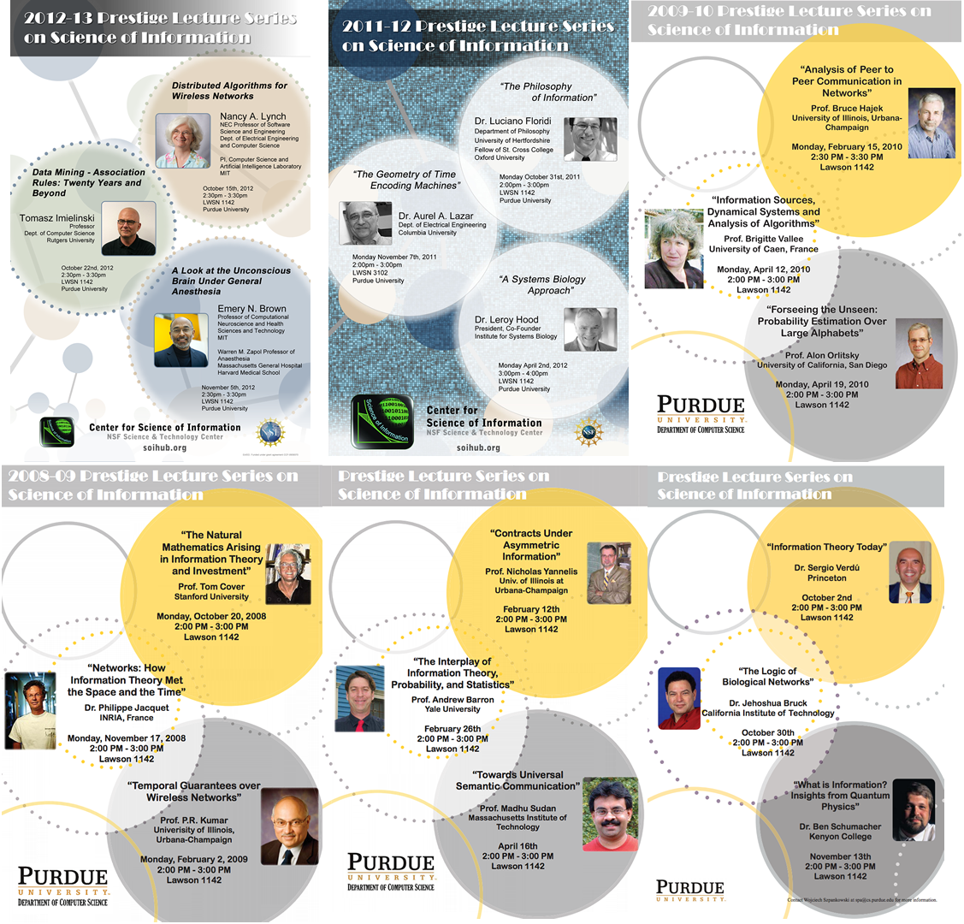
Prestige Lecture Series

