Slide 1
Data Science
Dianna Xu
Bryn Mawr College

Slide 2
The Course
300-level Computer Science elective
CS majors and minors
Pre-reqs: CS1, CS2 (Data Structures), Discrete Math and Linear Algebra
Unstructured data and explorative data analysis
Iterative processes that require programming skills and and knowledge of algorithms

Slide 3
200-level Data Visualization Course
Taught Spring 2014 at Haverford
Stats basics, linear regression
Clustering
Baby network analysis – PageRank
Visualization with D3
50% overlap of students

Slide 4
Topics
Statistical methods (2-3 weeks)
basics, regression analysis, Bayesian methods
Machine learning background (2-3 weeks)
multivariate regression and logistic regression
Dimensionality reduction (3 weeks)
PCA, SVD, Kernel PCA, other non-linear methods
Topological data analysis (2-3 weeks)
manifold learning, intro to TDA
Network analysis (2-3 weeks)
collaborative filtering, community detection

Slide 5
Project-Oriented
Students will team up for a semester-long project on data analysis for local "data clients"
Faculty members who have "real life" data sets and research questions
Library, registrar and institutional research

Slide 6
Data Sets
Digital Du Chemin
repertory of polyphonic songs from 16th-century France
Dark Reactions
chemical experiments with associated reactants and results
Maine athletes
Anil's bio data?

Slide 7
Machine Learning Modules
Focused on the process of doing (good) machine learning i.e.
(step 1) Pose a problem in the language of machine learning
(step 2) Gather data
(step 3) Choose a potential method for solving the problem
(step 4) Setup an experiment to properly evaluate your method
(step 5) Evaluate experiment and possibly go to step 2 or 3
Possible toolsets:
iPython notebook
Scikit-learn

Slide 8
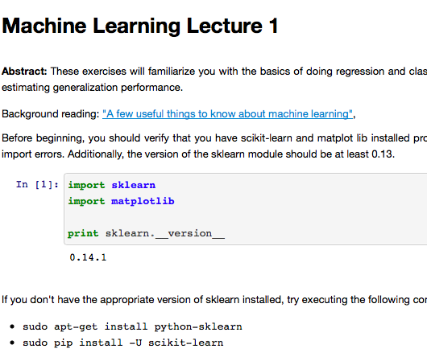
iPython Notebook Modules
http://occam.olin.edu/sites/default/files/DataScienceMaterials/machine_learning_lecture_1/Machine%20Learning%20Lecture%201.html
http://occam.olin.edu/sites/default/files/DataScienceMaterials/machine_learning_lecture_2/Machine%20Learning%20Lecture%202.html

Slide 9
Open-source, python-based package for machine learning.
Principal strength is a consistent API and enforcement of "good" machine learning practices

