Slide 1
Topological Data Analysis
Matthew L. Wright
Institute for Mathematics
and its Applications
University of Minnesota

Slide 2
What is the goal of
topological data analysis (TDA)?
TDA attempts to discern topological features of data.
e.g. components, loops,
graph structure
set of discrete points, with a metric

Slide 3
Example: What topological features does the following data exhibit?
Problem: Discrete points have trivial topology.

Slide 4
Idea: Connect nearby points, build a simplicial complex.
1. Choose a distance d.
2. Connect pairs of points that are no further apart than d.
3. Fill in complete simplices.
d
4. Homology detects the loop.
Problem: How do we choose distance d?

Slide 6
If d is too small…
…then we detect noise.

Slide 8
If d is too large…
…then we get a giant simplex (trivial homology).

Slide 10
Idea: Consider all distances d.
Record persistent homology in a barcode:
d:
0
1
2
3

Slide 11
Idea: Consider all distances d.
Short bars represent noise.
Long bars represent features.
Record persistent homology in a barcode:
d:
0
1
2
3

Slide 12
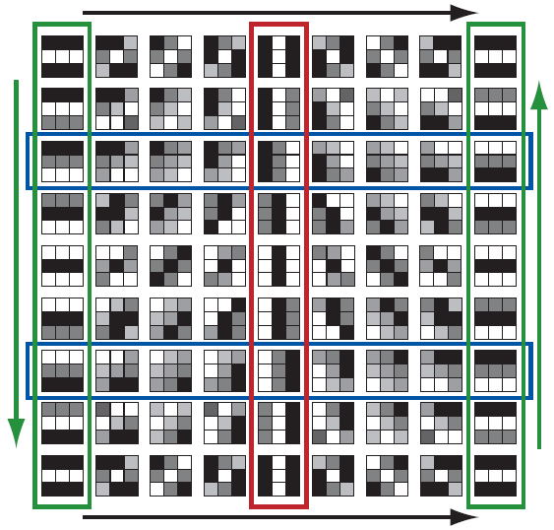
Where has TDA been used?
Image Processing
The space of 3x3 high-contrast patches from digital images has the topology of a Klein bottle.
Gunnar Carlsson, Tigran Ishkhanov, Vin de Silva, Afra Zomorodian. “On the Local Behavior of Spaces of Natural Images.” Journal of Computer Vision. Vol. 76, No. 1, 2008, p. 1 – 12.
Image credit: Robert Ghrist. “Barcodes: The Persistent Topology of Data.” Bulletin of the American Mathematical Society. Vol. 45, no. 1, 2008, p. 61-75.

Slide 13
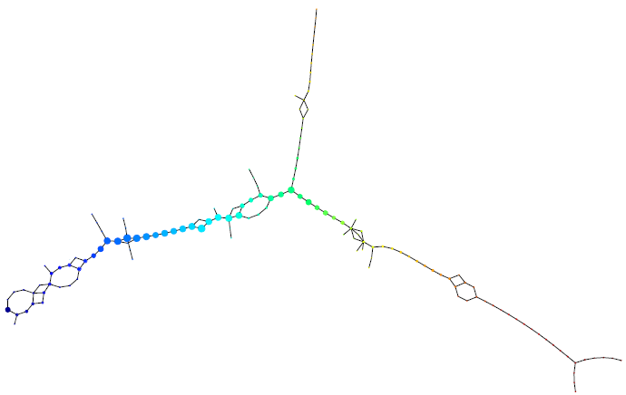
Where has TDA been used?
Cancer Research
Topological analysis of very high-dimensional breast cancer data can distinguish between different types of cancer.
Monica Nicolau, Arnold J. Levine, Gunnar Carlsson. “Topology-Based Data Analysis Identifies a Subgroup of Breast Cancers With a Unique Mutational Profile and Excellent Survival.” Proceedings of the National Academy of Sciences. Vol. 108, No. 17, 2011, p. 7265 – 7270.

Slide 14
TDA can be taught at many different levels.
Students who are comfortable with linear algebra can learn the persistence algorithm and do persistent homology computations.
$$H_{n}\left(X\right)={\ker{∂_{n}}}/{\operatorname{im}{∂_{n+1}}}$$
$𝔽_{2}$ coefficients
+
There are many possibilities for programming and computational projects.
$$\left[\begin{matrix}1 & 1 & 0 & 1 & 0 \\ 0 & 1 & 1 & 0 & 1 \\ 0 & 0 & 1 & 1 & 1 \\ 1 & 0 & 0 & 0 & 0\end{matrix}\right]$$

Slide 15
TDA can be taught at many different levels.
At a more elementary level, Euler characteristic can be used for data analysis without the computational complexity of persistent homology.
χ = #(vertices) – #(edges) + #(faces) – ‧‧‧
For example, an Euler characteristic curve has been successfully used for image recognition (Richardson and Werman, 2014).

Slide 16
For more information:
Robert Ghrist. “Barcodes: The Persistent Topology of Data.” Bulletin of the American Mathematical Society. Vol. 45, no. 1, 2008, p. 61-75.
Herbert Edelsbrunner, John Harer. “Persistent Homology – a Survey.” Surveys on Discrete and Computational Geometry: Twenty Years Later. AMS, 2008, p. 257-282.
Gunnar Carlsson. “Topology and Data.” Bulletin of the American Mathematical Society. Vol. 46, no. 2, 2009, p. 255-308.

