Slide 1
Introducing Science of Information Into a CS Upper Level Class
Willamette University
Computer Science Department
Haiyan Cheng

Slide 2
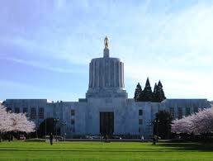
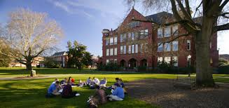
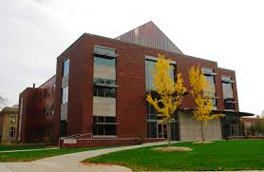
Willamette University
1842
Salem, Oregon
Private liberal arts college
2000 undergraduate students

Slide 3
Computer Science Department
Four faculty members
Typically graduates 6-8 CS majors per year
Teaches Quantitative Analysis (QA) courses to non-majors to satisfy General Education Requirements.
Lacking upper level electives courses.
New courses: Problem solving with Matlab, Computational Science and Applications.

Slide 4
My Involvement In the CSoI
Attended the workshop at Purdue university at summer 2013
Introduced the module to the CS-435 Computational Science and Application class
Two weeks theoretical contents: Science of information, Computational Science
Goals:
  Introduce the concept of science of information
  Make students aware the applications of science of information in various fields

Slide 5
Learning Outcomes
Understand Science of Information and its broader applications in different fields.
Understand the main issues in problem solving
Implement algorithms with Matlab to solve practical problems.
Improve proficiency in abstract thinking and independent problem solving

Slide 6
Existing Course Contents
Project oriented
Six projects
Learn subject knowledge and problem solving with Matlab
Course Deliverables:
  Pop quiz
  Lab projects
  Final group projects

Slide 7
Project 1: Statistics Project
  Import raw data into Matlab
  Reorganize and assign them to named variables
  Perform simple statistical analysis (mean, variance, mode, median)
  Probability density function
  Generate scatter plot, line plot and histogram.
  display results in the console and write to a file.

Slide 8
Project 2: Finance Project
  Read and write formatted text file (stock prices)
  Use a for loop
  Plot a two-color bar chart
  Plot a customized line chart
  Use Matlab built-in functions
  Perform stock performance analysis (daily rate of return, cumulative rate of return, average daily and annualized rate of return, average and annualized volatility, information ratio)

Slide 9
Project 3: Physics Project
  Generate random numbers to simulate random events
  Use an if else statement
  Write a user defined function
  Perform run time test for a numerical simulation
  Learn advanced MATLAB plotting techniques and animations in 3D.

Slide 10

Project 4: Mathematics Project
  Solve an ordinary differential equation with numerical approximation method (Forward Euler method)
  Compare the numerical solution with the theoretical solution
  Analyze the errors in the numerical algorithm
  Experiment with the rate of the convergence of a numerical algorithm

Slide 11
Project 5: Image Project
  How images are stored and represented in Matlab
  How to use a 3-D array
  How to load, resize and save an image
  How to convert a color image to a black-and-white image
  Image repair and edge detection
  Matlab image processing toolbox functions

Slide 12
Project 6: Sound Project
  Basic mechanism of sound
  How sound is stored and represented in Matlab
  How to load, plot, and play a piece of sound file
  How to record sound with Matlab
  How to create your own music.

Slide 13
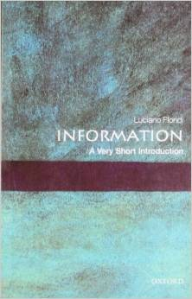
Science of Information Module
First two weeks: Introduction to Science of information and Computational science
Require students to read and discuss implications of information and how does that affect our life.
Used Deepak Kumar’s course material (slides) for information introduction based on the book: Information: A very short introduction

Slide 14
Ideas and Plans
Can’t offer a full-fledged Science of Information course
Integrate into the current independent study course.
Test run:
  First half of the semester: use existing modules to learn the subject (optionally, develop a course ware that can be used in the future.)
  Second half: work on information related projects

