Slide 1
BOUNDLEss Analytics
PREDISCOVERY – FINDING NEEDLES IN HAYSTACK OF DATA

Slide 2
background
Boundless analytics was developed at Rutgers under direction of Tomasz Imielinski, with support NSF CCF-0939370 (subcontract with NSF CSol STC)
It has debuted as an educational tool in data literacy class Data 101 at Rutgers in spring of 2021
150 students have used it in preliminary data exploration in spring 2021 semester.

Slide 3
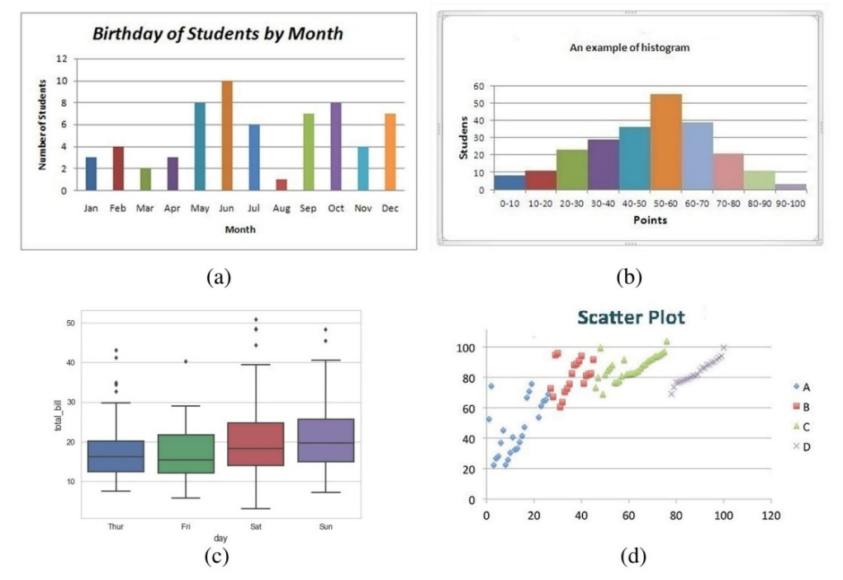
Distributions and plots

Slide 4
Cubes – slices - conjuncts
MOVIE DATA SET (IMDB from Kaggle)
Slice: Genre =‘Comedy’ & Country =‘UK’
Slice: Rating =‘R’ & Country = ‘US’
Slice: Country =‘France’ and Genre =‘Action’ and Rating = ‘PG’
Exponential number of slices – potentially even with minimum support

Slide 5
Plot zero and slice plots
Take, for example, a histogram of IMDB scores HIST(IMDB)
Plot Zero:
p0=HIST(IMDB) over entire data set of movies
Slice Plot:
pS = HIST(IMDB) over a slice Country =‘France’ and Genre =‘Action’ and Rating = ‘PG’
Order by DISTANCE d(pS,p0) in ascending order: from most distant first

Slide 6
Pre-discovery with boundless analytics
For each plot type: Finding slice –plots which are as different from the plot zero
Such plots are good LEADS for further exploration

